Slide 1
Accessing WebEx
To access WebEx, you can:
Click on the link provided by your instructor OR
Go to https://uwaterloo.webex.com/ and enter the event number and password provided by your instructor
-------------------------------------------------------------------------------------------------------------------------------------------------------------------------------------
**Ensure you log in to WebEx using your WatIAM credentials (should be formatted as uwuserid@uwaterloo.ca) but do NOT include “edu” in your email
** Passwords you have saved may autofill to WebEx and cause errors if they include “edu” in your email. If you have passwords saved, consider using a different browser or an incognito window.
**It is recommended you use Chrome, Microsoft Edge or Firefox to access WebEx

Slide 2
Accessing WebEx Error
If “edu” is included in your email when logging in, you will receive the following error message. In order to log in, you will need to either open an incognito tab (Ctrl + Shift + N for Chrome) OR open a new browser like Firefox.

Slide 3
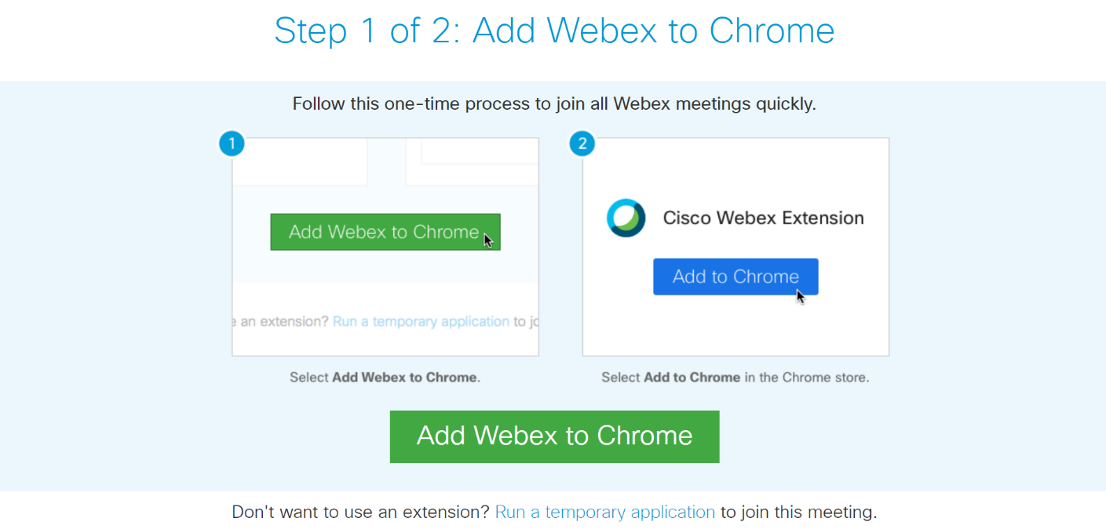
Accessing WebEx cont.
If you have not used WebEx before, you will be asked to download a Chrome extension to run the software. You can download the extension OR download a temporary application with the link at the bottom of the page. Both options will allow you to access the WebEx.

Slide 4
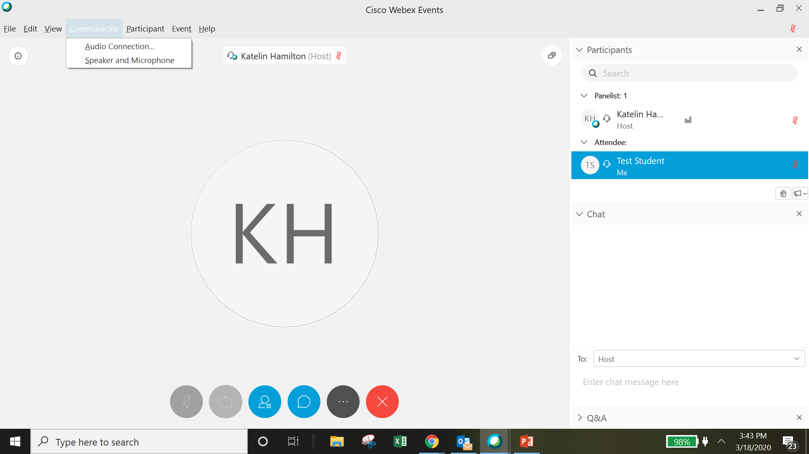
After Joining the WebEx
If you are having difficulties hearing the speaker, click “Communicate” from the top menu and edit your audio settings
Your audio will be muted during the class, so you will need to ask questions using the chat OR Q&A feature. Your instructor will provide guidance.
To open the chat, click the blue speech bubble icon. Make sure you have selected “Host and Presenter” from the “To” dropdown menu.
If you have questions that are not answered during class, please email your instructor.

