Slide 1
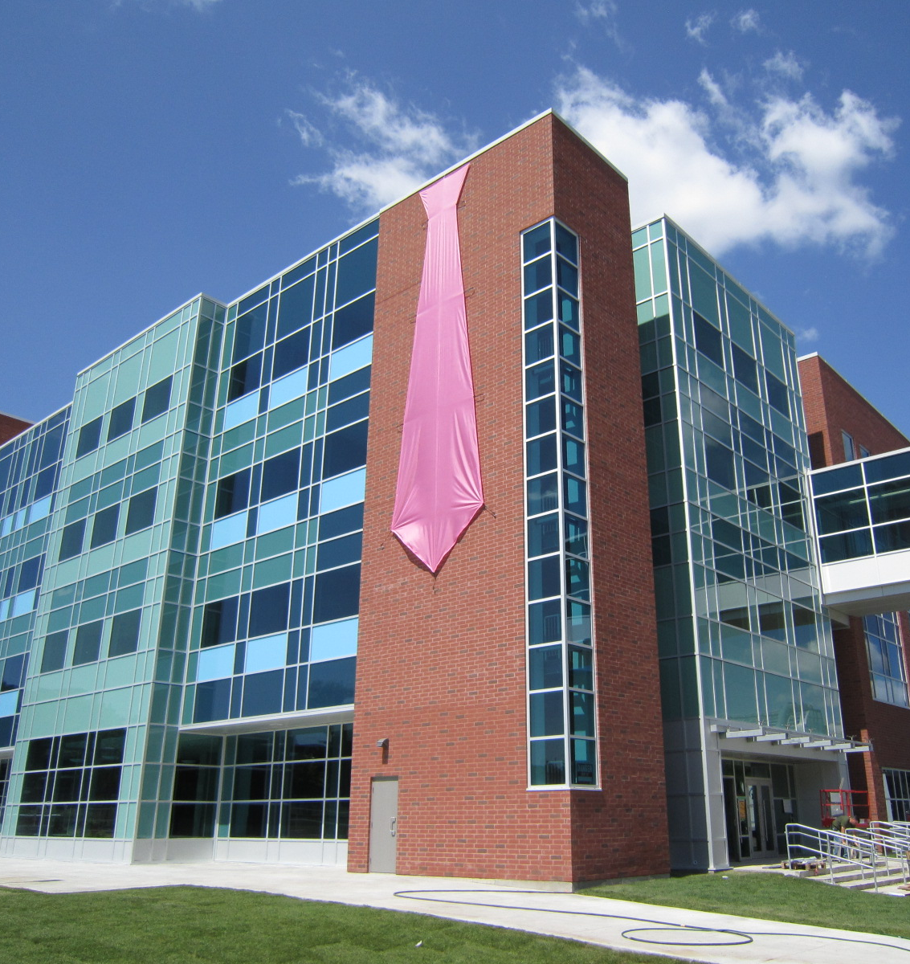
Actuarial Science First Year Information night

Slide 2
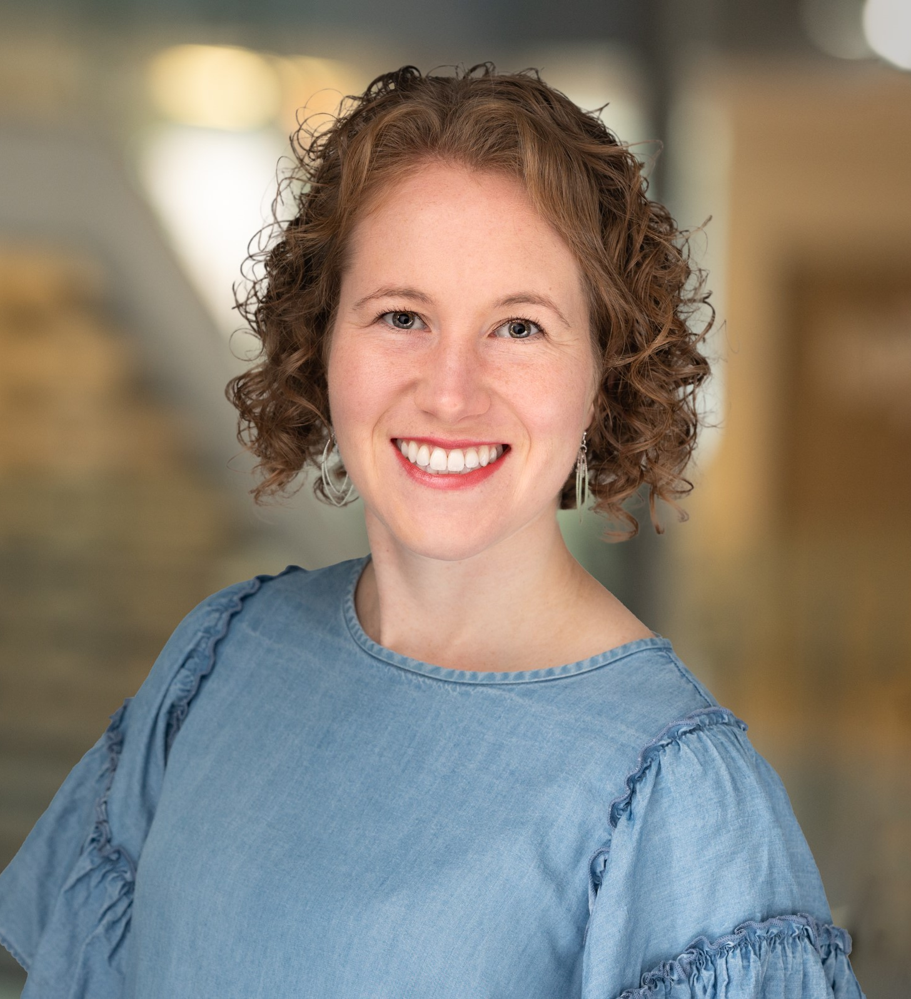
Emily Kozlowski (she/her)
Associate Professor, Teaching Stream
ASA, ACIA
Head Actuarial Science Advisor
Dept of Statistics and Actuarial Science
Email: SASugradADV@uwaterloo.ca
Notes:
BMath and MMath in Actuarial Science at Waterloo
Faculty member for 8 years in SAS

Slide 3
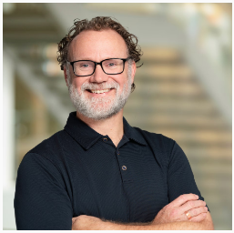
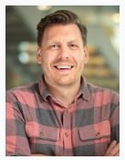
Other Actuarial Science (and Statistics) Advisors
Christopher Finn
ACTSC + STATs Academic Advisor
& Student Experience Specialist
Steve Van Doormaal
Undergraduate Studies Manager

Slide 4
What do the advisors do?
Sign course override (and course selection override) forms for all STAT and ACTSC courses (also MTHEL 131 and ENGL 378).
Sign plan modification forms (used to declare majors/joints/minors/specializations) for all ACTSC and STAT plans.
Answer questions about courses in ACTSC and STAT. Things like pre-req or anti-req questions, substitutions, offerings, order to complete them and so on.
Answer questions about the programs in ACTSC and STAT, such as electives needed, average to maintain, average calculation, how to do a double major or a minor with it.
Advise on actuarial careers and accreditation processes.
Notes:
Steve and Chris have office hours each week and do a lot of hands on advising for more day-to-day cases.
I’m answering lots of questions by email and focus mostly on student questions re course overrides/substitutions, ACTSC careers and accreditation/professional bodies, and complex cases. I also do a lot behind the scenes related to the overall program, program changes, new courses, and accreditation programs.

Slide 5
How do I get help from an advisor?
First check the FAQ and Table of Questions pages on the department website.
If you can’t find your question, then you can either email the advisors at SASUGradAdv@uwaterloo.ca or visit us (in-person or virtually) during our regular advising hours. Hours are posted on the department website.
Table of Questions: https://uwaterloo.ca/statistics-and-actuarial-science/undergraduate-studies/academic-advising
FAQs: https://uwaterloo.ca/statistics-and-actuarial-science/undergraduate-studies/academic-advising/faq-actuarial-science-and-statistics
Advising Hours: https://uwaterloo.ca/statistics-and-actuarial-science/current-undergraduate-students/advising-hours

Slide 6
What is Actuarial Science?
https://www.youtube.com/watch?v=X2bax2Sim8Q
Notes:
https://www.youtube.com/watch?v=X2bax2Sim8Q

Slide 7
What is Actuarial Science?
“Actuaries are business professionals who apply their knowledge of mathematics – particularly of probability, statistics, and risk theory – to real-life financial problems involving future uncertainty.”
Actuaries work in:
Insurance Companies (Life and P&C)
Consulting Firms
Investment Banks
Governments
Regulatory/Financial Oversight Organizations
Any company with large volumes of data / financial uncertainties / a desire to manage their risk and capitalize on insights from big data

Slide 8
What do Actuaries Do?
Design, price, and manage products (insurance, pension plans) used to give consumers financial security
Manage companies’ financial risks and solvency
Create models to analyze impacts of climate change and emerging society-wide risks and design mitigation solutions
Use data to build predictive models and inform decisions (ex. fraud detection, marketing campaigns, product development)

Slide 9
How Do I Become an Actuary?
Unlike data scientists or statisticians, actuaries hold professional designations based on the organization they belong to and their status in the professional examination system.
Some of the professional actuarial organizations are:
Society of Actuaries, SOA (www.soa.org),
Canadian Institute of Actuaries, CIA (www.actuaries.ca),
Casualty Actuarial Society, CAS (www.casact.org)
Institute and Faculty of Actuaries, IFoA (www.actuaries.org.uk)
Students who study Actuarial Science at Waterloo are well on their way to earning associate level designations by the time they graduate.

Slide 10
Why be an Actuary?
Accredited actuaries have significant brand recognition and career growth potential (both salary amount and diverse opportunities)
Apply a combination of statistics, finance, data science, and risk management along with domain knowledge within insurance or otherwise
Rewarding career with the opportunity to serve the public good
Demand for actuaries is high currently
Notes:
Some recent data from last year:
-most students have 3-4 exams passed by graduation
-70% of actsc majors are co-op students
-placement rate for co-op students within 1 year of graduation is ~100% in their field and over 85% when considering all (co-op and non-coop) students

Slide 11
Sample Co-op Jobs and Careers
Co-ops:
Actuarial Analyst
Data Scientist
Defined Benefit Pension Administrator
Investment Banking Analyst
Careers:
VP Individual Life Pricing, Sun Life Financial
CRO, Premier Life Insurance Company
Vice President Enterprise Analytics & Data Office, Definity Insurance
Principal, Private Capital at Ontario Teachers’ Pension Plan
Portfolio Manager, Ambassador Catastrophe Bond Fund
Notes:
Most grads go into traditional actuarial roles which are labelled as “actuarial analyst”. Actuarial analysts at insurance companies work in a wide range of specific jobs such as
-Pricing
-Valuation
-asset liability management
-product management
-internal project consultant
-predictive analytics/data science
-research and assumption setting.
Actuarial analysts at consulting firms work as actuarial consultants for external clients doing similar roles to those listed above.
Common employers are: Sun Life, Manulife, Equitable Life, Canada Life, Definity, Travellers, Intact, The Co-operators, Desjardins, Deloitte, PwC, Willis Towers Watson, Eckler, Munich Re, SCOR Re, Aon Hewitt, Aviva, Northbridge Insurance, and Oliver Wyman.
Some graduates also work in less traditional roles such as data scientist at a wide range of companies, or investment banking at places like TD Bank, Goldman Sachs, and JP Morgan.

Slide 12
Admission requirements
To declare Actuarial Science as a major, joint, or minor, students are required to have:
Completed MTHEL131 with a minimum grade of 60.0%; or, for Business Administration and Mathematics Double degree students, a minimum grade of C- in BUS121W.
A minimum major average of 70.0%; or if a MAV does not yet exist
A minimum cumulative average (CAV) of 70.0% on at least 10 passed courses
ACTSC MAV exists once you have 3 courses from: STAT 230/231, ACTSC 231/232, any 300-400 level math courses
No limit to number of students
Notes:
Emphasize okay to not declare in 2A and declare later!!

Slide 13
What is MTHEL 131?
Introduction to Actuarial Practice
Individual life insurance products. Introduction to property and casualty insurance. Introductory risk management, insurance pricing and valuation. Pension plan design.
A broad overview of the actuarial industry and fundamental risk management/actuarial principles with limited math. The course is offered both fall and winter terms, so if you aren’t in it now, make sure you sign up for it in Winter, otherwise you won’t be able to declare Actuarial Science in 2A.

Slide 14
How do I declare my major?
To declare your major, you fill out a plan modification form and email it to us at sasugradadv@uwaterloo.ca and we will sign it/send for processing if you meet the requirements.
You can find links to the plan mod form on our website or here directly: https://uwaterloo.ca/the-centre/forms-and-official-documents/forms-undergraduate-students/plan-modification-form
When you declare with the plan mod form, you can also identify the “calendar year” (aka Requirement Term) you’re using.

Slide 15
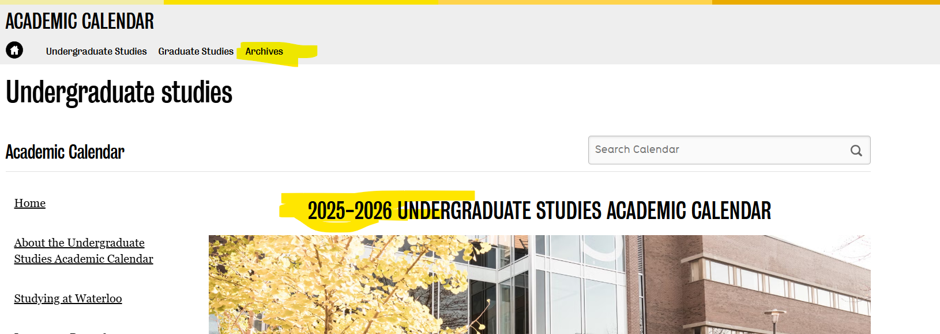
Calendar Years
A new Undergraduate Studies Academic Calendar is published each year and covers Fall 20XY – Spring 20X(Y+1)
You can see old calendars on the Archives tab
Students can follow any calendar year from their first term in the Math Faculty and onwards for program requirements
Notes:
Course pre-reqs are always based on the current calendar year

Slide 16
Calendar Years
Actuarial Science program requirements have been the same for the past number of years, but will be changing for the Fall 2026 – Spring 2027 calendar:
In place of a choice between STAT 340 and 341, STAT 341 will now be required
STAT 440 and STAT 444 are added to a list of courses from which you must choose 2
Finance and Predictive Analytics Specializations are changing
We are also creating a new course: ACTSC 456 Statistical Learning in Actuarial Science
There are potentially further changes taking effect Fall 2027 to introduce even more flexibility into the plan related to the choice of 400-level ACTSC courses

Slide 17
What if I want to declare BOTH ActSci and Stats?
To declare a double major in Actuarial Science and Statistics you need to have:
a CAV of 70+% (or MAV of 70%+) for ACTSC
a FAV (Faculty Average = avg of all Math courses) 65+% for STATs (normally satisfied with MAV of 70%+)
passed 10 courses
completed MTHEL 131 with 60%+
To complete the double major, you need to meet all the specific Actuarial Science course requirements PLUS STAT 332 (counted in the one additional 300 or 400 math requirement), and 3* 400-level Statistics courses.
*only 1 if you take two of STAT 440/431/433/441/443/444 in the ACTSC additional list.

Slide 18
1A/1B Courses – Actuarial Science
Fall | Winter
CS 115/135 | CS 116/136
MATH 135 | MATH 136
MATH 137 | MATH 138
Communication List 1 Course | ECON 101
MTHEL 131 | AFM 101 (MTHEL 131 if not taken in 1A)
*There is flexibility when you take ECON 101/102, AFM 101 and the rest of the non-math electives. The most important thing is taking MTHEL 131 in your first year if you want to get into ActSci at the start of year 2.

Slide 19
2A/2B Courses – Actuarial Science
Fall | Winter
STAT 230 | Stat 231
MATH 235 | ACTSC 232
MATH 237 | ACTSC 372
ACTSC 231 | Elective or AMATH 250
ECON 102 | Elective
*All of ACTSC 231, 232, and 372 open to any math student, other ACTSC 3XX and 4XX only open to ACTSC majors

Slide 20
What courses should I watch out for?
ACTSC 232 – often taken in 2B, requires 60+% in ACTSC 231
ACTSC 331 – requires 60+% in ACTSC 232
Almost all 300 and 400 level ACTSC – requires you to be declared as ActSci
ACTSC 431 – requires 60+% in ACTSC 363
ENGL 378 – requires 70+% in your first communication course (EMLS 101R, 102R, EMLS/ENGL 129R, ENGL 109, COMMST 100, 223)
STAT 330, 333, 340, 341 – requires 60+% in STAT 230
STAT 331, 332 – requires 60+% in STAT 231

Slide 21
Suggested Non-Math Courses
For actuarial science you have a minimum of
27 math courses
10 non-math courses
3 courses that can be anything
2 of the non-math courses are communication courses.
Another 4 of the non-math courses are ECON 101/102, AFM 101, MTHEL 131.
However, the others can be:
Courses that will help you complete a minor in another field: Economics, Psychology, Physics etc.
Courses that you find interesting
Notes:
So up to 13 non-math courses are possible

Slide 22
Adding the Predictive Analytics Specialization to ACTSC
As of the 2026/2027 calendar, to complete Honours Actuarial Science with the Predictive Analytics Specialization you must complete the Honours Actuarial Science plan plus the following:
1 of ACTSC 454 or ACTSC 457– Counts as #1 of “Two additional 400-level ACTSC courses”
ACTSC 456 – Counts as #2 of “Two additional 400-level ACTSC courses”
STAT 431 and STAT 440 – Completes the “Two additional courses chosen from” list
1 of STAT 442, STAT 443, or STAT 444 – will count as the “One additional 300- level or 400-level math course”
Notes:
ACTSC 454 = Longevity and Mortality using Predictive Analytics
ACTSC 457 = Predictive Modelling in Property and Casualty Insurance
ACTSC 456 = Statistical Learning in Actuarial Science
STAT 431 = Generalized Linear Models and their Applications
STAT 440 = Computational Inference
STAT 442 = Data Visualization
STAT 443 = Forecasting
STAT 444 = Statistical Learning – Advanced Regression

Slide 23
Adding the Finance Specialization to ACTSC
As of the 2026/2027 calendar, to complete Honours Actuarial Science with the Finance Specialization you must complete the Honours Actuarial Science plan plus the following:
STAT 340 – will count as the “One additional 300- level or 400-level math course”
1 of CS 370 or CS 371
ACTSC 423, ACTSC 445, and ACTSC 447 – completes the “Two additional 400-level ACTSC courses” and also one of the “Two additional courses chosen from” list.
Notes:
STAT 340 = Stochastic Simulation Methods
CS 370 = Numerical Computation
CS 371 = Introduction to Computational Mathematics
ACTSC 423 = Topics in Financial Econometrics
ACTSC 445 = Quantitative Enterprise Risk Management
ACTSC 447 = Numerical Computation for Financial Modelling

Slide 24
What is the Canadian Institute of Actuaries (CIA)?
Professional Actuarial body in Canada
Offers the following designations:
ACIA – Associate of the Canadian Institute of Actuaries
FCIA – Fellow of the Canadian Institute of Actuaries (top level)

Slide 25
What is the SOA?
Society of Actuaries (SOA): Professional body in the United States, focused on life/health insurance.
Actuaries complete a series of professional exams to earn an actuarial credential:
ASA – Associate of the Society of Actuaries
FSA – Fellow of the Society of Actuaries (top level)
For ASA: 6 exams, 4 e-learning modules, complete UW VEE courses
For FSA: 4 exams after ASA

Slide 26
What is the CAS?
Casualty Actuarial Society (CAS): Professional body in the United States, focused on property and casualty (i.e. home and auto) insurance.
Actuaries complete a series of professional exams to earn an actuarial credential:
ACAS – Associate of the Casualty Actuarial Society
FCAS – Fellow of the Casualty Actuarial Society (top level)
For ACAS: 7 exams, 3 e-learning modules, complete UW VEE courses
For FCAS: 3 exams after ACAS

Slide 27
CIA University Accreditation Program
A practicing actuary in Canada needs only an FCIA, and an FCIA is well-recognized internationally.
Only in the last few years has the CIA started to offer its own education pathway for designation, having relied on SOA/CAS exams in the past.
Thus, most actuaries have held FSA and FCIA, or FCAS and FCIA designations historically.
Employers have updated their hiring practices and study compensation to fully recognize actuaries using only the CIA accreditation system.

Slide 28
CIA University Accreditation Program
The CIA University Accreditation Program (UAP) allows students who have successfully completed the ACTSC program at UW (or other accredited universities) to bypass all preliminary exams from the SOA or CAS and move directly to writing the ACIA capstone exam which earns them the ACIA designation.
You need to graduate with an ACTSC major with completion of:
STAT 341 (now explicitly required starting in F26 calendar)
Two courses from this list:
STAT 431;
STAT 441;
STAT 443.
https://uwaterloo.ca/statistics-and-actuarial-science/current-undergraduate-students/undergraduate-actuarial-accreditation-pathways
Notes:
STAT 431, 441, and 443 are all options on the “2 additional required from this list” requirement.

Slide 29
CIA University Accreditation Program
In addition to the ACIA Capstone exam (6 hours spread over 2 sessions, open book), you must complete 2 e-learning modules:
Actuarial Foundations
Predictive Analytics
You can complete your ACIA Modules while in undergrad, along with registering as a CIA student member (for free), both of which can be indicated on your resume.
For FCIA: 3 exams (4 hours each, open book) after ACIA

Slide 30
CIA University Accreditation Program
For the CAS, the CIA UAP is recognized and provides waivers for 4 ACAS exams (Exam 1, Exam 2, MAS-I, MAS-II) for students who complete the ACIA capstone exam with the short-term section for the specialized section of the exam.

Slide 31
VEEs
The SOA and CAS have Validation by Educational Experience (VEE) Requirements
You earn VEEs by completing the following courses with a grade of at least 70%:
https://uwaterloo.ca/statistics-and-actuarial-science/current-undergraduate-students/undergraduate-actuarial-accreditation-pathways
VEE topic | Required courses
Economics | ECON 101 and ECON 102
Accounting and Finance | ACTSC 372 and AFM 101
Mathematical Statistics | STAT 330
Notes:
Note that all of the VEE courses are required courses for the actsc major
Talk about why students may still choose to write SOA/CAS exams: opportunity to do so in co-op term, employer paid support, resume, salary bonuses

Slide 32
Useful Resources
On our department website we have:
Program sheets to help with your course planning
Link to the list of projected course offerings
Admission requirements and links to forms like course override and plan mod forms
Information on Undergraduate Student Research Awards (URSA)
I also highly recommend you get involved with the student-run UW ActSci Club (Instagram handle @uwactsciclub) right away
Notes:
Uw ActSci Club is an amazing resource. Highly highly recommend for networking opportunities, advice for which exams to write when, discount codes for exam study material, resume and interview prep support, extra-curricular opportunities in executive roles etc.

Slide 33
Questions?
Thank you for coming!
https://uwaterloo.ca/statistics-and-actuarial-science/undergraduate-studies

