Slide 1
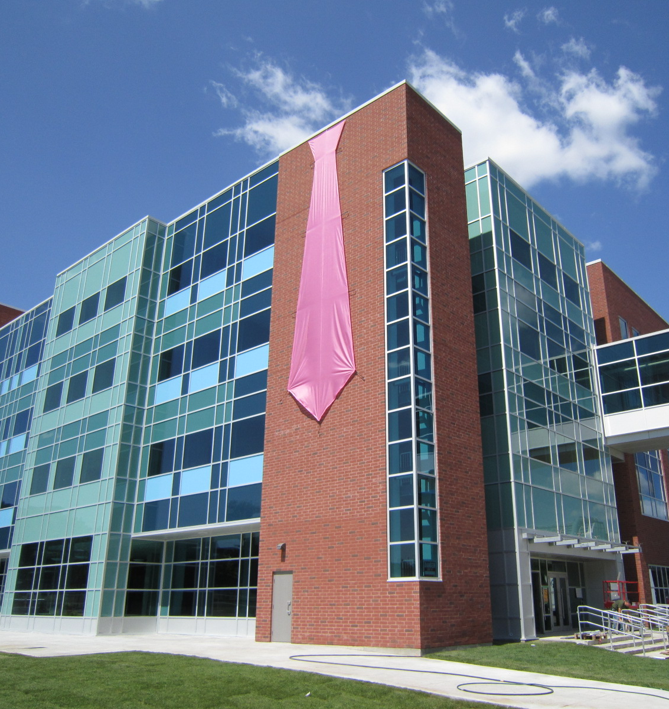
First Year Information night Statistics and Actuarial Science (SAS)

Slide 2
Meet (some of) your Statistics and Actuarial Science Advisors
Emily Kozlowski – Associate Professor Teaching Stream, Head ActSci advisor, Waterloo alumni, twice (BMath & MMath), in Actuarial Science, and an associate in the SOA & CIA.
Riley Metzger – Associate Professor Teaching Stream, Head Stat advisor, and Waterloo alumni, twice (BMath & MMath), in Statistics.

Slide 3
What do the advisors do?
Sign course (selection) override forms for all STAT and ACTSC courses (also MTHEL 131 and ENGL 378).
Sign plan modification forms (used to declare majors/joints/minors/specializations) for all ACTSC and STAT plans.
Answer questions about courses in ACTSC and STAT. Things like pre-req or anti-req questions, substitutions, offerings, order to complete them and so on.
Answer questions about the programs in ACTSC and STAT, such as electives needed, average to maintain, average calculation, how to do a double major or a minor with it.
Many, many more things!

Slide 4
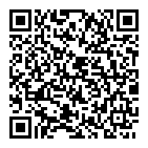
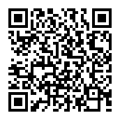
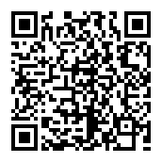
How do I get help from an advisor?
First check the FAQ and Table of Questions pages on the department website.
If you can’t find your question, then you can either email the advisors at SASUGradAdv@uwaterloo.ca or visit us (in-person or virtually) during our regular advising hours. Hours are posted on the department website.
FAQ
Tables of Questions
Advising hours
Notes:
Should mention that need to be using campus wifi to access Ohs ticket system

Slide 5
Statistics, Biostatistics and DAta Science

Slide 6
Plan Venn diagram

Slide 7
Hal Varian, Executive Google.com
Dream Job - Statistician (BioStatistician or Data Scientist)

Slide 8
Statistics

Slide 9
Statistics
The field of drawing reliable conclusions from data.
Example Questions:
How do governments and businesses come up with their conclusions about the population or the economy?
How does a company know their marketing campaign has been successful?
In manufacturing, what’s the appropriate amount of defects to have from one machine?
Notes:
Students in first year take the same core math courses across all programs: Calculus, Algebra (proofs course), Computer Science, and Linear Algebra. In addition, students from most programs are required to take a communications course (eg. intro to academic writing or public speaking) in first year. The number of electives and the number of options they have for electives depends on their program.

Slide 10
Admission requirements
Statistics
Cumulative average (CAV) of 60%+ and
Math average (MAV) of 65%+
10 Passed Courses
No limit to number of students

Slide 11
1A/1B Courses - STATISTICS
Fall | Winter
CS 115/135 | CS 116/136
MATH 135 | MATH 136
MATH 137 | MATH 138
Communication List 1 Course | STAT 230 (if you have 80 or more in MATH 137) or a Non Math Elective
Non Math Elective | Non Math Elective
*This is the standard sequence for math students. If you are having difficulties or you are excelling there are alternative sequences. Please contact a year 1 math advisor to find out more: MathAdvisors@uwaterloo.ca.

Slide 12
Suggested Non Math Courses
For statistics you have a minimum of
26 math courses
10 non math courses (1 Communication course + ENGL 378 + 8 Other courses)
4 courses that can be anything
Non Math Course Selection:
Courses that will help you complete a minor in another field: Biology, Economics, Psychology, Physics etc.
Courses that you find interesting

Slide 13
Biostatistics

Slide 14
Biostatistics
The field of drawing reliable conclusions from data in the life sciences.
Example Questions:
Does a particular vaccine reduce the likelihood of getting COVID?
What affect does a government policy have on the proportion of smokers?
What is the home range of a bear?
Statistics
Bio-Stats
Life
Sciences
Notes:
Students in first year take the same core math courses across all programs: Calculus, Algebra (proofs course), Computer Science, and Linear Algebra. In addition, students from most programs are required to take a communications course (eg. intro to academic writing or public speaking) in first year. The number of electives and the number of options they have for electives depends on their program.

Slide 15
Admission requirements
Biostatistics
Cumulative average (CAV) of 60%+ and
Math average (MAV) of 65%+
10 Passed Courses
No limit to number of students

Slide 16
1A/1B Courses - BIOSTATISTICS
Fall | Winter
CS 115/135 | CS 116/136
MATH 135 | MATH 136
MATH 137 | MATH 138
Communication List 1 Course | STAT 230 (if you have 80 or more in MATH 137) or a Non Math Elective
Non Math Elective | Non Math Elective
*This is the standard sequence for math students. If you are having difficulties or you are excelling there are alternative sequences. Please contact a year 1 math advisor to find out more: MathAdvisors@uwaterloo.ca.

Slide 17
Suggested Non Math Courses
For biostatistics you have a minimum of
26 math courses
10 non math courses (1 Com course + ENGL 378 + one of BIOL 239, or HLTH 101 + 7 other courses)
4 courses that can be anything
Non Math Course Selection:
Courses that will help you complete a minor in another field: Biology, Economics, Psychology, Physics etc.
Courses that you find interesting

Slide 18
Flexability
STATISTICS and to a lesser extent BIOSTATISTICS are very flexible plans.
EXAMPLE:
Part of the 26 required math courses for STATISTICS are:
4 MATH 3XX/4XX
3 MATH (any level)
These 7 courses can be in ANY field (CO, PMATH, AMATH, etc). Hence it is EASY to add a joint, minor or major to this plan.

Slide 19
Data SCIENCE

Slide 20
Data Science
The field of drawing reliable conclusions from large data sets. It studies things such as AI, and Machine Learning.
Example Questions:
Spam filtering: How to classify emails as spam versus legitimate
Computer Vision: recognize objects in images and videos
Speech Recognition: recognize words from an audio signal
Conversational Agents: learn how to respond to user queries
Data
Science
Computer
Science
Statistics
Notes:
Students in first year take the same core math courses across all programs: Calculus, Algebra (proofs course), Computer Science, and Linear Algebra. In addition, students from most programs are required to take a communications course (eg. intro to academic writing or public speaking) in first year. The number of electives and the number of options they have for electives depends on their program.

Slide 21
Admission requirements
Data Science
Cumulative average (CAV) of 60%+ and
Math average (SMAV) of 65%+ and
CS average (MAV) of 70% and
10 Passed Courses
These are minimums as the plan is COMPETITIVE
50 seats per year (roughly 16 per term)

Slide 22
BMath Data Science FAQs: ADMISSION AVERAGES
What was the latest admission averages?
Each term the admission averages differ as the plan is competitive.
We look at 3 averages on a minimum of 10 courses:
CAV (cumulative or overall average). This is the average of every course you take that has a numeric grade.
Math MAV (Math major average). This is all of your courses offered by the faculty including CS 115, MATH 135, MATH 137, etc.
CS MAV (CS major average). This does not include any course below CS 136. Nor does it include non CS major courses such as CS 231.
This past Sept the CAV was at least 85 for incoming students. We then wanted the other two averages to be “high”.

Slide 23
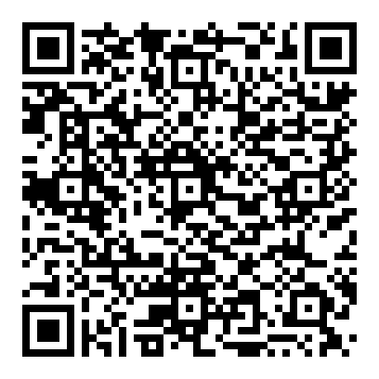
BMath Data Science FAQs: APPLICATIONS
Applications
When do you apply?
Are you taking CS 136 or have you already passed it?
Will you have 10 passed courses by the end of term?
Are you currently in lectures?
Then you can apply by filling out our online form. It is really quick and only requires your name and IDs.
When do you learn your results?
In the first month of the NEXT term. This may be after the add period of courses.
Application Received During Lecture Period | Results Communicated to Applicants
Fall Term (DUE: DEC 3rd, 2024) | By end of Jan
Winter Term | By end of May
Spring Term | By end of Sept

Slide 24
BMath Data Science FAQs: What if I am NOT ACCEPTED?
I didn’t get in, can I apply again?
Yes, you can apply again, however it would be wise to have a back-up plan in place.
Other Suggestions?
An alternative might be a Statistics Major with a Computing Minor. Aim to take CS 431.
Another alternative might be computational math major with a concentration on Statistics and a computing minor.

Slide 25
BMath Data Science FAQs: What if I am NOT ACCEPTED?
Can I take less than 5 courses a term and still get into Data Science? Can I WD a course(s)?
Yes you can. However we will not accept you into the program until you have at least 10 passed courses.
Can I retake courses to increase my grade?
Yes. However I do not recommend it. Why?
Both the original course and retaken course will be on your record. Both courses go into your average with equal weighting.
You are allowed at most 3 attempts at any course.
You will accumulate an unusable attempt. You are allowed a maximum of 10 of these.

Slide 26
1A/1B Courses – BMath Data Science
Fall | Winter
CS 115/135 | CS 116/136
MATH 135 | MATH 136
MATH 137 | MATH 138
Communication List 1 Course | STAT 230 (if you have 80 or more in MATH 137) or a Non Math Elective
Non Math Elective | Non Math Elective
*This is the standard sequence for math students. If you are having difficulties or you are excelling there are alternative sequences. Please contact a year 1 math advisor to find out more: MathAdvisors@uwaterloo.ca.

Slide 27
Suggested Non Math Courses
For data science you have a minimum of
29.5 math courses
10 non math courses (1 Communication course + ENGL 378 + 8 Other courses)
0.5 courses that can be anything
Non Math Course Selection:
Courses that will help you complete a minor in another field: Economics, Psychology, Physics etc.
Courses that you find interesting

Slide 28
LESS FLEXIBLE
Data Science CANNOT...
Be combined with any other math major or joint.
Be combined with Double Degree (you must take the BCS version)

Slide 29
BCS DATA SCIENCE vs BMATH DATA SCIENCE
BCS
BMATH
2 Communication courses
Access to all CS major courses
Depth and Breadth requirements on non math electives
1 Communication course + ENGL 378
Access to limited CS major courses
NO depth and breadth requirements on non math couress, you can take what you want

Slide 30
COURSES OF INTEREST
In Biostatisitcs, Data Science and Statistics

Slide 31
Courses with Grade Requisites
ENGL 378 – requires 70+% in your first communication course (EMLS 101R, 102R, EMLS/ENGL 129R, ENGL 109, COMMST 100, 223)
STAT 330, 333, 340, 341 – requires 60+% in STAT 230
STAT 331, 332 – requires 60+% in STAT 231

Slide 32
Main Courses in Data Science
Any course in STAT 44X
A popular course in AI/ML is STAT 441 which requires STAT 341

Slide 33
Main Courses in BIOSTATISTICS
STAT 337 – An introduction to Biostatistics
STAT 431, 437, 438 – Additional courses in Biostatistics.

Slide 34
EMPLOYMENT
In Biostatistics, Data Science and Statistics

Slide 35
What kind of jobs do Statistics students get?
SAMPLE CO-OP JOBS | SAMPLE CAREERS
Compensation Data Analyst, Hay Group | Statistician, Statistics Canada
Metadata Management Consultant, Bank of Montreal | Software development analyst, IBM Canada Ltd.
Statistician, Labstat International ULC | Research biostatistician, Chedoke-McMaster Hospitals

Slide 36
What kind of jobs do Biostatistics and Data Science students get?
Biostatistics
Data Science
SAMPLE CO-OP JOBS | SAMPLE CAREERS
Cancer Genome Data Analyst, Ontario Institute for Cancer Research | Bioinformatician, Peter McCallum Cancer Centre
Medical Research Assistant, London Health Sciences Centre | Biostatistician, Alberta Health Services
Research Assistant, Development Research Centre of the State Council | Senior Policy Developer, Workplace Safety and Insurance Board
SAMPLE CO-OP JOBS | SAMPLE CAREERS
Computer Vision Researcher, Slyce | Machine Learning Researcher/Practitioner
Data Mining Research Assistant, Simon Fraser University | Business Analyst
Data Scientist Intern, Facebook | Data Engineer

Slide 37
Actuarial Science

Slide 38
What is Actuarial Science?
“Actuaries are business professionals who apply their knowledge of mathematics – particularly of probability, statistics, and risk theory – to real-life financial problems involving future uncertainty.”
Actuaries work in:
Insurance Companies (Life and P&C)
Consulting Firms
Investment Banks
Governments
Regulatory/Financial Oversight Organizations
Any company with large volumes of data / financial uncertainties / a desire to manage their risk and capitalize on insights from big data
Notes:
What do Actuaries do?:
Design, price, and manage products (insurance, pension plans) used to give consumers financial security
Manage companies’ financial risks and solvency
Create models to analyze impacts of climate change and emerging society-wide risks and design mitigation solutions
Use data to build predictive models and inform decisions (ex. fraud detection, marketing campaigns, product development)

Slide 39
What is Actuarial Science?
https://www.youtube.com/watch?v=X2bax2Sim8Q
Notes:
https://www.youtube.com/watch?v=X2bax2Sim8Q

Slide 40
How Do I Become an Actuary?
Unlike data scientists or statisticians, actuaries hold professional designations based on the organization they belong to and their status in the professional examination system.
Some of the professional actuarial organizations are:
Society of Actuaries, SOA (www.soa.org),
Canadian Institute of Actuaries, CIA (www.actuaries.ca),
Casualty Actuarial Society, CAS (www.casact.org)
Institute and Faculty of Actuaries, IFoA (www.actuaries.org.uk)
Students who study Actuarial Science at Waterloo are well on their way to earning associate level designations by the time they graduate.

Slide 41
Why be an Actuary?
Accredited actuaries have significant brand recognition and career growth potential (both salary amount and diverse opportunities)
Apply a combination of statistics, finance, data science, and risk management along with domain knowledge within insurance or otherwise
Rewarding career with the opportunity to serve the public good
Demand for actuaries is very high currently
Notes:
Some recent data from last year:
-most students have 3-4 exams passed by graduation
-70% of actsc majors are co-op students
-placement rate for co-op students within 1 year of graduation is ~100% in their field and over 85% when considering all (co-op and non-coop) students

Slide 42
Admission requirements
To declare Actuarial Science as a major, joint, or minor, students are required to have:
Completed MTHEL131 with a minimum grade of 60.0%; or, for Business Administration and Mathematics Double degree students, a minimum grade of C- in BUS121W.
A minimum special major average of 70.0%; or if a SMAV does not yet exist
A minimum cumulative average of 70.0% on at least 10 passed courses
ACTSC SMAV exists once you have 3 courses from: STAT 230/231, ACTSC 231/232, any 300-400 level math courses
No limit to number of students
Notes:
Emphasize okay to not declare in 2A and declare later!!

Slide 43
What is MTHEL 131?
Introduction to Actuarial Practice
Individual life insurance products. Introduction to property and casualty insurance. Introductory risk management, insurance pricing and valuation. Pension plan design.
A broad overview of the actuarial industry without all the math. The course is offered both fall and winter terms, so if you aren’t in it now, make sure you sign up for it in Winter, otherwise you won’t be able to declare Actuarial Science in 2A.

Slide 44
What if I want to declare BOTH ActSci and Stats?
To declare a double major in Actuarial Science and Statistics you need to have:
a CAV of 70+% (or SMAV of 70%+)
a MAV 65+% (normally satisfied with SMAV of 70%+)
passed 10 courses
completed MTHEL 131 with 60%+
To complete the double major you need to meet all the specific Actuarial Science course requirements PLUS STAT 332 (counted in the one additional 300 or 400 math requirement), and 3* 400-level Statistics courses.
*only 1 if you take two of STAT 431/433/441/443 in the ACTSC additional list.

Slide 45
1A/1B Courses – Actuarial Science
Fall | Winter
CS 115/135 | CS 116/136
MATH 135 | MATH 136
MATH 137 | MATH 138
Communication List 1 Course | ECON 101
MTHEL 131 | AFM 101 (MTHEL 131 if not taken in 1A)
*There is flexibility when you take ECON 101/102, AFM 101 and the rest of the non-math electives. The most important thing is taking MTHEL 131 in your first year if you want to get into ActSci at the start of year 2.

Slide 46
2A/2B Courses – Actuarial Science
Fall | Winter
STAT 230 | Stat 231
MATH 235 | ACTSC 232
MATH 237 | ACTSC 372
ACTSC 231 | Elective or AMATH 250
ECON 102 | Elective
*All of ACTSC 231, 232, and 372 open to any math student, other ACTSC 3XX and 4XX only open to ACTSC majors

Slide 47
What courses should I watch out for?
ACTSC 232 – often taken in 2B, requires 60+% in ACTSC 231
ACTSC 331 – requires 60+% in ACTSC 232
Almost all 300 and 400 level ACTSC – requires you to be declared as ActSci
ACTSC 431 – requires 60+% in ACTSC 363
ENGL 378 – requires 70+% in your first communication course (EMLS 101R, 102R, EMLS/ENGL 129R, ENGL 109, COMMST 100, 223)
STAT 330, 333, 340, 341 – requires 60+% in STAT 230
STAT 331, 332 – requires 60+% in STAT 231

Slide 48
Suggested Non-Math Courses
For actuarial science you have a minimum of
27 math courses
10 non-math courses
3 courses that can be anything
2 of the non-math courses are communication courses.
Another 4 of the non-math courses are ECON 101/102, AFM 101, MTHEL 131.
However, the others can be:
Courses that will help you complete a minor in another field: Economics, Psychology, Physics etc.
Courses that you find interesting
Notes:
So up to 13 non-math courses are possible
Note: student submitted question on minors that work well, can be anything really, some students do ECON, CS, double major with STATs works well.

Slide 49
Adding the Predictive Analytics Specialization to ACTSC
As of the 2024/2025 calendar, to complete Honours Actuarial Science with the Predictive Analytics specialization you must complete the Honours Actuarial Science plan plus the following:
1 of ACTSC 454 or STAT 437 – ACTSC 454 will count for the “Two additional 400-level ACTSC courses”.
1 of STAT 440 or STAT 442 – will count as the “One additional 300- level or 400-level math course”.
All of CS 330, STAT 341, STAT 431, STAT 441 and STAT 443 – The 400 level STAT courses can count as your “Two additional courses chosen from” list.
Notes:
If want to do PA with STAT double, choose ACTSC 454 instead of STAT 437, this frees up a course to take STAT 332. If not, you end up with too many math courses and would have to take STAT 332 as 41st course. Rest of stat double requirements automatically met.

Slide 50
Adding the Finance Specialization to ACTSC
As of the 2025/2026 calendar, to complete Honours Actuarial Science with the Finance specialization you must complete the Honours Actuarial Science plan plus the following:
1 of AFM 424 or ACTSC 423/AFM 423 (advanced Finance course) – will count on “Two additional courses chosen from” list.
1 of CS 370 or CS 371 – will count as the “One additional 300- level or 400-level math course”.
All of ACTSC 445, STAT 340, AFM 102 and CS 476 – ACTSC 445 will count for the “Two additional 400-level ACTSC courses”.

Slide 51
What is the Canadian Institute of Actuaries (CIA)?
Professional Actuarial body in Canada
Offers the following designations:
ACIA – Associate of the Canadian Institute of Actuaries
FCIA – Fellow of the Canadian Institute of Actuaries (top level)

Slide 52
What are the SOA/CAS?
Society of Actuaries (SOA): Professional body in the United States, focused on life/health insurance.
Actuaries complete a series of professional exams to earn an actuarial credential:
ASA – Associate of the Society of Actuaries
FSA – Fellow of the Society of Actuaries (top level)
Casualty Actuarial Society (CAS): Professional body in the United States, focused on property and casualty (i.e. home and auto) insurance.
Actuaries complete a series of professional exams to earn an actuarial credential:
ACAS – Associate of the Casualty Actuarial Society
FCAS – Fellow of the Casualty Actuarial Society (top level)

Slide 53
University Accreditation Program and VEEs
A practicing actuary in Canada needs only an FCIA, and an FCIA is well-recognized internationally.
Only in the last few years has the CIA started to offer its own education pathway for designation, having relied on SOA/CAS exams in the past.
Thus, most actuaries have held FSA and FCIA, or FCAS and FCIA designations historically.

Slide 54
University Accreditation Program and VEEs
The CIA University Accreditation Program (UAP) allows students who have successfully completed the ACTSC program at UW (or other accredited universities) to bypass all preliminary exams from the SOA or CAS and move directly to writing the ACIA capstone exam which earns them the ACIA designation.
You need to graduate with an ACTSC major with completion of:
STAT 341; and
Two courses from this list:
STAT 431;
STAT 441;
STAT 443.
https://uwaterloo.ca/statistics-and-actuarial-science/current-undergraduate-students/canadian-institute-actuaries-cia-accreditation-society
Notes:
Have to choose STAT 341 from 340/341 choice. (340 required for Finance Spec, 341 required for PA spec. Finance spec would take 341 as an elective course).
STAT 431, 441, and 443 are all options on the “2 additional required from this list” requirement.

Slide 55
University Accreditation Program and VEEs
Students can still pursue SOA/CAS designations by writing their respective exams.
For the SOA, they also have Validation by Educational Experience (VEE) Requirements.
You earn VEEs by completing the following courses with a grade of at least 70%:
https://uwaterloo.ca/statistics-and-actuarial-science/current-undergraduate-students/canadian-institute-actuaries-cia-accreditation-society
VEE topic | Required courses
Economics | ECON 101 and ECON 102
Accounting and Finance | ACTSC 372 and AFM 101
Mathematical Statistics | STAT 330
Notes:
Talk about why students may still choose to write SOA/CAS exams: opportunity to do so in co-op term, employer paid support, resume, salary bonuses
Note that all of the VEE courses are required courses for the actsc major

Slide 56
Sample Co-op Jobs and Careers
Co-ops:
Actuarial Analyst
Data Scientist
Defined Benefit Pension Administrator
Investment Banking Analyst
Careers:
VP Individual Life Pricing, Sun Life Financial
CRO, Premier Life Insurance Company
Vice President Enterprise Analytics & Data Office, Definity Insurance
Principal, Private Capital at Ontario Teachers’ Pension Plan
Portfolio Manager, Ambassador Catastrophe Bond Fund
Notes:
Most grads go into traditional actuarial roles which are labelled as “actuarial analyst”. Actuarial analysts at insurance companies work in a wide range of specific jobs such as
-Pricing
-Valuation
-asset liability management
-product management
-internal project consultant
-predictive analytics/data science
-research and assumption setting.
Actuarial analysts at consulting firms work as actuarial consultants for external clients doing similar roles to those listed above.
Common employers are: Sun Life, Manulife, Equitable Life, Canada Life, Definity, Travellers, Intact, The Co-operators, Desjardins, Deloitte, PwC, Willis Towers Watson, Eckler, Munich Re, SCOR Re, Aon Hewitt, Aviva, Northbridge Insurance, and Oliver Wyman.
Some graduates also work in less traditional roles such as data scientist at a wide range of companies, or investment banking at places like TD Bank, Goldman Sachs, and JP Morgan.

Slide 57
Useful Resources
On our department website we have:
Program sheets to help with your course planning
Links to student opportunities: Student ActSci club (Instagram handle @uwactsciclub), Financial Analysis and Risk Management Student Association (FARMSA), Mathematics Society of UWaterloo (MathSoc), Undergraduate Student Research Awards (USRA)
Links to various campus services, supports, and important university resources
AccessAbility Services, Student Success Office, Immigration Consulting, and more
schedule of classes, exam schedule, calendar of important dates, and more
Notes:
Uw ActSci Club is an amazing resource. Highly highly recommend for networking opportunities, advice for which exams to write when, discount codes for exam study material, resume and interview prep support, extra-curricular opportunities in executive roles etc.

Slide 58
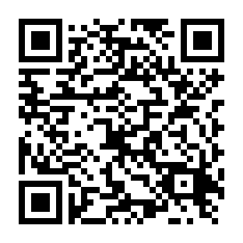
Questions?
Thank you for coming!
https://uwaterloo.ca/statistics-and-actuarial-science/undergraduate-studies

