Slide 1
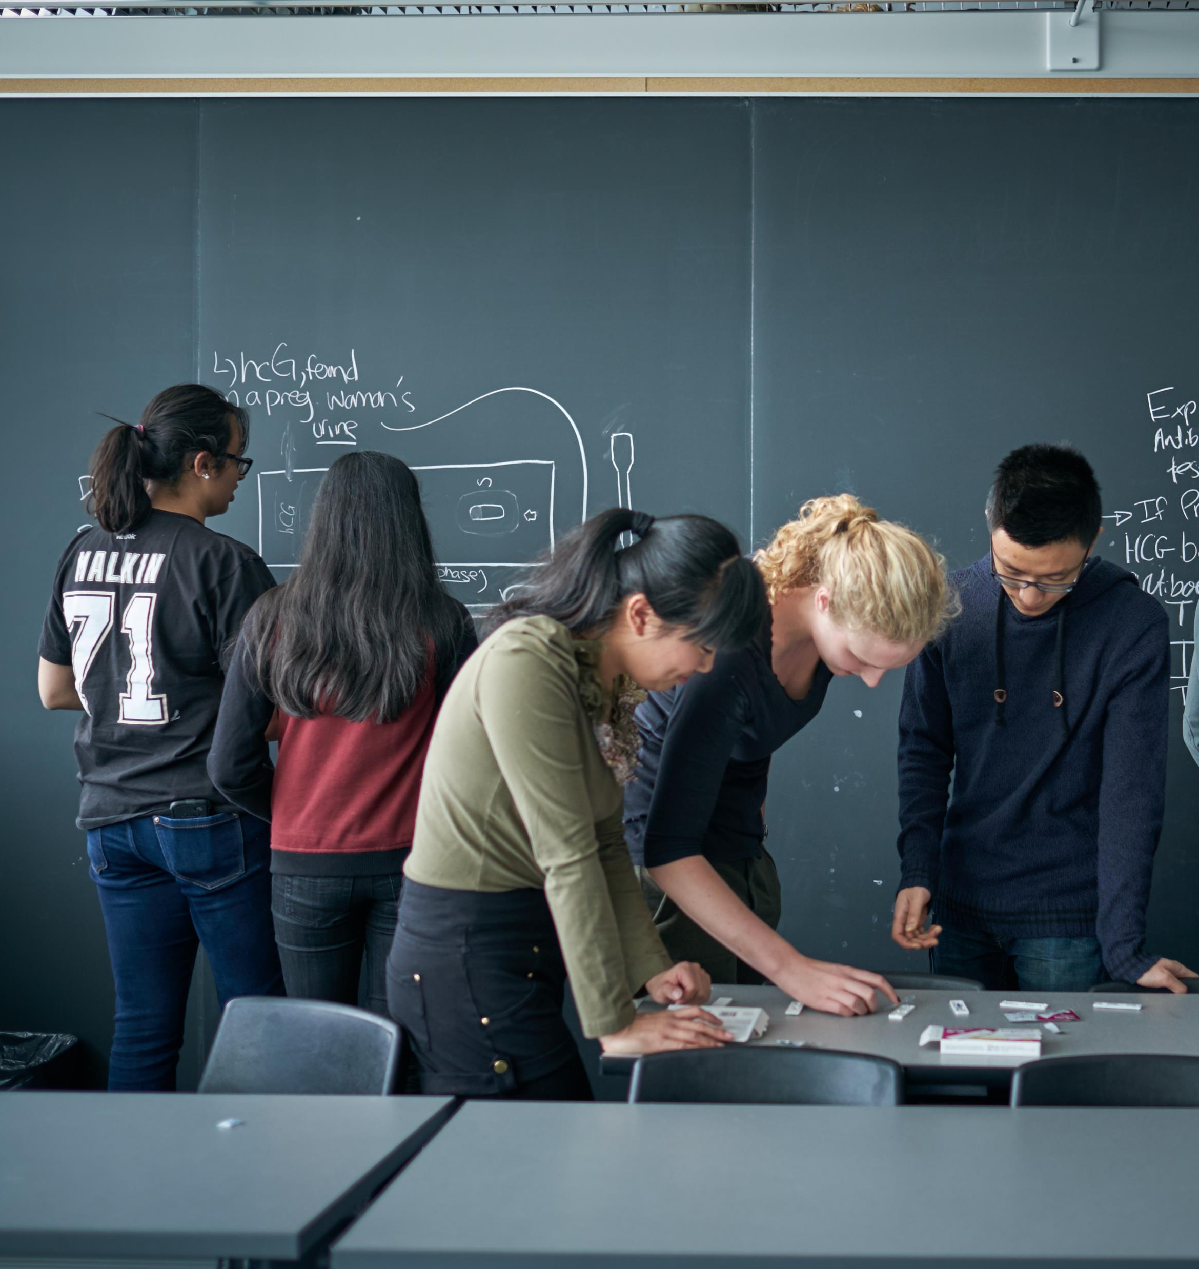
SYSTEMS DESIGN ENGINEERING INFORMATION SESSION
November 9, 2024

Slide 2
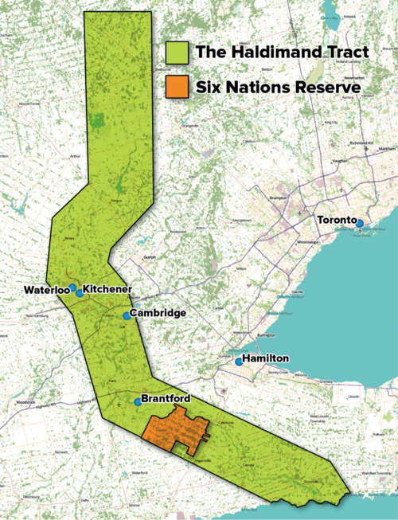
UNIVERSITY OF WATERLOO TERRITORIAL ACKNOWLEDGEMENT
The University of Waterloo acknowledges that much of our work takes place on the traditional territory of the Neutral, Anishinaabeg and Haudenosaunee peoples.
Our main campus is situated on the Haldimand Tract, the land granted to the Six Nations that includes six miles on each side of the Grand River.
Our active work toward reconciliation takes place across our campuses through research, learning, teaching, and community building, and is centralized within the Office of Indigenous Relations.
Image source: Adam Lewis, “Living on Stolen Land” Alternatives Journal December 2015

Slide 3
Systems design Engineering Overview

Slide 4
WHAT IS SYSTEMS DESIGN ENGINEERING?
Uses engineering, math, and science skills with a systems approach
Covers system's lifecycle, including conception, design, implementation, testing, and maintenance
Employs methodologies like systems- thinking, modeling, simulation, and optimization to understand and improve system performance
Emphasis on collaboration through working in teams and with stakeholders and community
Comprehensive problem definition and analysis to design holistic solutions
Notes:
Systems Design Engineering is a multidisciplinary program that integrates engineering, math, and science to create innovative solutions to complex problems. The primary focus of this discipline is on designing and integrating various components and subsystems so they work together efficiently and effectively. This holistic perspective is crucial for optimizing overall system performance. Central to the program is the emphasis on design. You'll engage in numerous design projects throughout your studies, learning to apply design thinking and systems methodologies to real-world challenges. Systems Design Engineering is a dynamic and comprehensive field that plays a vital role in the development of complex systems across various industries. Its focus on integration, collaboration, and adaptability makes it essential in today’s technological landscape.

Slide 5
COURSE PLAN OVERVIEW
Notes:
So, what can you expect to learn as a Systems Design Engineering student?

Slide 6
SYDE CURRICULUM
Year 1
Year 2
Year 3
Year 4
Year 5
Fall | Winter | Spring
1A | Work | 1B
SYDE 161 Intro to Design | CO-OP | SYDE 162 Human Factors in Design
SYDE 121 Digital Comp |  | SYDE 223 Data Struc. & Algorithm
SYDE 113 Engineering Math |  | SYDE 114 Matrices & Linear sys.
SYDE 181 Physics: Statics |  | SYDE 192 Digital Systems + Lab
SYDE 111 Calculus 1 |  | SYDE 112 Calculus 2
SYDE 101 Comm: written/ OralE |  | Elective
SYDE 101L Comm: Visual
Fall | Winter | Spring
Work | 2A | Work
CO-OP | SYDE 261 Design, Systems & Society | CO-OP
 | SYDE 263 Engineering Prototyping
 | SYDE 285 Materials Chemistry
 | SYDE 182 Physics: Dynamics
 | SYDE 211 Calculus 3
 | SYDE 283 Physics: Electricity, Magnetism & Optics
Fall | Winter | Spring
2B | Work | 3A
SYDE 262 Engineering Economics of Design | CO-OP | SYDE 361 System Design Methods
SYDE 292 Circuits, Instrumentation& Measurements + Lab |  | SYDE 351 System Model 1
SYDE 252 Linear Systems & Signals |  | SYDE 312 Applied Linear Algebra
SYDE 212 Probability & Statistics |  | SYDE 381 Thermodynamics
SYDE 286 Mechanics of Deformable Solids |  | SYDE 383 Fluid Mechanics
Fall | Winter | Spring
Work | 3B | Work
CO-OP | SYDE 362 Systems Design Methods 2 | CO-OP
 | SYDE 352 Intro to Control Systems + Lab
 | SYDE 411 Optimization and Numerical Methods
 | SYDE 300 Work-Term Symposium Poster
 | Elective
 | Elective
Fall | Winter
4A | 4B
SYDE 461 Capstone Project 1 | SYDE 462 Capstone Project 2
SYDE 532 Intro to Complex Sys. | Elective
Elective | Elective
Elective | Elective
Elective | Elective
Notes:
This slide provides a comprehensive look at the Systems Design Engineering (SYDE) curriculum over five years. It’s important to note that because this is a co-op program, your typical 4-year bachelor degree is extended to be 5-years, however you do graduate with up to two years of paid work experience.​
​​
You begin with foundational courses and complete your first co-op work term in your second term at university (from January – April). This allows students to engage in their first co-op experience early on.​
You’ll also notice that each term throughout your degree you will take one design course. Design courses in Systems Design Engineering are a core component of the program, focusing on the practical application of theoretical knowledge to solve real-world problems. These courses guide students through the process of conceptualizing, developing, and optimizing complex systems through hands-on, collaborative projects.
​​
In your upper-years you’ll also have some more room in your schedule to choose your technical electives, so you can decide where to focus your studies. Technical electives include options such as Engineering Biomechanics, Introduction to Machine Learning, and Autonomous Mobile Robots, among others.​
​
This curriculum ensures that students are well-rounded, with strong academic foundations, continuous design practice, and valuable work experience from co-op terms. By the time you graduate, you will have both the technical skills and the real-world knowledge to excel in a variety of industries.

Slide 7
Specializations
Notes:
Before we dive deeper into the program, let’s explore the various types of systems that are integral to Systems Design Engineering. Each type of system has its own unique characteristics and functions, and understanding these differences is essential for designing effective and efficient solutions. We’ll look at four main categories: human factors and interfaces, intelligent and automated systems, physical and mechatronic systems, and social and environmental systems. By examining these types, we can better appreciate the complexities and interdependencies that shape the systems we interact with every day. Let’s begin by diving into the first type: human factors and interfaces.

Slide 8
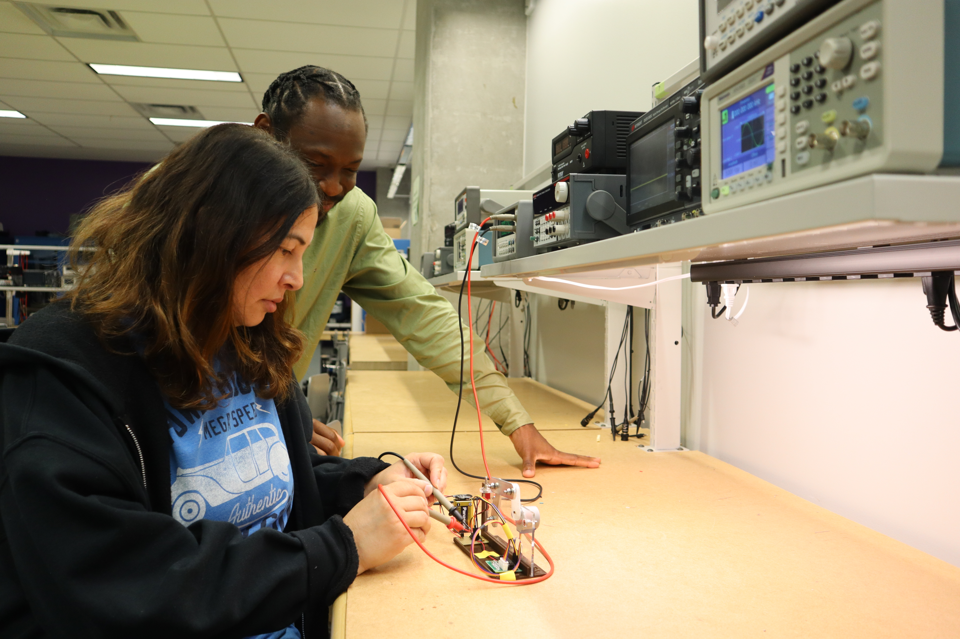
FIELDS OF FOCUS
SYDE students may choose to take their technical electives from a more restricted list to receive one of the following specializations:
Human Factors and Interfaces
Intelligent and Automated Systems
Physical and Mechatronic Systems
Societal and Environmental Systems

Slide 9
HUMAN FACTORS AND INTERFACES
Human-computer interaction
User interface design
Ergonomics in vehicles
Example: augmented reality for pilot training
Notes:
Human factors and interfaces focus on how people interact with systems. This area examines ergonomics, usability, and user experience to ensure that systems are designed with the user in mind. Understanding human behavior and capabilities is essential for creating intuitive interfaces that enhance productivity and reduce errors. This consideration is crucial in areas like software design, transportation systems, and healthcare.

Slide 10
INTELLIGENT AND AUTOMATED SYSTEMS
Artificial intelligence
Machine learning
Image processing
Modelling of physiological systems and disease
Example: Autonomoose, Canada’s first autonomous vehicle approved for driving on public roadways
Notes:
Intelligent and automated systems incorporate advanced technologies such as artificial intelligence (AI) and machine learning to improve decision-making and efficiency. These systems can perform tasks with minimal human intervention, leading to enhanced productivity in fields like manufacturing, logistics, and smart home technology. Examples include autonomous vehicles and robotic process automation.

Slide 11
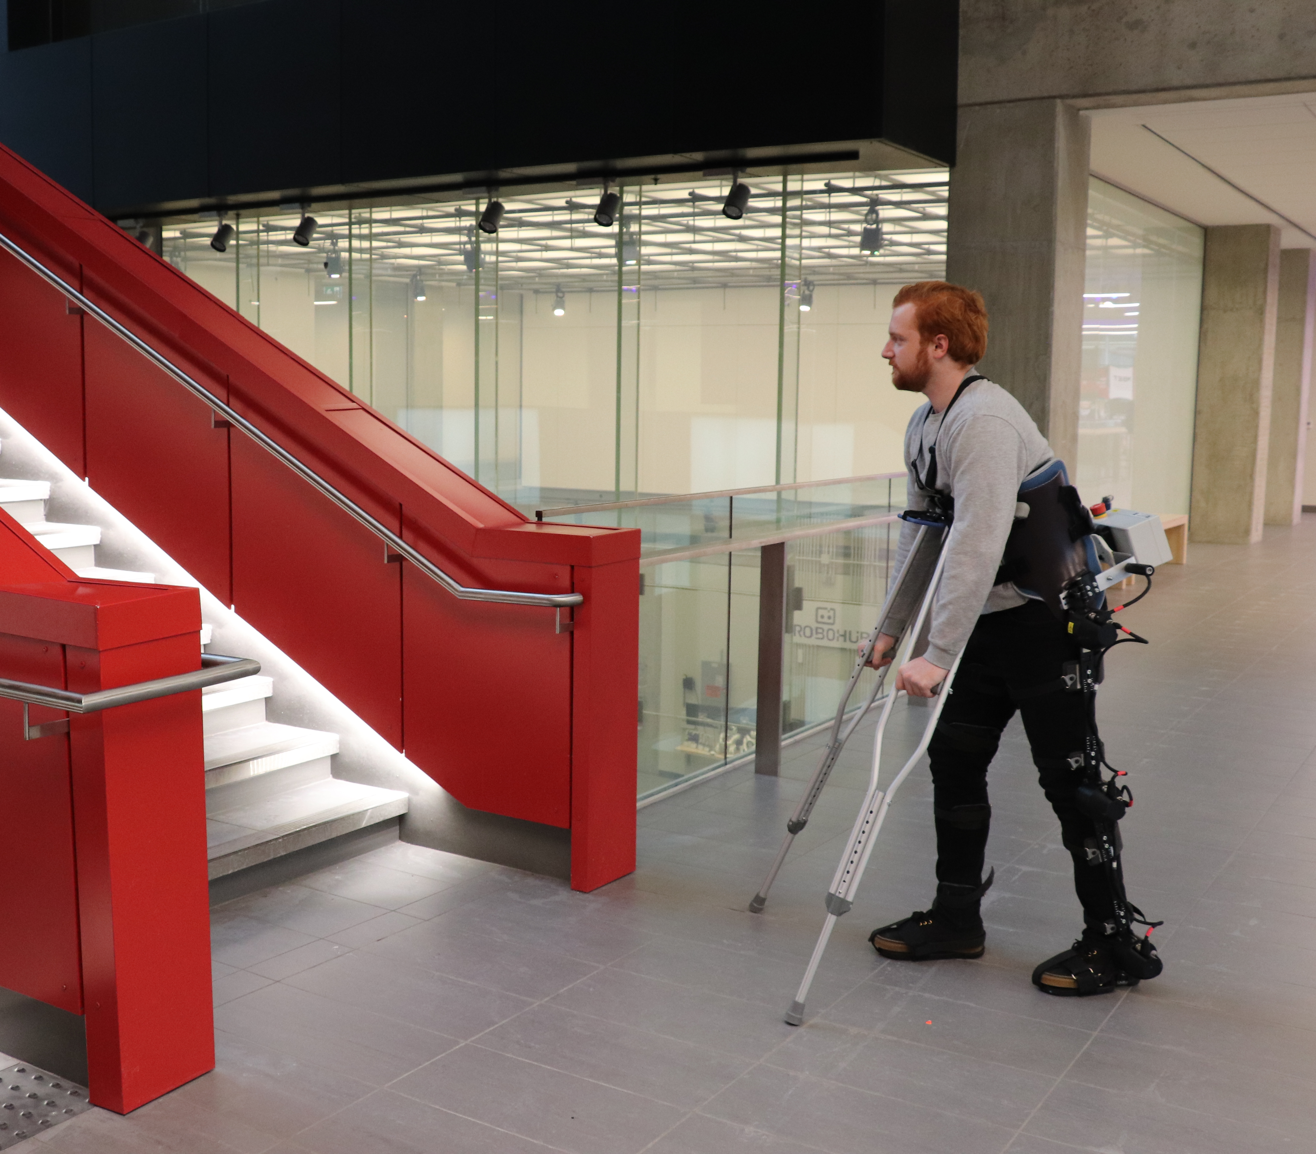
PHYSICAL AND MECHATRONIC SYSTEMS
Robotics
MEMS
Nanotechnology
Automation in manufacturing
Example: exoskeleton capable of walking and environmental recognition
Notes:
Physical systems encompass tangible elements, while mechatronic systems combine mechanical engineering, electronics, and computer science. This integration allows for the creation of smart devices and robots that perform complex tasks. Examples include robotic arms used in assembly lines and automated guided vehicles in warehouses, highlighting the synergy between hardware and software in modern engineering.

Slide 12
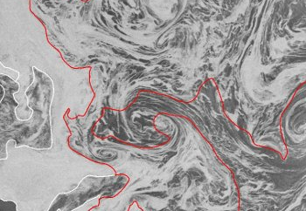
SOCIETAL AND ENVIRONMENTAL SYSTEMS
Climate
Energy
Transportation
Natural disaster recovery
Community resilience
Ethics
Remote sensing
Infrastructure
Example: remote sensing of sea ice
Notes:
Social and environmental systems consider the interactions between people and their environments. This includes analyzing socio-economic factors and ecological impacts to ensure sustainable practices. Systems in this category address challenges such as urban planning, resource management, and climate change, emphasizing the need for solutions that balance human needs with environmental preservation.

Slide 13
CUSTOMIZING YOUR DEGREE
Software Engineering
Physical Sciences
Statistics
Artificial Intelligence (AI)
Systems Design Engineering
Mechatronics
Human Factors & Interfaces
Intelligent & Automated Systems
Biomechanics
Management Sciences
Physical & Mechatronics Systems
Societal & Environmental Systems
Environmental Engineering
Life Sciences
Entrepreneurship
Quantum Engineering
Computing
Computer
Engineering
Notes:
Alongside the requirements of your degree, you may choose to add a specialization or option to focus in on specific areas of interest. Specializations are program-specific and typically require 4-6 courses to be completed. Systems Design Engineering offers four specializations that you can add to your degree in your upper years: Human factors & interfaces, intelligent & automated systems, physical & mechatronic systems, or societal & environmental systems.
In the Faculty of Engineering, we also have options, which are available in any of our engineering programs and typically require 5-8 courses to be completed. Some popular options for Systems Design Engineering students to add in their upper years include entrepreneurship, computer engineering, or biomechanics, however there are a total of 13 options you may choose from.

Slide 14
WHY CHOOSE SYSTEMS DESIGN ENGINEERING?
Notes:
Before we dive deeper into the program, let’s explore the various types of systems that are integral to Systems Design Engineering. Each type of system has its own unique characteristics and functions, and understanding these differences is essential for designing effective and efficient solutions. We’ll look at four main categories: human factors and interfaces, intelligent and automated systems, physical and mechatronic systems, and social and environmental systems. By examining these types, we can better appreciate the complexities and interdependencies that shape the systems we interact with every day. Let’s begin by diving into the first type: human factors and interfaces.

Slide 15
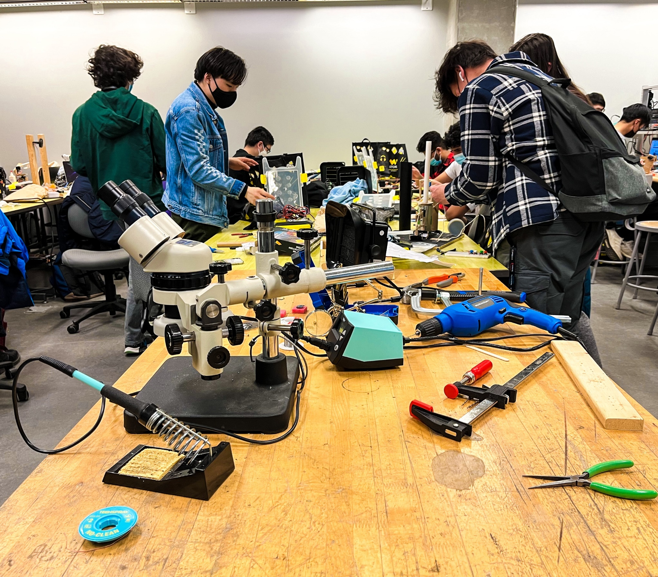
PROGRAM DIFFERENTIATORS
Solid technical education in engineering: mechanical, electrical, software, and more
Design course in every term
Labs and hands-on experiences
Ample technical and complementary elective options
Unlimited potential for SYDE graduates
Notes:
There are a number of features in our program that make us stand out. Firstly, we are a highly interdisciplinary program where you will learn to integrate solid technical education in a variety of engineering disciplines, such as mechanical, electrical, and software, to solve complex problems. This multidisciplinary approach equips students with a broad skill set, allowing them to tackle diverse engineering challenges.
Furthermore, a unique feature of the program is the design course integrated into every term. This continuous focus on design ensures that students are regularly applying their knowledge to solve real-world problems, building creativity, innovation, and problem-solving skills throughout their studies.
The program also emphasizes practical, hands-on learning through labs and experiential projects. These opportunities allow students to gain valuable, direct experience working with the tools and technologies they will use in their careers.
Students also have access to a wide range of technical and complementary electives, allowing them to tailor their education to their interests. Whether focusing on a specific industry or broadening their expertise, the program offers flexibility to explore various pathways.
With a diverse skill set and strong design foundation, SYDE graduates have unlimited potential in their careers. The multidisciplinary training prepares them for roles in a wide variety of industries, from tech and healthcare to infrastructure and environmental systems.

Slide 16
CO-OP IN SYDE
Explore careers, earn money, and gain experience through North America's largest co-op (paid internship) program
96% of our co-op grads employed six months after graduation find jobs related to skills they acquired at Waterloo, compared to 83% of all university graduates in Ontario
Sample co-op jobs:
Product design/development
Rapid prototype software developer
Application developer
Machine learning developer
QA analyst
Control systems software designer co-op
Product manager
Notes:
At Waterloo, students have the opportunity to explore careers, earn money, and gain real-world experience through North America's largest co-op (paid internship) program. This program is a cornerstone of Waterloo's approach, allowing students to apply classroom knowledge in professional settings and build valuable industry connections. In Systems Design Engineering, you are required to complete 5 out of 6 possible co-op work terms in order to graduate.
One of the standout statistics is that 96% of our co-op graduates find employment related to the skills they acquired at Waterloo within six months of graduation. In comparison, only 83% of all university graduates in Ontario achieve the same. This showcases how co-op provides a direct path to career success by equipping students with relevant, in-demand skills.
During their co-op terms, students gain experience in a variety of exciting and specialized roles, such as:
Product design/development, involves creating and refining new products or systems. Students work on everything from concept generation to prototyping, giving them firsthand experience in turning ideas into tangible outcomes.
Rapid prototype software developer, create quick, functional models of software applications to test ideas and functionalities. This role is critical in innovation-driven industries, allowing teams to iterate designs rapidly.
User experience designer, focus on how users interact with products or systems. They help improve usability and overall user satisfaction by designing intuitive, user-friendly interfaces.
Application developer, responsible for coding and creating software applications. This role helps students gain experience in programming and developing applications for various industries, including mobile and web-based platforms.
Machine learning developer, work on creating algorithms that enable systems to learn and make decisions based on data. This is an exciting role that combines software development with cutting-edge AI technologies.
Quality assurance analyst, ensures that products, especially software, meet specific standards before release. Co-op students in this role focus on identifying bugs, running tests, and ensuring overall system functionality.
Control systems software designer, work on designing and developing control systems software, which is crucial for managing automated processes in industries such as manufacturing, robotics, and automotive systems.
Product managers, oversee the development and launch of products, working with engineering, marketing, and design teams. This role gives students leadership experience in guiding a product from conception to market launch.
These co-op experiences provide not just exposure but real skills that align directly with future career opportunities.
By participating in these internships, students gain a competitive edge in the job market, often leading to full-time offers in their chosen fields post-graduation.

Slide 17
AFTER GRADUATION
Find careers in a wide range of areas:
Graduate studies
MEng, MASc, PhD
Product Design and Development | Environmental Systems Design | Supply Chain and Logistics
Energy Systems | Product Management | Automotive Systems
Machine Learning and AI | Data Science and Analytics | Aerospace Engineering
Control Systems and Automation | Application Development | User Experience Design
Notes:
A degree in Systems Design Engineering opens doors to various career paths across multiple sectors.
Key Areas of Employment:
Product Design and Development: Creating and improving products in industries like technology, healthcare, and consumer goods.
Software Development and AI: Developing applications, machine learning algorithms, and intelligent systems across various sectors.
Automation and Control Systems: Designing automated processes for industries like manufacturing, aerospace, and energy.
User Experience (UX) Design: Enhancing usability and interaction in digital services and consumer products.
Consulting and Project Management: Leading projects and offering expertise in systems design, optimization, and innovation.
Data Science and Analytics: Analyzing big data to drive insights in finance, healthcare, and marketing.
Sustainability and Environmental Systems: Developing solutions for renewable energy, water management, and eco-friendly infrastructure.
Cybersecurity: Designing and implementing secure systems to protect against digital threats.
Graduate Studies:
Graduates have the option to pursue advanced studies, including Master of Engineering (MEng), Master of Applied Science (MASc), or PhD programs, allowing for specialization and deeper research in areas of interest.
With such a diverse array of career opportunities and the option for further education, Systems Design Engineering graduates are well-prepared to make significant contributions to society while addressing critical challenges in a variety of industries.

Slide 18
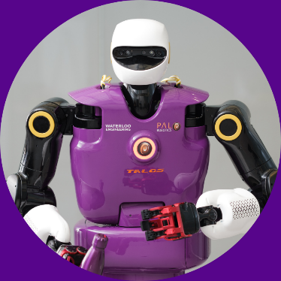
QUESTIONS?
CHATS WITH ENGINEERING STUDENT AMBASSADORS
uwaterloo.ca/future-students/ask/engineering
ADMISSIONS QUESTIONS
enginfo@uwaterloo.ca
TOURS & EVENTS
uwaterloo.ca/future-students/tours-events
Notes:
We’re happy to answer any questions you may have about our Systems Design Engineering program at this time.

