Slide 1
Text Analytics and Machine Learning Workshop
October 26, 2018
CPA Canada - Toronto, Canada

Slide 2
Text analytics use is skyrocketing
More machine readable text …
Computing & data storage that is cheaper, more mobile, powerful & connected
Machine learning
More efficient, less error prone text processing
More data for business intelligence
= better predictions
IntellyticsHub

Slide 3
Text of interest to accountants includes:
News – e.g. earnings announcements, trade publications
Business documents: invoices, contracts
Meeting minutes
Emails
Social media
Annual reports (MD&A, audit report, internal control report, etc.)
Proxy statements (Committee reports, director biographies)
Contracts
Conference call transcripts
Interview transcripts

Slide 4
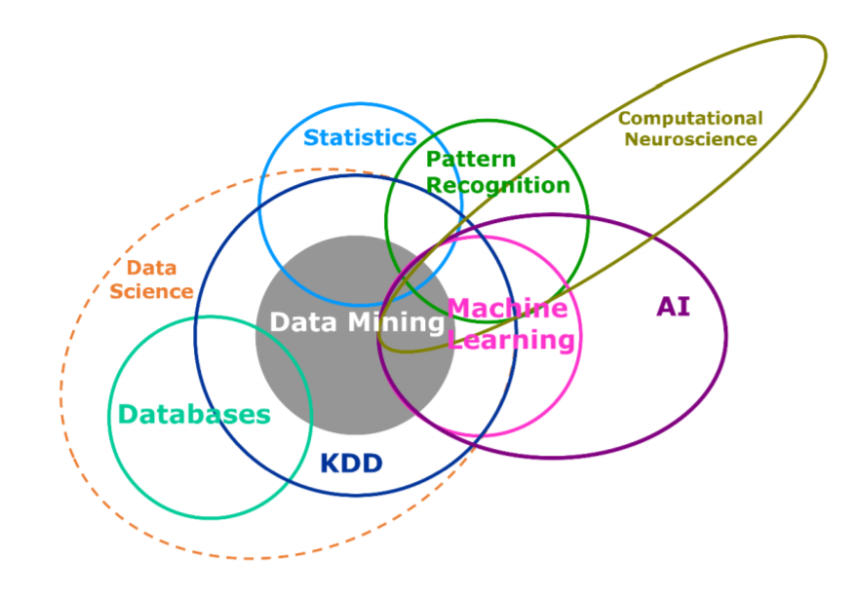
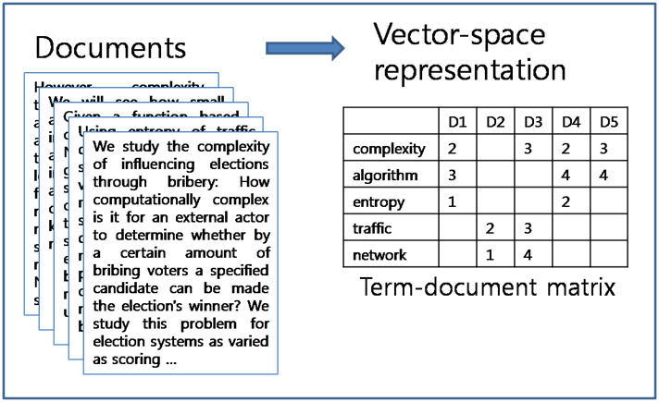
Text Analytics + Machine Learning: a powerful duo
Text analytics: Extracts relevant information from text by turning unstructured text into data for analysis. Techniques range from simple searches to using deep learning (a subset of machine learning) for natural language processing (NLP).
Machine learning: Builds systems that learn from data, identify patterns, and make predictions (and decisions) with minimal human intervention.
Structured data
SAS Institute: Hall, Dean, Kabul, and Silva: An Overview of Machine Learning

Slide 5
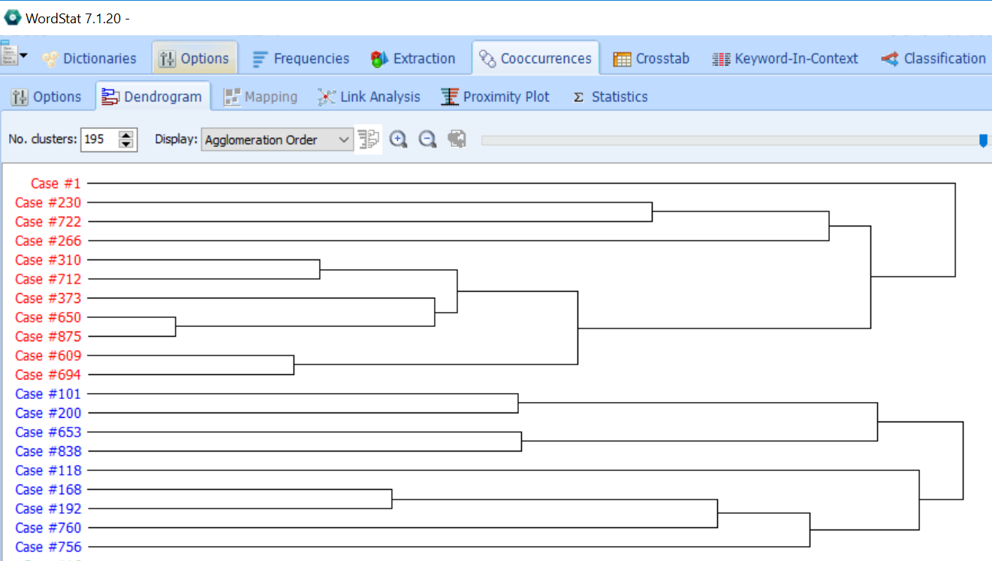
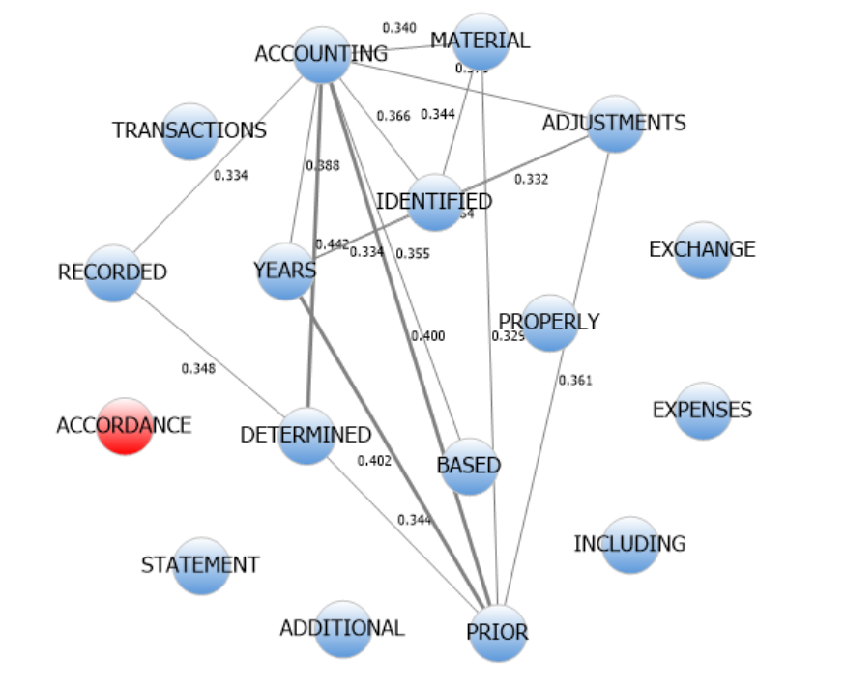
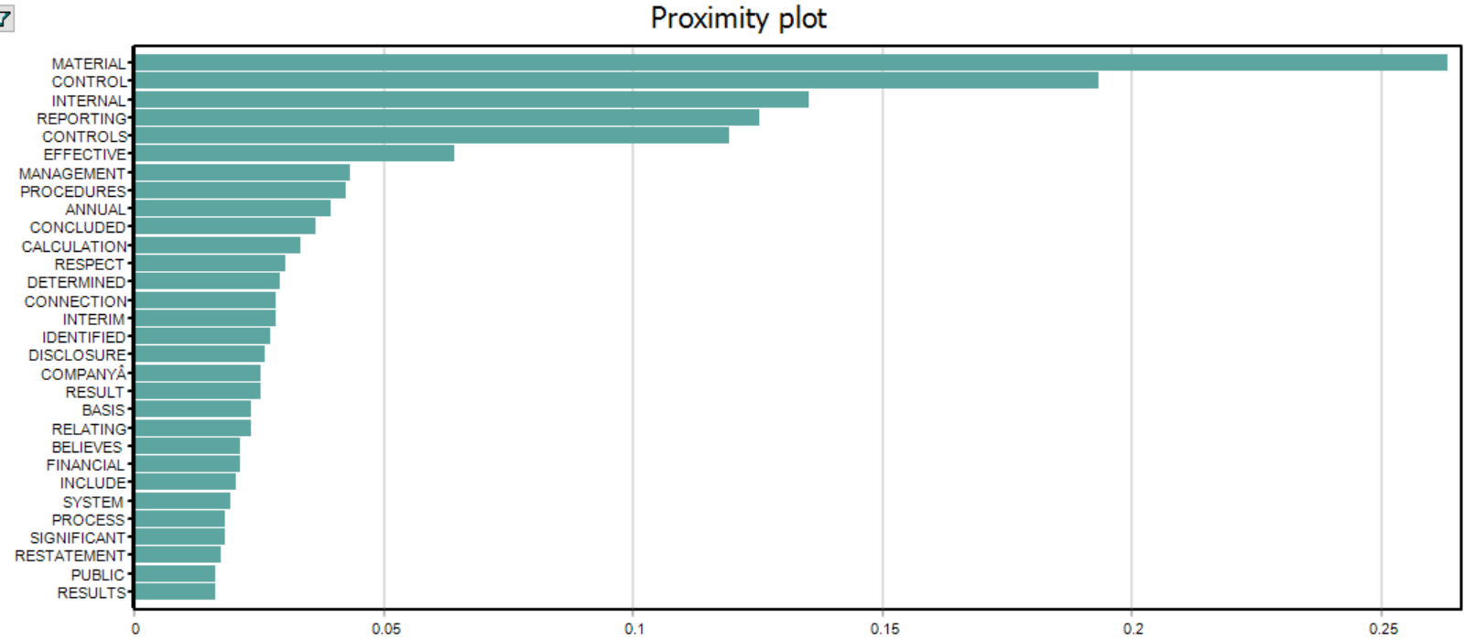
Text Analytics can…
Visualize and describe text
Crawl and tag social media, web resources, & other documents (e.g. contracts)
Search words/phrases/n-grams
Recognize entities
Classify documents
Identify topics in collections of text
Cluster similar documents
Extract text or concepts
Analyze sentiment and tone
Tag parts of speech - NLP
Structure text for analysis
Screen captures: Provalis Research - Wordstat

Slide 6
Machine Learning

Slide 7
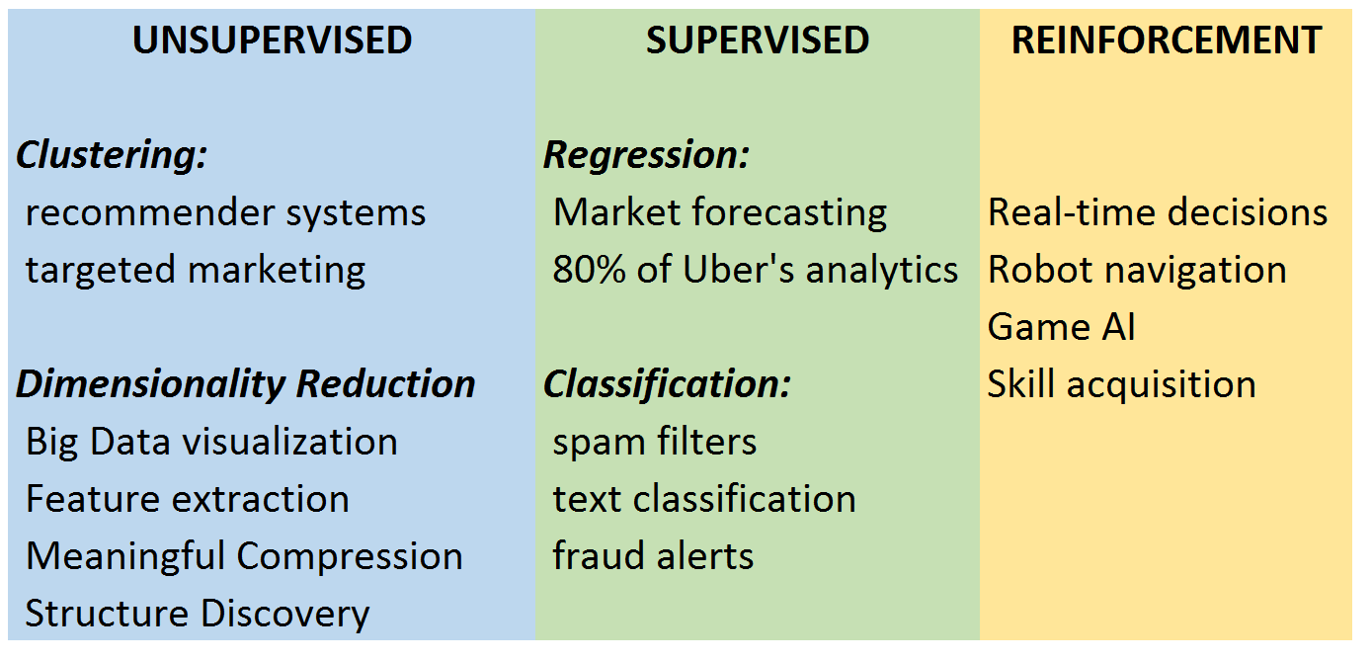
Types of machine learning

Slide 8
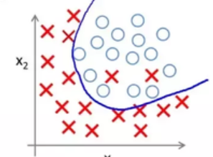
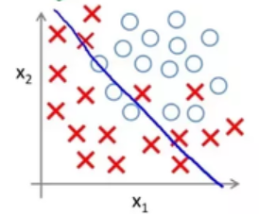
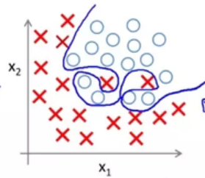
So many different models to choose from!
Simple methods may underfit
-> Poor prediction
Complex methods may overfit
-> not generalizable
Experiment to find the simplest one that predicts well enough

Slide 9
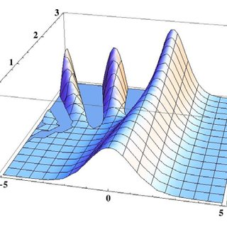
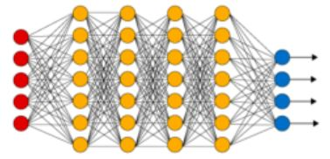
Choice considerations
Complex models may handle data better
Outliers
Non-linearity
Correlated variables
Unknown interactions between variables
More features than observations
data-driven, not theory-driven
Machine Learning is not a magic bullet
Relies on good data
Results biased by bias in data
“black box” interpretation challenge
Requires data science skills & infrastructure
that are in short supply

Slide 10
Deployment challenges
Data security & privacy concerns
Need to localize models
Models degrade quickly
Python, R other machine learning tools used to create the models may not be easy to put into production systems
“Making Netflix Machine Learning Algorithms Reliable”
International Conference on Machine Learning 2017

Slide 11
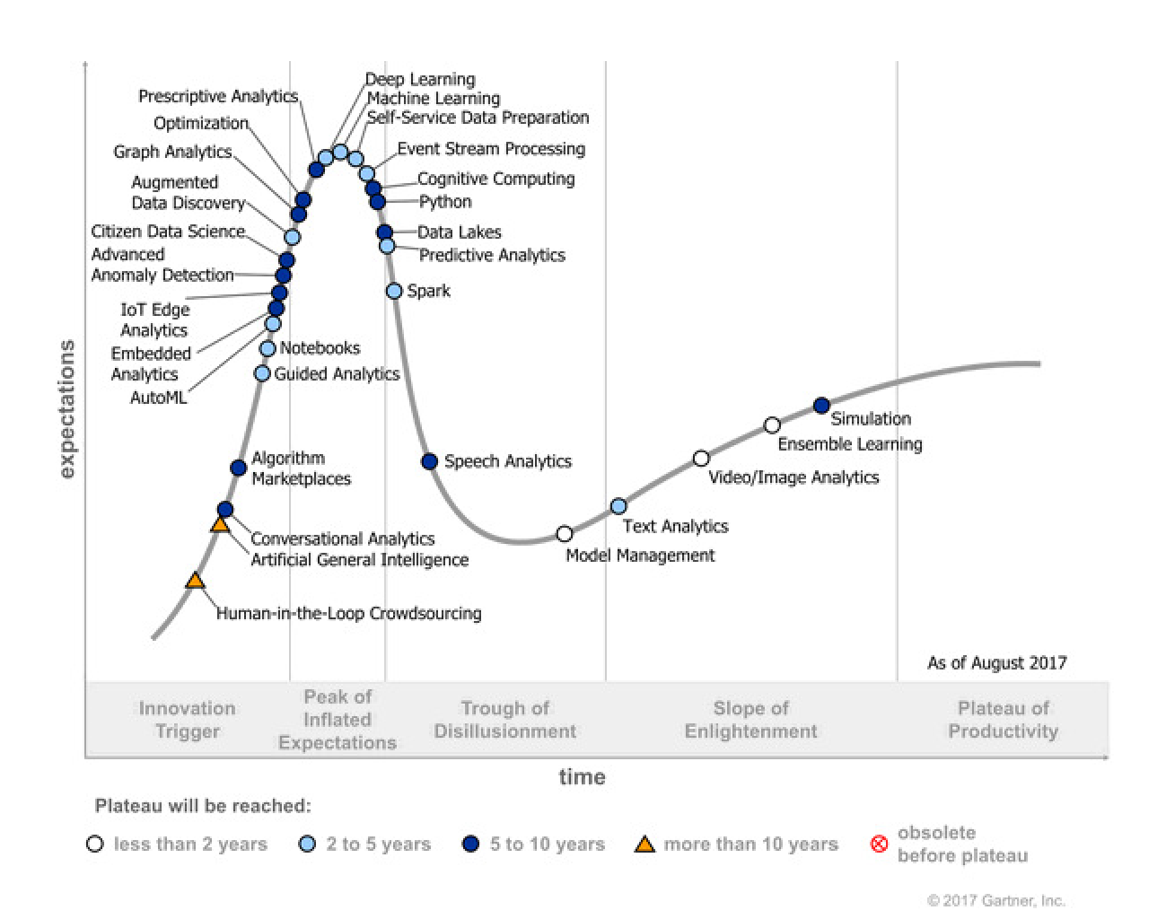
Gartner Hype Cycle
Machine Learning
Text Analytics

Slide 12
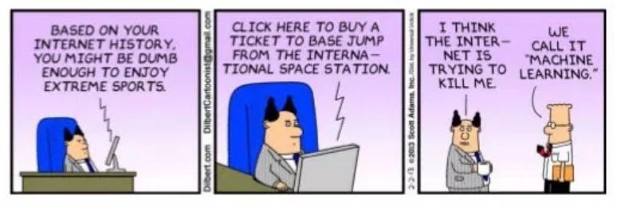
What machine learning can’t do … YET!
Think … infer … feel … create

