Slide 1
Text Analytics and Machine Learning Workshop Machine Learning Session
October 26, 2018
CPA Canada - Toronto, Canada

Slide 2
Machine Learning Session: Agenda
A little more on the machine learning
Hands-on with WordStat 8:
import text
visualize term frequencies & associations
pre-process text (stem, filter)
create a term document matrix
Hands-on with RapidMiner
import a term document matrix
Develop and cross-validate several classification algorithms
Compare the accuracy using out-of-sample observations

Slide 3
The Machine Learning Process
Identify a task or prediction problem
Collect data
Prepare data
Identify “features” – X and Y variables
Train & cross-validate several models
Evaluate models – out-of-sample tests
Select & deploy model
Interpret, infer, predict, or decide
Re-evaluate and update the model

Slide 4
The Machine Learning Process
Tips:
Ask specific questions that can be answered with a yes/no, the name of category/person/group, a number, what action to take next.
Google “data-science-for-beginners-the-5-questions-data-science-answers” for Microsoft’s video suggestions for formulating questions.
Identify a task or prediction problem
Collect data
Prepare data
Identify “features” – X and Y variables
Train & cross-validate several models
Evaluate models – out-of-sample tests
Select & deploy model
Interpret, infer, predict, or decide
Re-evaluate and update the model

Slide 5
The Machine Learning Process
Identify a task or prediction problem
Collect data
Prepare & explore data
Identify “features” – X and Y variables
Train & cross-validate several models
Evaluate models – out-of-sample tests
Select & deploy model
Interpret, infer, predict, or decide
Re-evaluate and update the model
For textual data:
Create a corpus:
Collect documents from the Web etc.
Save each as a string variable in a list
The “sample.csv” file downloaded for this workshop is a corpus of text.

Slide 6
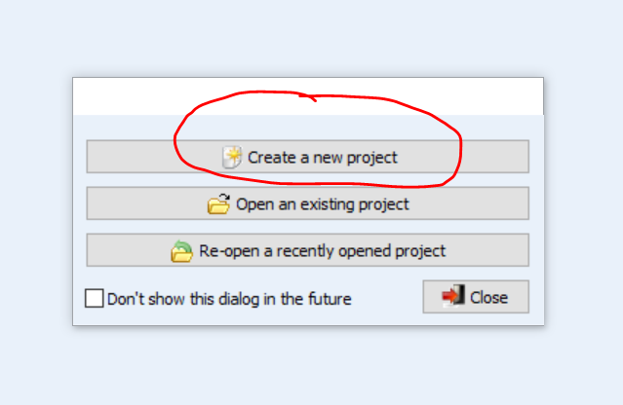
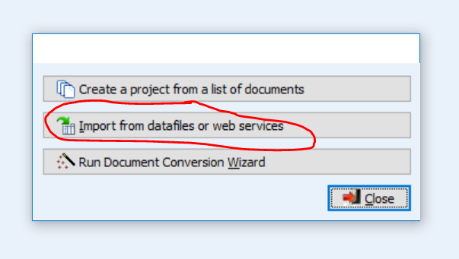
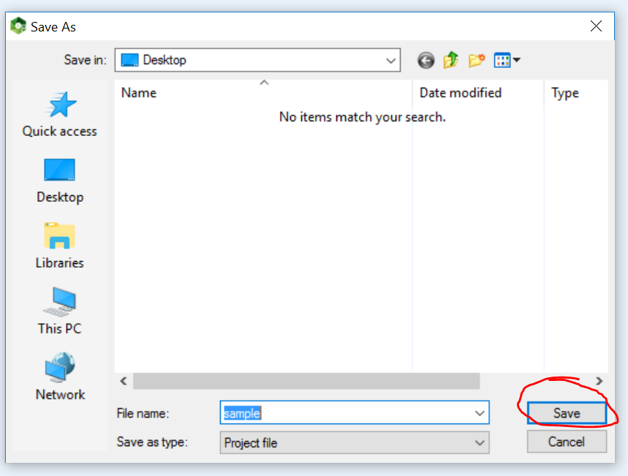
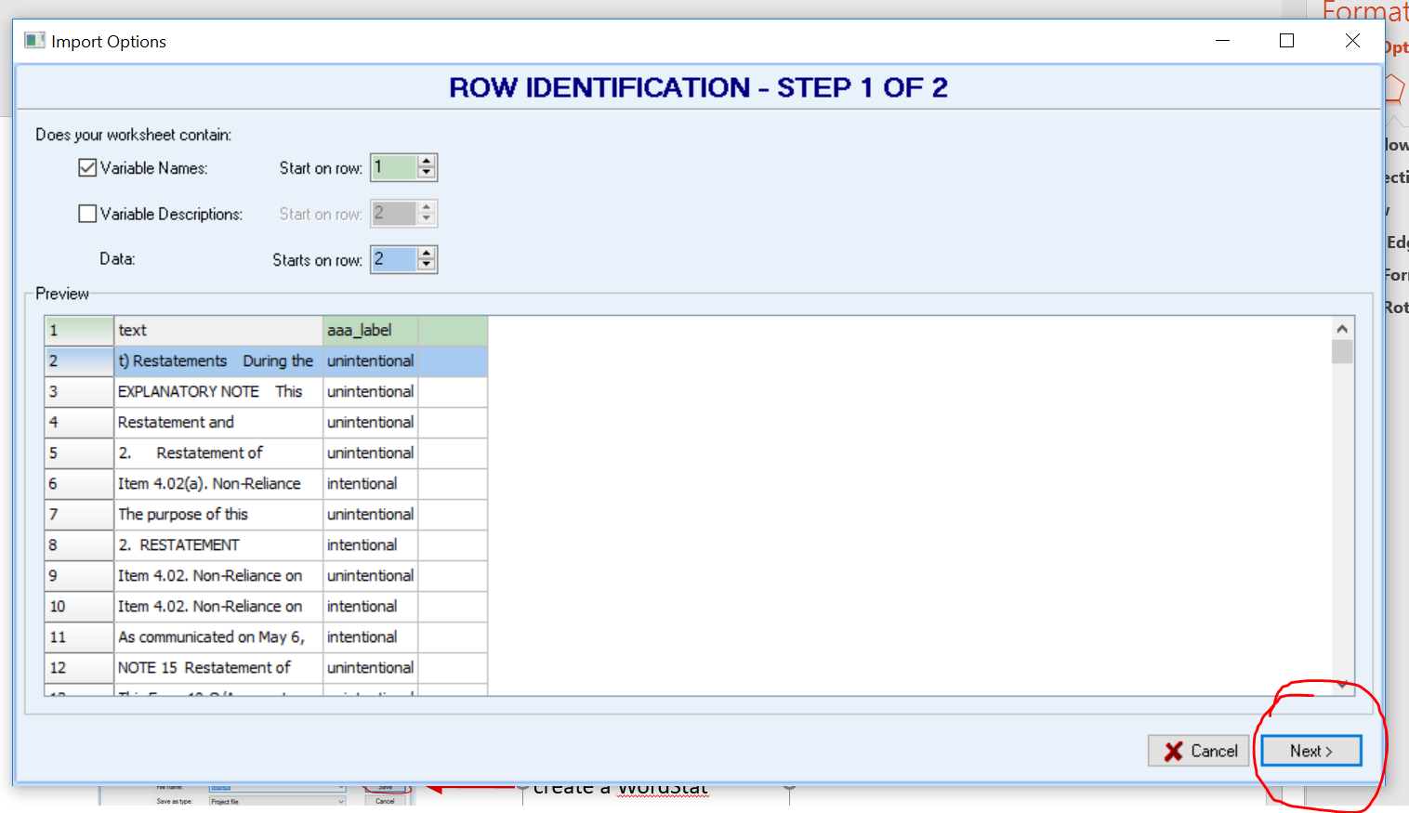
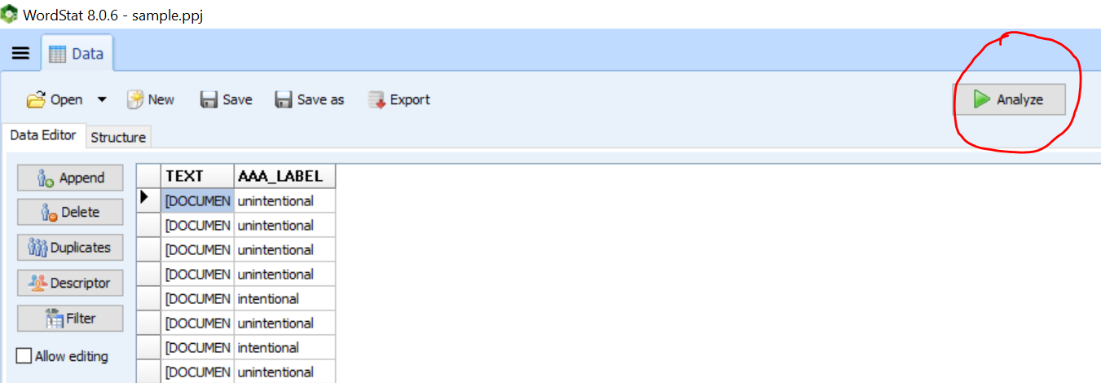
WordStat 8 – import the sample text
Step 1
Step 2
Step 3
start a new WordStat project
search and open the “sample.csv” file
Click “save” to create a new project
Step 4
Step 5
Click “Analyze” to start the text analysis
Click “next” then “import” on next 2 screens

Slide 7
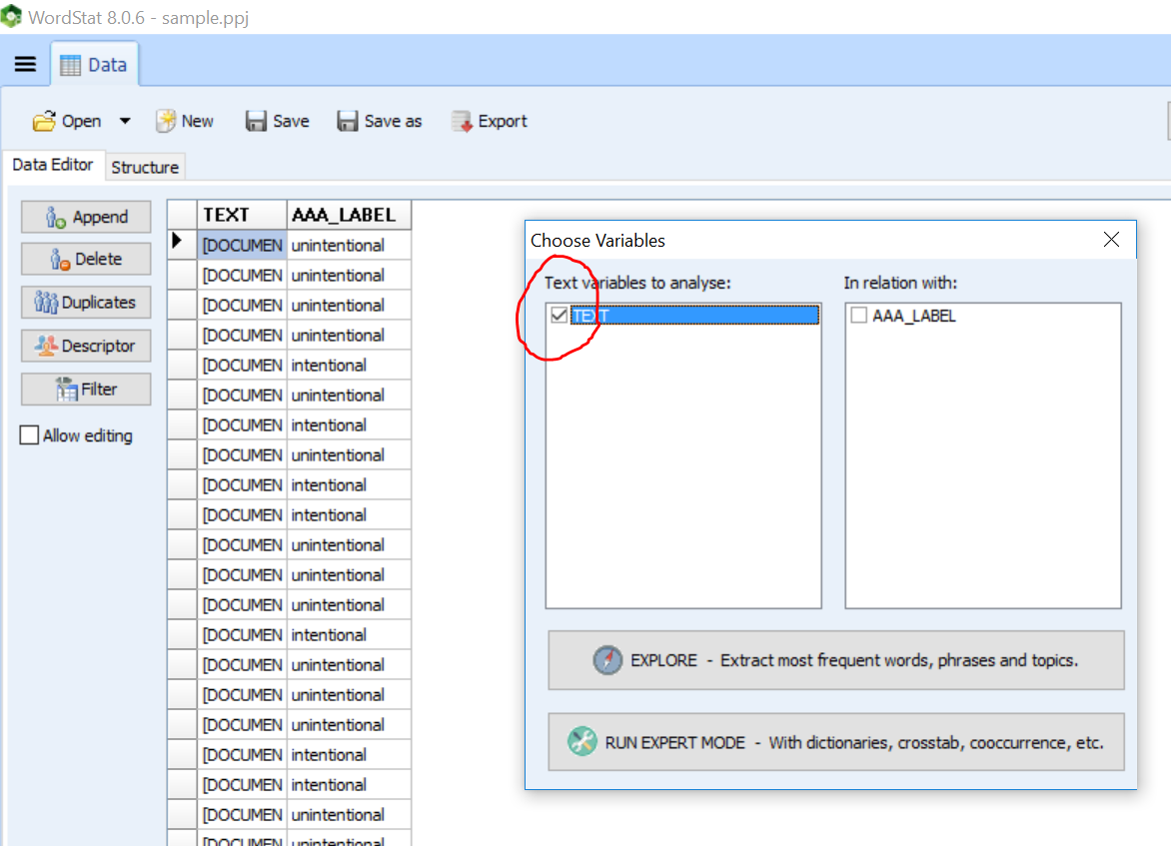
WordStat 8: start with the simple interface
1. Select the “Text” box and click “Explore”. Three tabs (Frequencies, Phrases, and Topics) will be added beside the Data tab.
2. Click the “Frequencies” tab to view word frequencies and a word cloud.
We’ll switch to “Expert Mode” later … don’t click for now or you’ll see different screens

Slide 8
Challenge 1: can you discover …
How many times does the word “error” appears in the sample?
How many documents contain the word “investigation”?
What proportion of the restatements that correct unintentional error and the restatements that correct intentional misstatements contain each word?
hint: use comparison panel at upper right and select variable AAA_label
Which company uses the infrequently occurring word “writedown”
hint: check “leftover words” and click “frequency” to see infrequently used words; the three horizontal bar icon to the left of the data tab allows drilling down to view “keyword-in-context”)

Slide 9
The Machine Learning Process
often 80% of process effort
“clean”, transform, filter, aggregate, impute, structure
For text often includes:
Remove noise
Filter rare/common words
Normalize
Remove punctation
convert to lower case
stem words
remove “stop words”
Tokenize
split text strings
create term document matrix
Identify a task or prediction problem
Collect data
Prepare & explore data
Identify “features” – X and Y variables
Train & cross-validate several models
Evaluate models – out-of-sample tests
Select & deploy model
Interpret, infer, predict, or decide
Re-evaluate and update the model

Slide 10
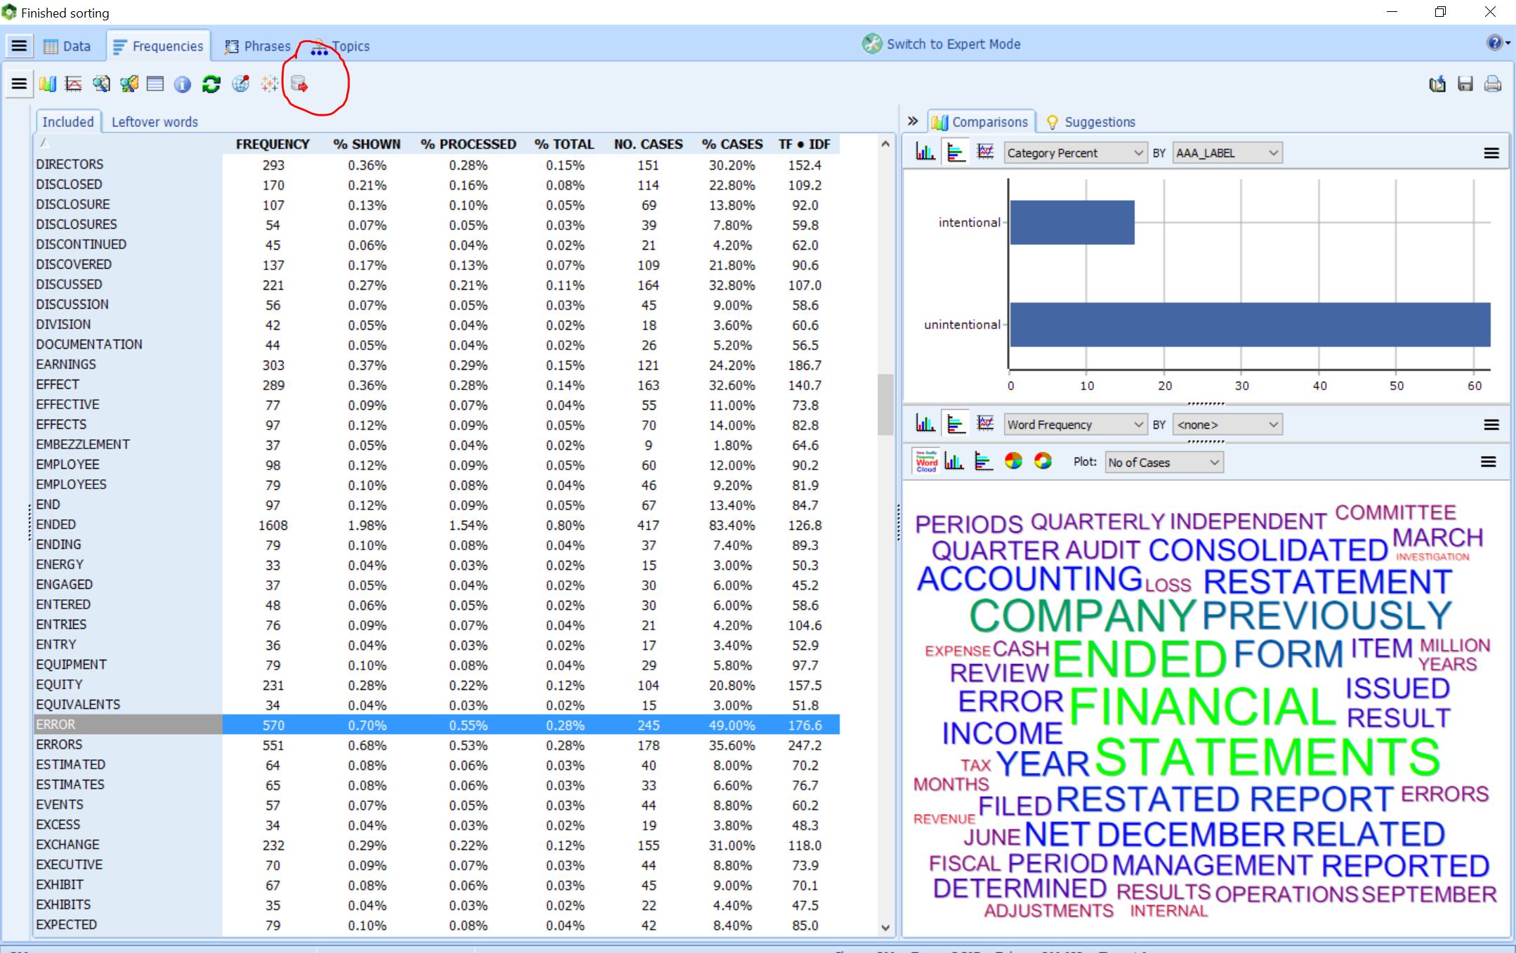
Click here to switch to “expert mode”:
more advanced visualizations and analyses
to preprocess text
2. Later, we will come back to the “data” tab and click here to export a term document matrix.

Slide 11
Challenge 2: can you …
“stem” words using English Porter stemming?
hint: click pre-processing
Ignore words occurring in less than 10 documents or more than 70% of the documents?
hint: click post-processing
Determine how many word stems are “included” in subsequent analyses?
hint: click the Frequencies tab … check the bottom of the screen

Slide 12
The Machine Learning Process
Challenge 3: a gentle intro to one type of machine learning classification
Click “classification”
Under classification options select AAA_LABEL as the variable to predict and 10 folds cross-validation as the validation method
Click “Run”
Click “Learn and Test”
Click “Run”
Observe Accuracy % and number “incorrect” in the confusion matrix
Hand up when done … and help your neighbor ☺ (we’ll work together on next step of this challenge)
Identify a task or prediction problem
Collect data
Prepare & explore data
Identify “features” – X and Y variables
Train & cross-validate several models
Evaluate models – out-of-sample tests
Select & deploy model
Interpret, infer, predict, or decide
Re-evaluate and update the model

Slide 13
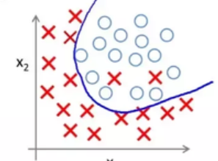
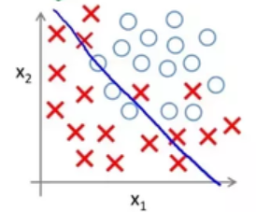
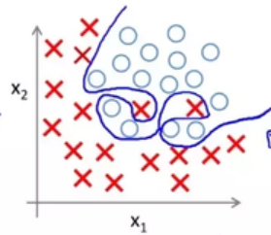
So many different models to choose from!
Simple methods may underfit
-> Poor prediction
Complex methods may overfit
-> not generalizable
Experiment to find the simplest one that predicts well enough

Slide 14
The Machine Learning Process
Identify a task or prediction problem
Collect data
Prepare & explore data
Identify “features” – X and Y variables
Train & cross-validate several models
Evaluate models – out-of-sample tests
Select & deploy model
Interpret, infer, predict, or decide
Re-evaluate and update the model
Export the term document matrix from WordStat:
Click “fFrequencies” Tab
Click the small disc icon below “Frequencies”
Save the exported file to your Desktop
Start RapidMiner Studio and import the term document matrix saved to your Desktop (next slide).

Slide 15
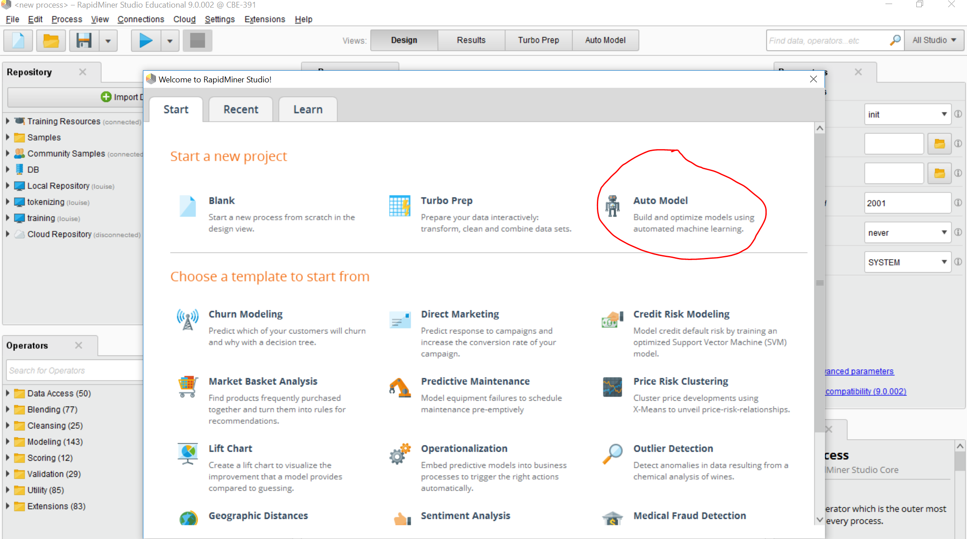
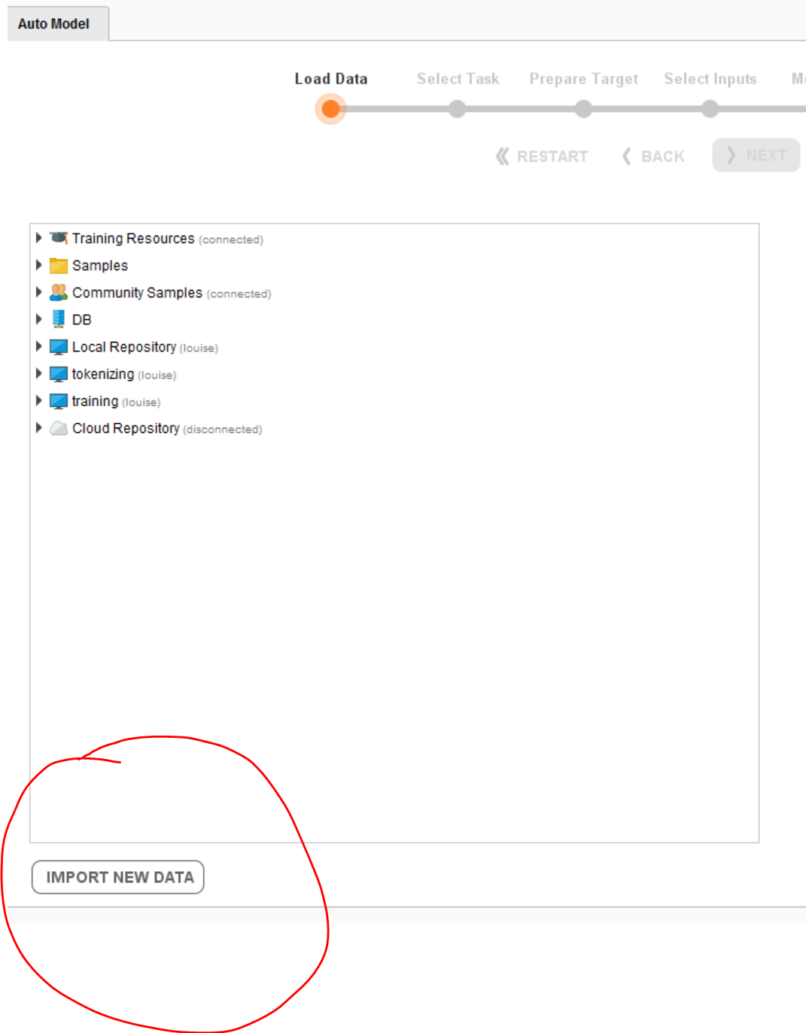
Launch RapidMiner and import the term document matrix created with WordStat
Step 1
Step 2

Slide 16
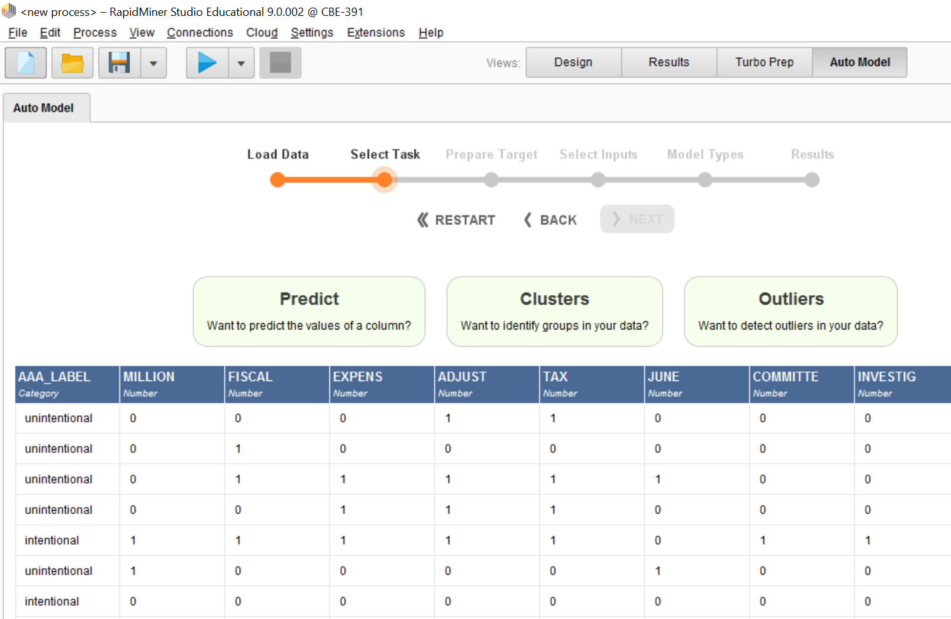
Follow the prompts:
Click Predict to begin
When prompted, click the AAA_LABEL column to select the variable to predict
Click “next” after each subsequent choice to run several classification algorithms

Slide 17
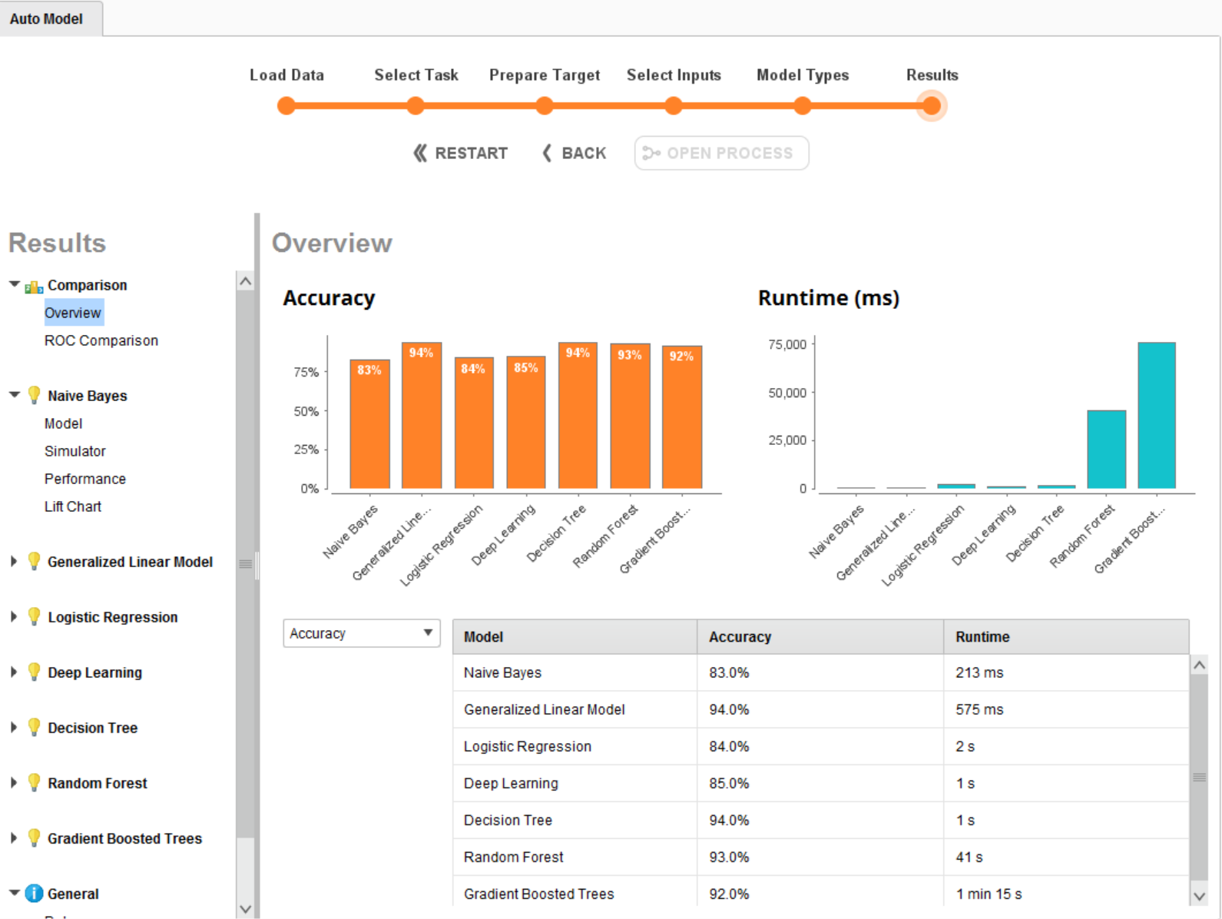
Overview of results for sample data:
We’ll “drill down” to see model details and open the RapidMiner detailed design for further modification.

Slide 18
The Machine Learning Process
Identify a task or prediction problem
Collect data
Prepare & explore data
Identify “features” – X and Y variables
Train & cross-validate several models
Evaluate models – out-of-sample tests
Select & deploy model
Interpret, infer, predict, or decide
Re-evaluate and update the model
Many models produce similar results. Model choice depends not only on overall accuracy of out-of-sample tests but also on factors such as ease of interpretation and deployment in real-time systems (if applicable)

Slide 19
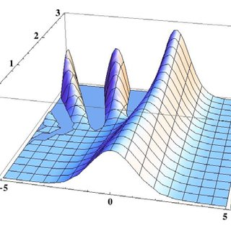
Interprebility
Ask yourself:
Do I understand my data?
Do I understand the model developed?
Do I trust these answers?
Simpler models that are easier to interpret and deploy are often a wise choice.
“Unfortunately, the complexity that bestows the extraordinary predictive abilities on machine learning algorithms also makes the answers the algorithms produce hard to understand, and maybe even hard to trust.”
Hall, Phan, and Ambati “Ideas on interpreting machine learning” O'Reilly Media March 15, 2017.

Slide 20
A few final thoughts….
Tools are rapidly evolving
Currently Python and R are the most widely used
A team approach is best … hiring one data scientist won’t make it happen
Success depends on asking the right questions and hiring/training/retaining the best people
CPAs are well positioned to craft the right machine learning strategies and to ask the right questions … to plan investment in machine learning, to begin machine learning projects, and to interpret results

