Slide 1

Text Extraction, Textual Analysis, and Model Building Workshop/Demo;
SeekiNF by SeekEdgar, LLC
Rajendra Srivastava
PhD (Physics), PhD (Accounting)
Professor Emeritus, University of Kansas; and CEO, SeekEdgar, LLC
Text Analytics and Machine Learning Workshop
October 26, 2018

Slide 2
OUTLINE
Introduction
Textual Analysis (Word count, sentence count, phrase count)
  Readability Indices
  Risk Sentiment
  Cosine similarity measure
  Word variation over time
  Sentiment analysis
SeekiNF: Search Engine for Extracting Knowledge from Industry Filings
Hands on Experience
Conclusion

Slide 3
Readability Indices
Gunning-Fog Index https://en.wikipedia.org/wiki/Gunning_fog_index
Smog Index https://en.wikipedia.org/wiki/SMOG
Flesch Reading Ease https://en.wikipedia.org/wiki/Flesch–Kincaid_readability_tests
Flesch-Kincaid Grade Level https://en.wikipedia.org/wiki/Flesch–Kincaid_readability_tests
Automated Readability Index https://en.wikipedia.org/wiki/Automated_readability_index
Coleman-Liau Index https://en.wikipedia.org/wiki/Coleman–Liau_index
Notes:
1.67 million hits on Google scholar

Slide 4
Textual Analysis Research
Few Examples
Loughran and McDonald (The Journal of Finance, 2011)
Li, F. (Journal of Accounting Literature, Vol. 29, 2010)
Liu and Moffitt (Journal of Emerging Technology in Accounting, 2016)
Lee, Churyk and Clinton (Strategic Finance , 2013, p. 33)
. . . . .Many others
Notes:
Loughran and Mcdonald: Textual analysis of a large sample of annual reports (10-Ks) of US public companies for 1994-2008
Link between their word lists under various categories (positive, uncertain, litigious, strong modal and weak modal) to 10-K filing returns, trading volume, subsequent return volatility, fraud, material weakness, and unexpected earnings.
Li, F.: . . . managers’ communication patterns could reveal certain managerial characteristics and thus have significant implications for understanding management decisions. Recent developments in behavioral economics emphasize the cognitive biases of human beings and the roles of these biases in decision making (Kahneman 2003). . . As a communication vehicle for management, textual disclosures can provide a means for researchers to assess managers’ behavioral biases and understand firm behavior.
Liu and Moffitt: Textual analysis of SEC Comments Letters and developed a measure of intensity based on the modality of comment letters Observed that the intensity of comment letters is positively associated with the probability of a restatement of the reviewed 10-K filings. Moreover, textual analysis and text mining techniques provide information about companies’ performance that is not available otherwise.

Slide 5
Loughran and McDonald
(The Journal of Finance, 2011)
  Textual analysis of a large sample of annual reports (10-Ks) of US public companies for 1994-2008
  Link between their word lists under various categories (positive, uncertain, litigious, strong modal and weak modal) to 10-K filing returns, trading volume, subsequent return volatility, fraud, material weakness, and unexpected earnings

Slide 6
F. Li
(Journal of Accounting Literature, Vol. 29, 2010)
  . . . managers’ communication patterns could reveal certain managerial characteristics and thus have significant implications for understanding management decisions. Recent developments in behavioral economics emphasize the cognitive biases of human beings and the roles of these biases in decision making (Kahneman 2003). . . As a communication vehicle for management, textual disclosures can provide a means for researchers to assess managers’ behavioral biases and understand firm behavior

Slide 7
Liu and Moffitt
(Journal of Emerging Technology in Accounting, 2016)
  Textual analysis of SEC Comments Letters and developed a measure of intensity based on the modality of comment letters.
  Observed that the intensity of comment letters is positively associated with the probability of a restatement of the reviewed 10-K filings.
  Moreover, textual analysis and text mining techniques provide information about companies’ performance that is not available otherwise.

Slide 8
Risk Sentiment measure by Feng Li
Do Stock Market Investors Understand the Risk Sentiment of Corporate Annual Reports?
Definition of Risk Sentiment:
  RS_{t} = ln(1+NR_{t})
Change of risk sentiment as
ΔRS_{t} = ln(1+NR_{t}) − ln(1 + NR_{t−1})
where NR_{t} and NR_{t−1} are the numbers of occurence of risk-related words in year t and year t − 1 respectively.
risk”, “risks”, “risky”, “uncertain”, “uncertainty”, and “uncertainties

Slide 9
The information content of mandatory risk factor disclosures in corporate filings
(Item 1A)
by
John L. Campbell • Hsinchun Chen •
Dan S. Dhaliwal • Hsin-min Lu • Logan B. Steele
In
Rev Account Stud (2014) 19:396–455

Slide 10
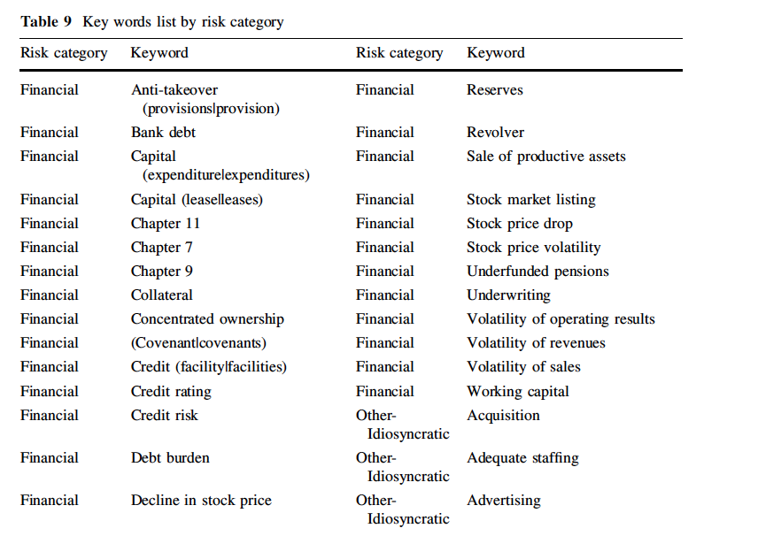
Word List for Financial Risk

Slide 11
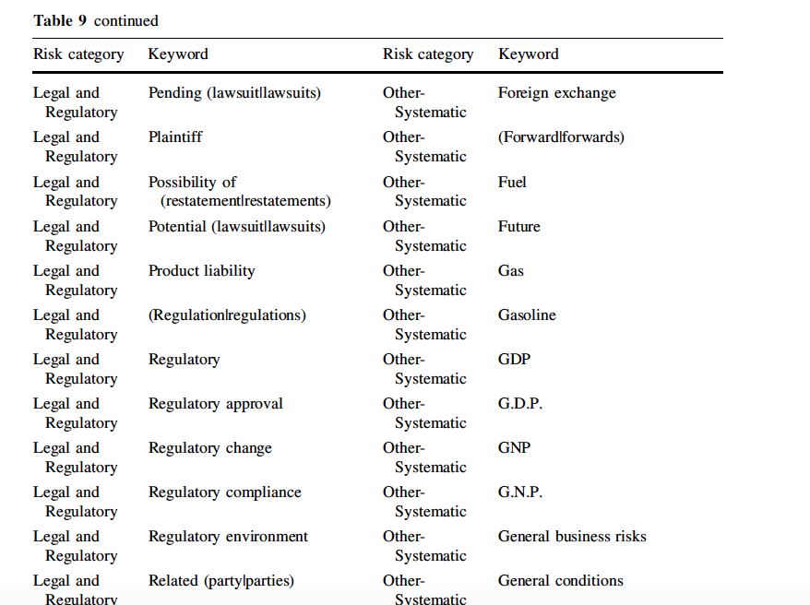
Word List for Litigation Risk

Slide 12
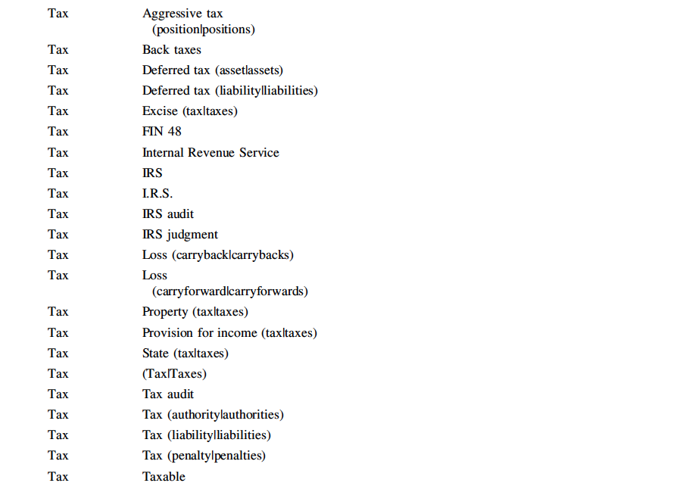
Word List for Litigation Risk

Slide 13
Textual Analysis Research
Examples (Continued)
Lee, Churyk and Clinton (Strategic Finance , 2013, p. 33)
Fraud detection model based on the textual, i.e., content, analysis of MD&A in 10-K:
Fraud_{i} = 2.89757 – 0.83408 (Positive Emmotion_{i})
– 0.48315 (Present Tense_{i})
+ .0001 (Total Words_{i})
– 2.80753(Colons_{i})
“Conventional fraud detection measures using ratio analysis and other financial data were either unable to detect the fraud or unable to detect it soon enough to avoid catastrophic outcomes”.

Slide 14
Using Nonfinancial Measures to Assess Fraud Risk
Brazel, Jones, and Zimbelman (JAR, December 2009)
This study explores whether nonfinancial measures (NFMs) to assess the reasonableness of financial performance and, thereby, help detect financial statement fraud.
Difference between financial and nonfinancial performance is significantly greater for firms that committed fraud than for their non-fraud competitors.
Notes:
This study examines whether auditors can effectively use nonfinancial measures (NFMs) to assess the reasonableness of financial performance and, thereby, help detect financial statement fraud (hereafter, fraud). If auditors or other interested parties (e.g., directors, lenders, investors, or regulators) can identify NFMs (e.g., facilities growth) that are correlated with financial measures (e.g., revenue growth), inconsistent patterns between the NFMs and financial measures can be used to detect firms with high fraud risk.

Slide 15
Measure of Competition
Li, Lundholm, and Minnis JAR, 2013, p. 399
Li, Lundholm, and Minnis (2013) develop a model to compute management's perception of the intensity of competition using textual analysis of firms’ 10-K filings.
Measure of competition varies across-industry and within-industry
It is related to the firm’s future rates of diminishing marginal returns.
This measure is based on the count of the number of words like “competition, competitor, competitive, compete, competing,” including those words with an "s" appended, less any case where "not," "less," "few," or "limited" precedes the word by three or fewer words.
PCTCOMP = 1000*NCOMP/NWORDS
where NCOMP = number of words in 10-K as described above and NWORDS = Total number of words without numbers.
Notes:
Li, Lundholm, and Minnis (2013) develop a model to compute management's perception of the intensity of competition using textual analysis of firms’ 10-K filings. They find that the measure of competition varies both across-industry and within-industry, and also show that each measure is related to the firm’s future rates of diminishing marginal returns. Their measure is based on the count of the number of occurrences of words “competition, competitor, competitive, compete, competing,” including those words with an "s" appended, less any case where "not," "less," "few," or "limited" precedes the word by three or fewer words.

Slide 16
Problems with Textual Analysis
Information needed is not easily available.
Current research has depended on the manual efforts and individuals’ programming skills in Perl and Python
Not all needed information is tagged
SEC is considering requiring disclosures of important non-financial information
XBRL Technology, but not all text can be tagged
Hence the need for a good search engine that will provide flexibility to perform textual analysis
Seek iNF, the search engine developed at the University of Kansas has great potentials for textual analysis and obtaining non-financial information.

Slide 17

Anytime, Anywhere, …
SEC Filings and PCAOB Reports at your finger tips in seconds

Slide 18
Professor Michael Minnis
University of Chicago
“I’ve really appreciated working with SeekEdgar.
The flexibility and speed of both the search engine and customer service has made data collection easier and more thorough.
Finding examples for my financial statement analysis class is also a pleasure.
I recommend trying SeekEdgar for

Slide 19
Some of the World’s Top Subscribers
University of Chicago
Georgetown University
New York University
Washington University in St. Louis
Yale University
City University of Hong Kong
Indian Institute of Management at Ahmadabad
Sogang University, Seoul, Korea
University of Amsterdam
Netherlands, University of New South Wales, Australia,
University of Sydney, Australia
University of Waterloo, Canada

Slide 20

Four Dimensions
Search: Specific Issues/Concerns
Obtain: Data not available
Perform: Textual Analyses
Download: All Searched Data

Slide 21
Power Features
Boolean Logic with multiple phrases (words like ‘a’, ‘in’, ‘if’, ‘no’, ‘of’, etc.)
Proximity Search two words within any number of words
Display Few words before & Few words after a Phrase/word
Compare (Cosine similarity metric and Word Variation)
Counters Multiple phrases, words, and sentences
Proximity Counter with Order Two words within few words with order
Built in Readability Metrics (Six readability indices)

Slide 22
Database Consists of
17 Million Filings and 33 Million Documents
(SEC Filings & PCAOB Reports)
1994-2018, daily updated

Slide 23
Cloud Technology
Use your iPad or iPhone
to query the system
Get results in seconds

Slide 24
No software
No programming
Don’t waste your time Learning programming! Use that time to be creative!
Search by Paragraph, Table, Footnote, MD&A, Audit Report, and SOX 404 Reports
Search by Specific Exhibits, Conference Calls, Shareholders Letter, and Press Releases

Slide 25
Unique Data Sets
Subsidiaries database
(Who owns who)
by year, by country, along with their addresses

Slide 26
Unique Data Sets
Conference calls transcripts
who said what?
(23 years with daily updates)

Slide 27
Unique Data Sets
Company specific information for the years 1994-2017 from 10Ks such as:
  CIK, Company Name, Business Address, Mailing Address,
  Filing Date,
  Date/Time Accepted,
  Period of Report,
  IRS No.,
  State of Incorporation,
  Fiscal Year End

Slide 28
Unique Data Sets
File Analyses for all 10Ks for 22 years (1994-2017):
  Word Count, Word Count without Numeric, Total Number of Sentences, and six readability indices.
Database based on Forms 3, and 4.
Compensation and Executive Bios from Form 424Bs for the years 2003-2017.

Slide 29
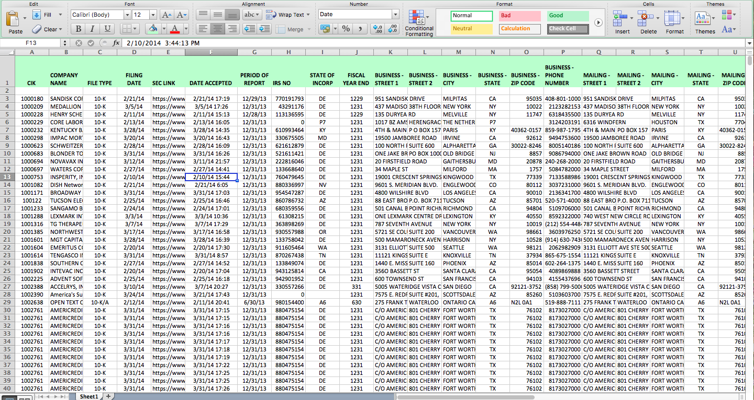

Slide 30
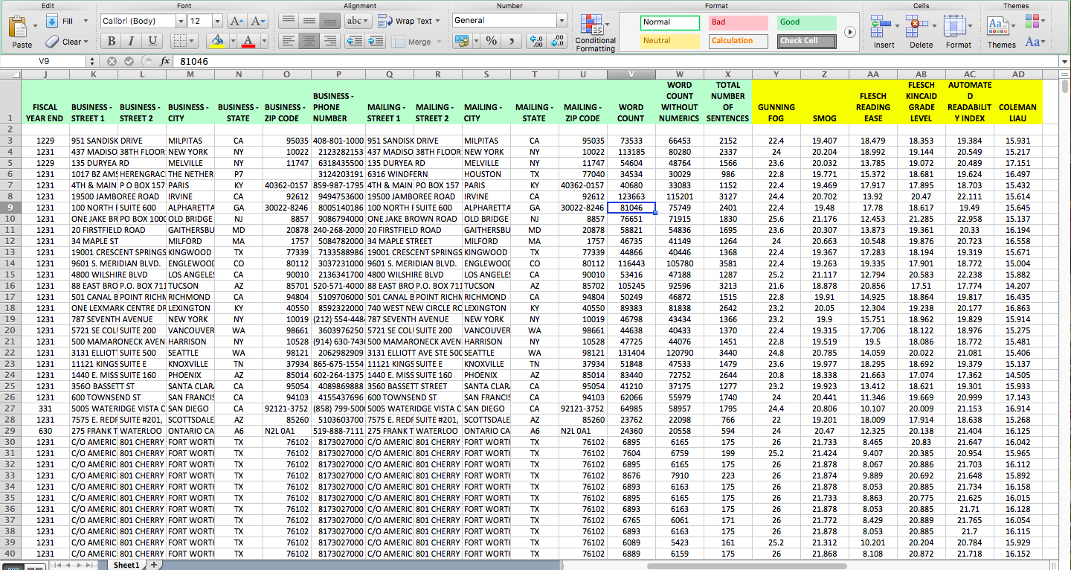

Slide 31
Unique Data Sets
Many more in Progress
(Keep in Touch)

Slide 32
Some Examples!

Slide 33
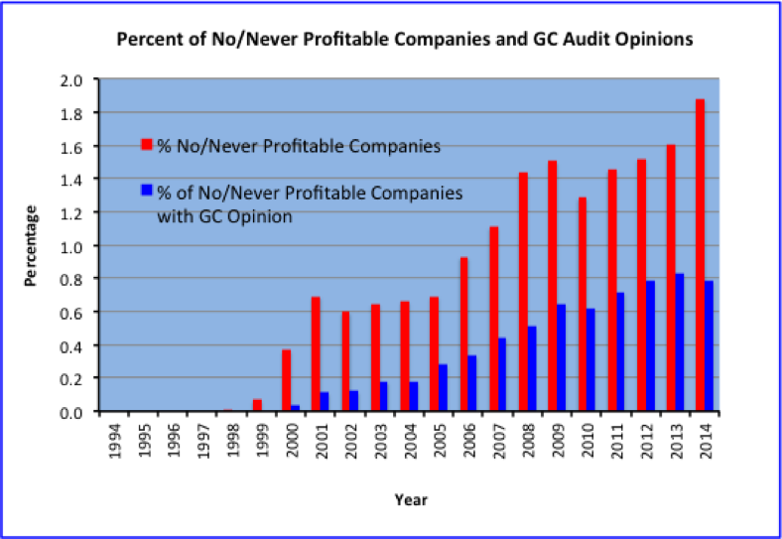
“We may never become profitable”
with GC Opinions by Year

Slide 34
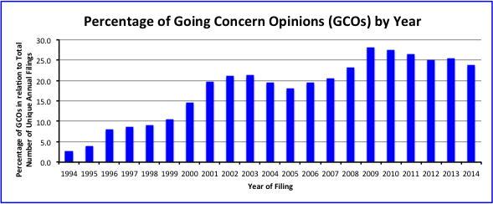
Example: Graph of Going Concern Opinions by Year

Slide 35
Executive Compensation
Executives Bios
Any Specific Data

Slide 36
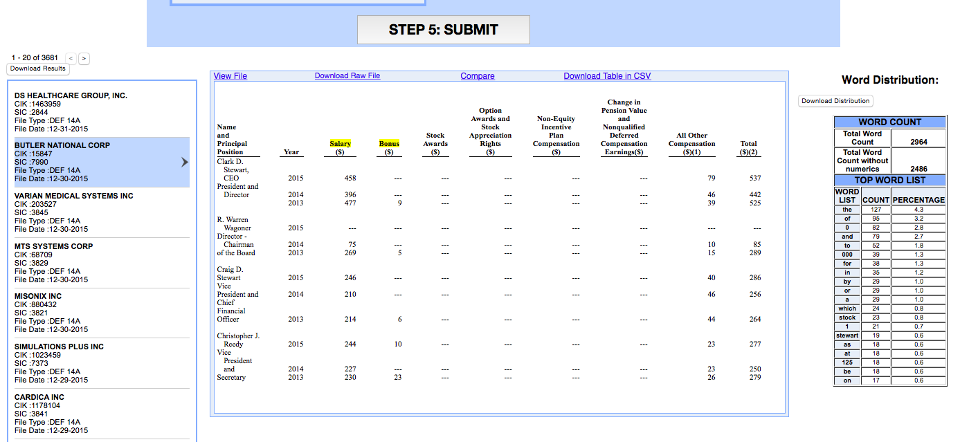
Executive Compensation Tables from DEF 14A

Slide 37
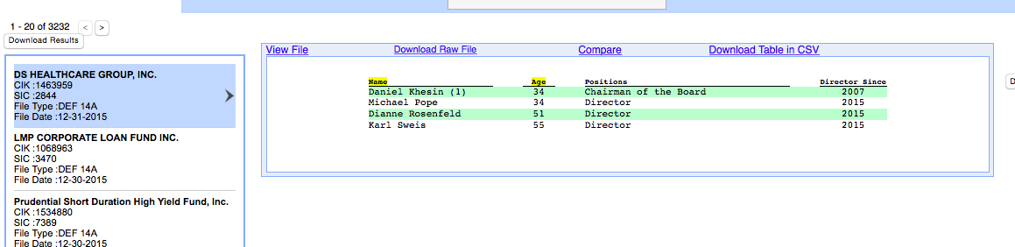
Executive Bios

Slide 38
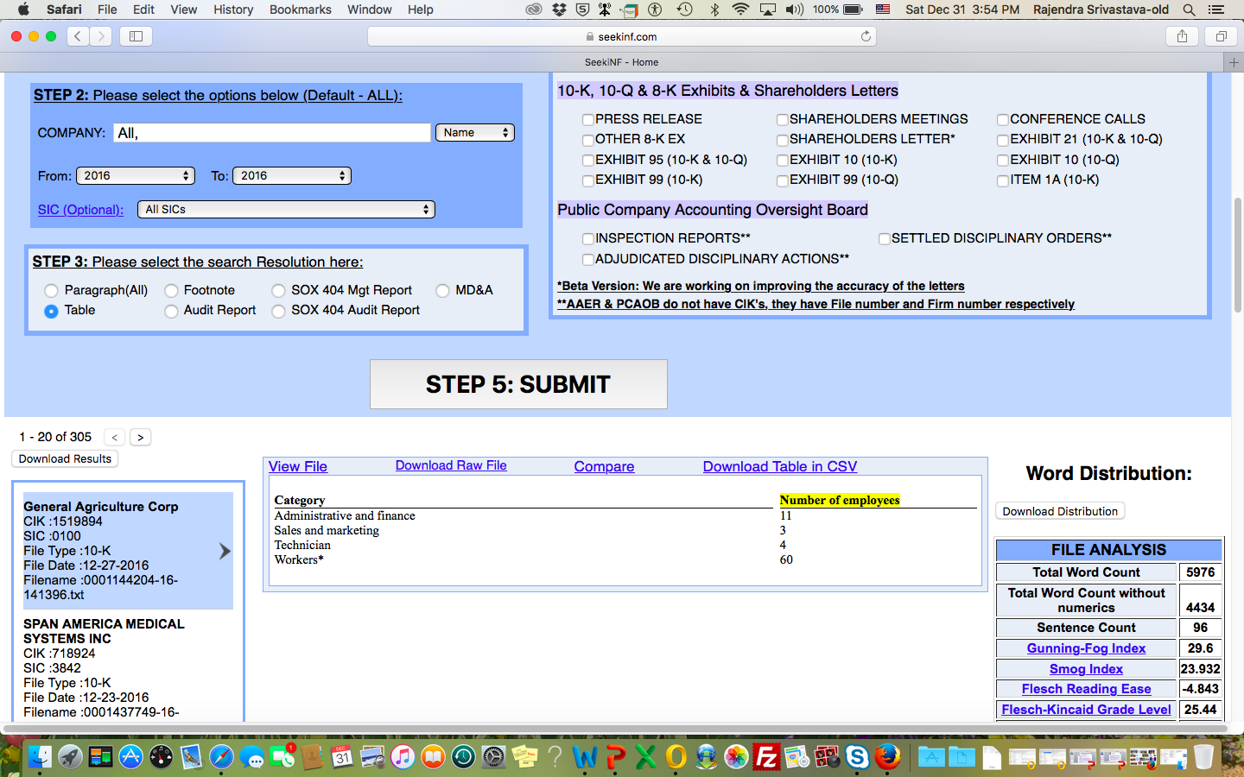
Number of Employees
From 10K

Slide 39
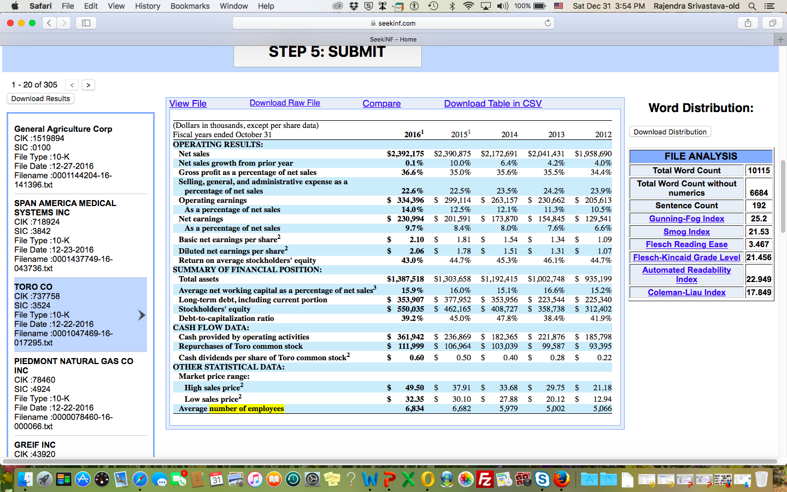
Number of Employees
From 10K

Slide 40
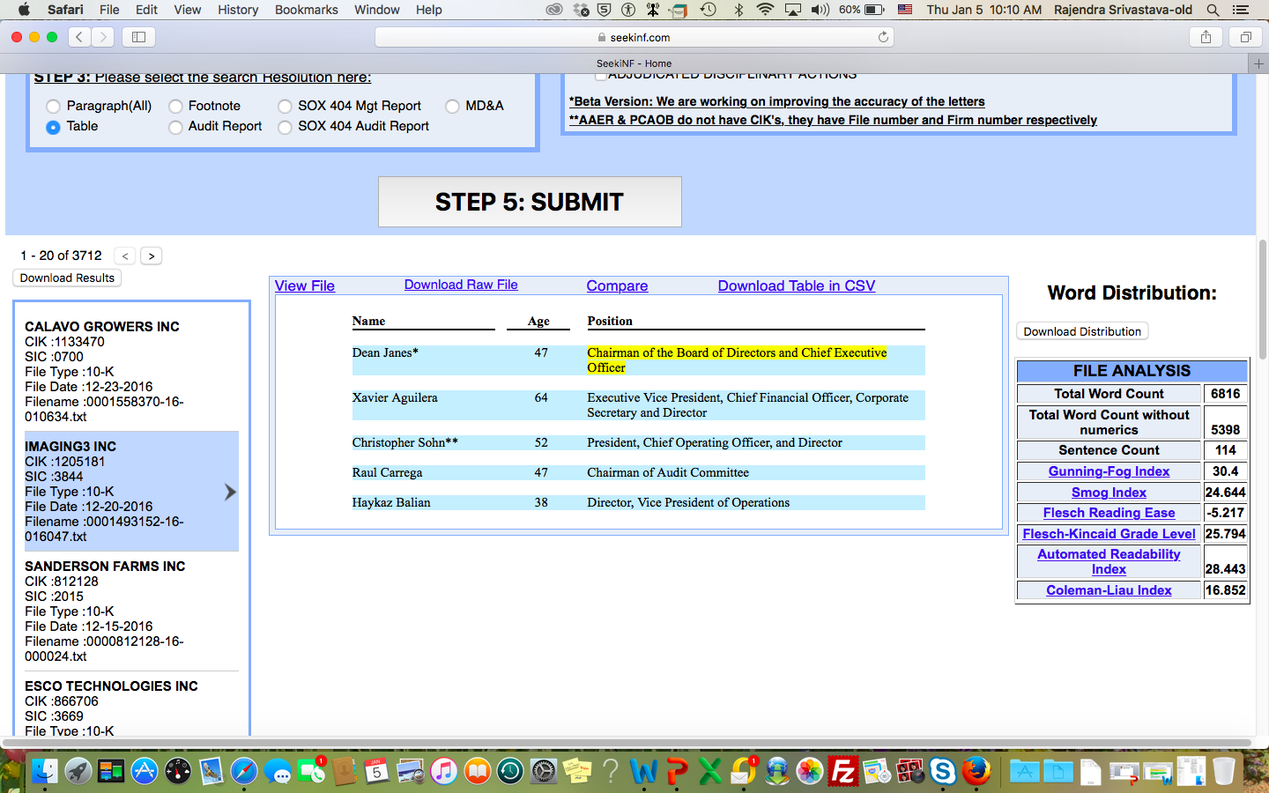
CEO and Chairman of the Board of Directors

Slide 41
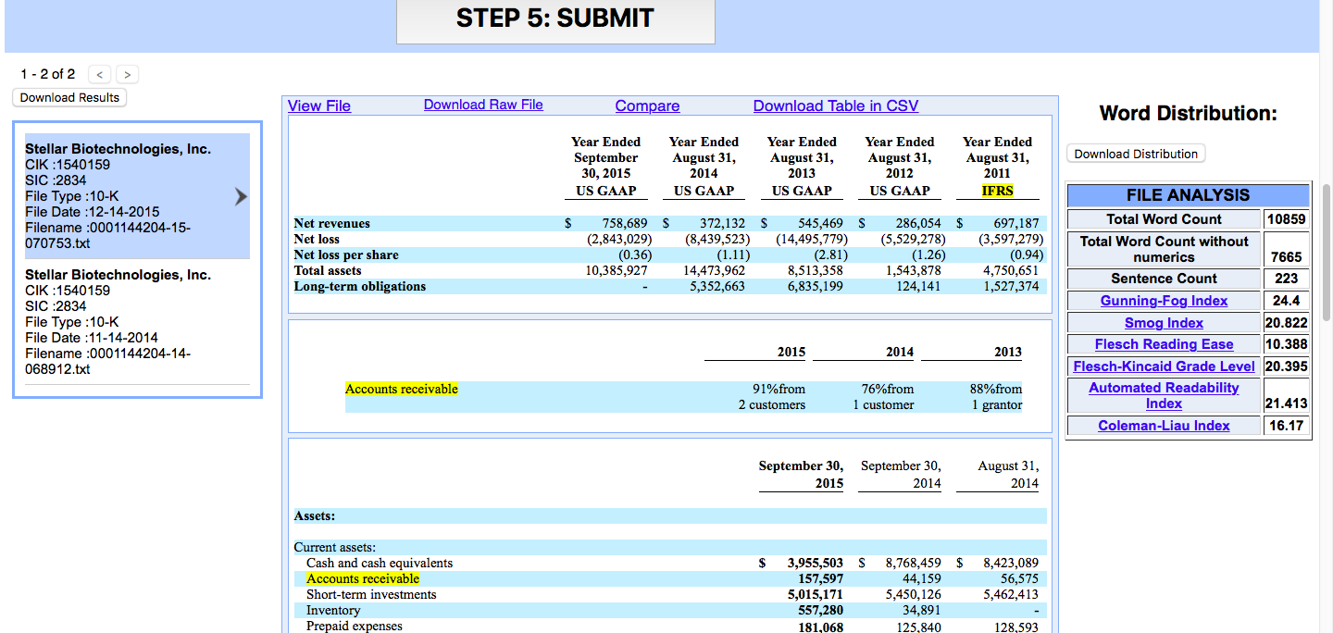
IFRS in US Companies

Slide 42

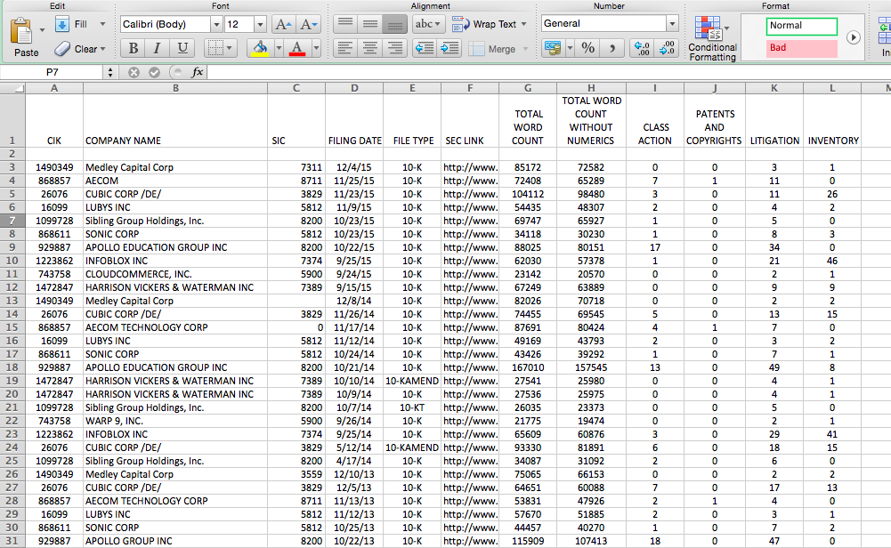
Multiple phrases/words Counts in a document

Slide 43
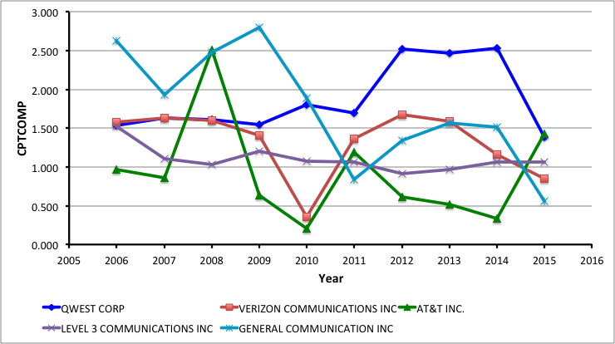
Competition Metric for Five companies for 10 years

Slide 44
Example: Readability Indices for Satyam and WIPRO
Satyam Textual Analysisç
Year | 2008 | 2007 | 2006 | 2005 | 2004 | 2003 | 2002
Total Word Count | 81258 | 85673 | 80785 | 58473 | 67858 | 70837 | 259828
Total Word Count without numerics | 74833 | 79145 | 74881 | 54641 | 60675 | 63526 | 227833
Sentence Count | 2642 | 2770 | 2575 | 1966 | 2175 | 2368 | 5770
Gunning-Fog Index | 21.6 | 21.6 | 21.6 | 20.8 | 20.8 | 20.4 | 20
Smog Index | 18.666 | 18.762 | 18.73 | 18.459 | 18.394 | 18.18 | 13.618
Flesch Reading Ease | 21.777 | 21.777 | 22.212 | 22.893 | 22.92 | 23.236 | 51.699
Flesch-Kincaid Grade Level | 17.281 | 17.344 | 17.411 | 17.001 | 17.014 | 16.704 | 16.962
Automated Readability Index | 17.759 | 17.819 | 17.908 | 17.316 | 17.383 | 16.964 | 13.404
Coleman-Liau Index | 14.439 | 14.357 | 14.145 | 14.2 | 14.239 | 14.386 | 0.293
WIPRO LTD
Year | 2008 | 2007 | 2006 | 2005 | 2004 | 2003 | 2002
Total Word Count | 93966 | 99464 | 96763 | 101922 | 87781 | 75005 | 120396
Total Word Count without numerics | 85584 | 90570 | 88177 | 93798 | 78915 | 66793 | 104844
Sentence Count | 3624 | 3894 | 3865 | 4080 | 3511 | 3290 | 4656
Gunning-Fog Index | 19.2 | 19.2 | 18.4 | 18.8 | 18.4 | 17.6 | 18.4
Smog Index | 17.059 | 16.935 | 16.644 | 16.797 | 16.625 | 16.004 | 16.688
Flesch Reading Ease | 28.928 | 28.956 | 30.938 | 30.24 | 30.684 | 32.505 | 30.451
Flesch-Kincaid Grade Level | 15.113 | 15.017 | 14.628 | 14.771 | 14.579 | 13.785 | 14.629
Automated Readability Index | 15.082 | 15.012 | 14.573 | 14.709 | 14.397 | 13.423 | 14.471
Coleman-Liau Index | 14.04 | 14.182 | 13.916 | 13.97 | 13.9 | 14.05 | 13.959

Slide 45
Example: Graph of Readability Indices for Satyam and WIPRO

Slide 46
Example: Graph of Readability Indices for Satyam and WIPRO

Slide 47
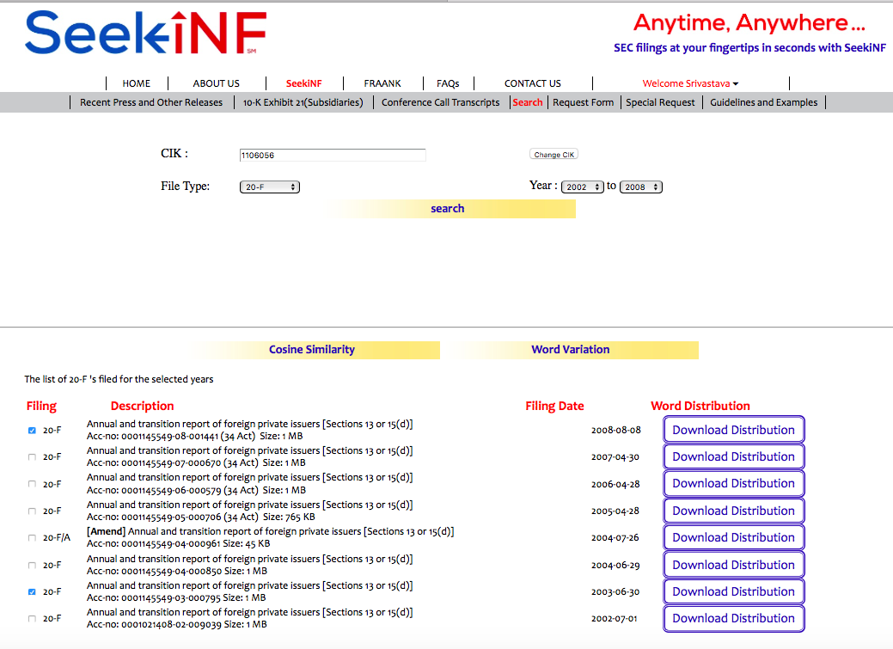
Example: Compare

Slide 48
Example: Cosine Similarity
Measure Data for Satyam and WIPRO
Once your click on the Compare button after selecting the two years filings, the system will yield the result in a CSV file which you can open and save in Excel. Repeating this process for each pair, (2003, 2008), (2003, 2007), (2003, 2006), (2003, 2005), (2003, 2005), and (2003, 2004), I obtained the following data.
Cosine Similarity Scores 20F |  | File 1 VS File 2
Satyam | CIK | 2008 VS 2003 | 2007 VS 2003 | 2006 VS 2003 | 2005 VS 2003 | 2004 20F/A VS 2003 | 2004 VS 2003
 | 1106056 | 0.986219031 | 0.986518731 | 0.986687789 | 0.983219142 | 0.884167909 | 0.995569951
WIPRO | CIK | 2008 VS 2003 | 2007 VS 2003 | 2006 VS 2003 | 2005 VS 2003 | 2004/A VS 2003 | 2004 VS 2003
 | 1123799 | 0.992107956 | 0.993143381 | 0.993785122 | 0.992941528 | 0.802915992 | 0.996115982
The following data was obtained by rearranging the above data. See the next slide for the plots
Year | Satyam Cosine Measure | WIPRO Cosine Measure
2008 | 0.986219031 | 0.992107956
2007 | 0.986518731 | 0.993143381
2006 | 0.986687789 | 0.993785122
2005 | 0.983219142 | 0.992941528
2004 | 0.995569951 | 0.996115982
2003 | 1.0 | 1.0

Slide 49
Example: Graph of Cosine Similarity
Data for Satyam and WIPRO

Slide 53
Example:
Word Variation Year-to-Year

Slide 54
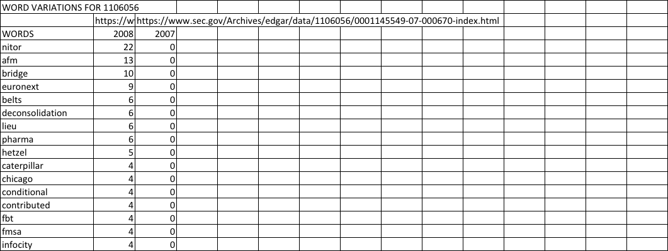
Example: Word Variations
Year-to-Year for Satyam and WIPRO
New Words in 20-F of 2008 that were not present in 20-F of 2007 for Satyam
Words in 20-F of 2008 that are not present
in 20-F of 2007 for Satyam

Slide 55
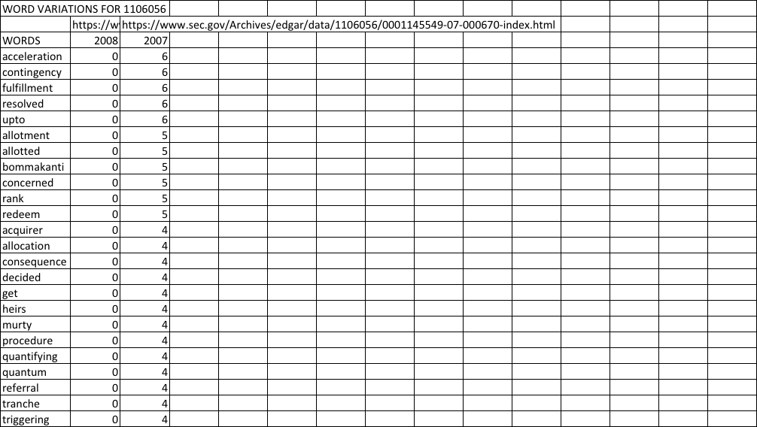
Example: Word Variations
Year-to-Year for Satyam and WIPRO
Words absent in 20-F of 2008, but were present in 20-F of 2007 for Satyam
Words in 20-F of 2007 that are not present
in 20-F of 2008 for Satyam

Slide 56
Please send me a note at resrivastava@seekedgar.com for ID and Password

Slide 57
Hands on Exercise
Cosine Measure for Satyam for 2004, 2005, 2006, 2007 w.r.t. 2003
  Go to https://www.seekedgar.com
  Log-in using ID = cpacanada@gmail.com
  Password = SeekEdgar.CPA
  Go to Cosine Measure site by typing “a|the” without quotes in Step 1
  Step 2: Type Satyam Computer Services LTD
  Step 3: Paragraph (all)
  Step 4: Select 20F, Step 5: Submit
  Select “Cosine Similarity/Word Variation” from the top/middle of the display window

Slide 58
Example: Cosine Similarity
Measure Data for Satyam and WIPRO
Once your click on the Compare button after selecting the two years filings, the system will yield the result in a CSV file which you can open and save in Excel. Repeating this process for each pair, (2003, 2008), (2003, 2007), (2003, 2006), (2003, 2005), (2003, 2005), and (2003, 2004), I obtained the following data.
Cosine Similarity Scores 20F |  | File 1 VS File 2
Satyam | CIK | 2008 VS 2003 | 2007 VS 2003 | 2006 VS 2003 | 2005 VS 2003 | 2004 20F/A VS 2003 | 2004 VS 2003
 | 1106056 | 0.986219031 | 0.986518731 | 0.986687789 | 0.983219142 | 0.884167909 | 0.995569951
WIPRO | CIK | 2008 VS 2003 | 2007 VS 2003 | 2006 VS 2003 | 2005 VS 2003 | 2004/A VS 2003 | 2004 VS 2003
 | 1123799 | 0.992107956 | 0.993143381 | 0.993785122 | 0.992941528 | 0.802915992 | 0.996115982
The following data was obtained by rearranging the above data. See the next slide for the plots
Year | Satyam Cosine Measure | WIPRO Cosine Measure
2008 | 0.986219031 | 0.992107956
2007 | 0.986518731 | 0.993143381
2006 | 0.986687789 | 0.993785122
2005 | 0.983219142 | 0.992941528
2004 | 0.995569951 | 0.996115982
2003 | 1.0 | 1.0

Slide 59
Thanks!!
Questions?

