Slide 1

Your project name here
Project Kick-off
Date

Slide 2


Agenda
PROJECT OVERVIEW
LESSONS LEARNED

Slide 3
Project overview

Slide 4

Project Purpose
Project Purpose

Slide 5

PROJECT DELIVERABLES
Project Deliverables

Slide 6

PEOPLE
Executive Sponsors (if applicable)
Name
Sponsors
Name
Steering Committee (if applicable)
Name

Slide 7
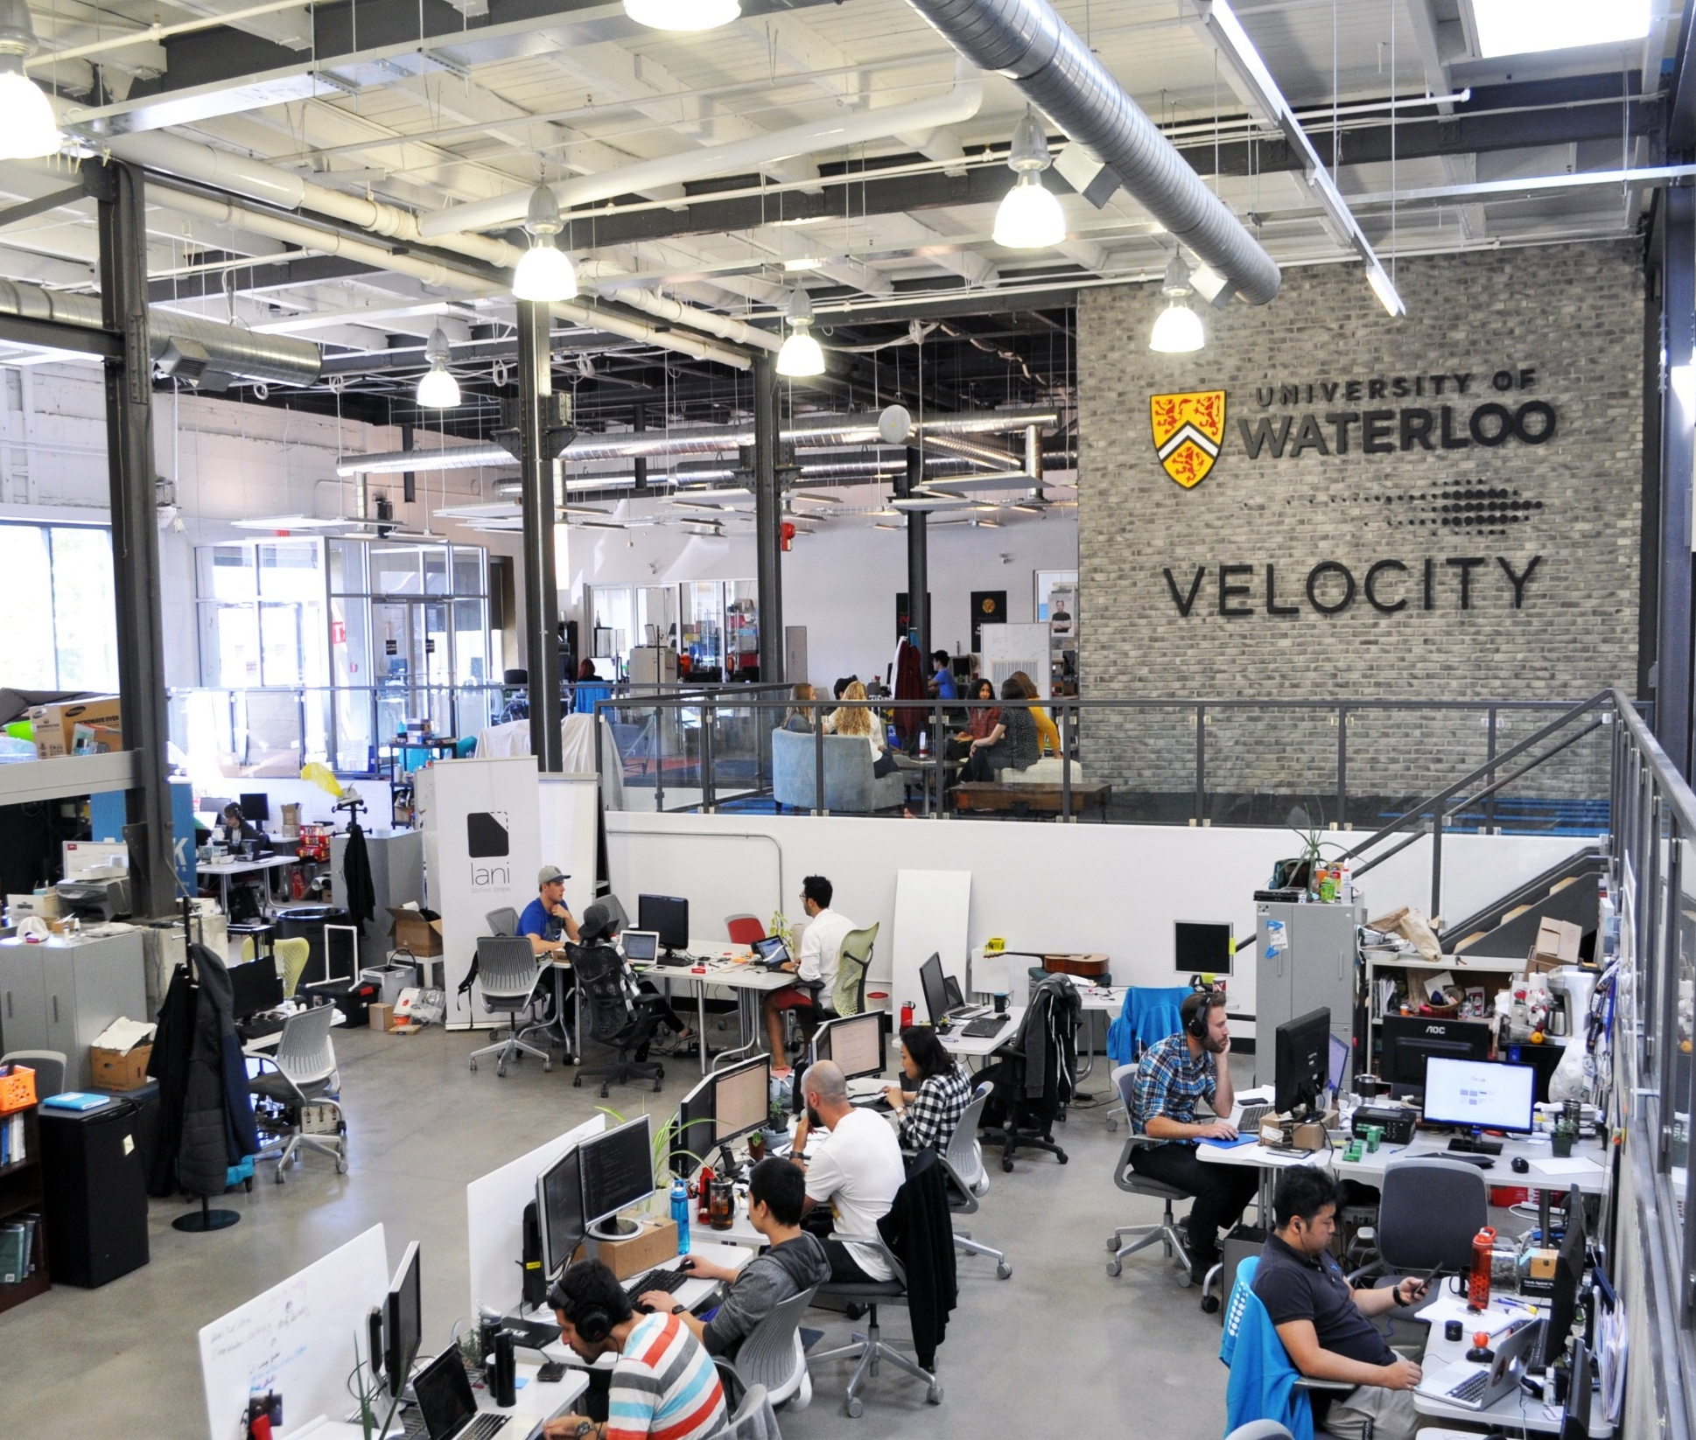
PEOPLE
Project Team
Name

Slide 8

PEOPLE
Project Team – continued (if applicable)
Name

Slide 9
TIMELINE & PROJECT DELIVERABLES
Milestones | Start Date | Completed On

Slide 10

Project Outcome
Key Highlights
Brief summary of the project's outcome in terms of time, budget, scope, and success criteria, presented in point form.
This is a summary slide to also transition to the next slides to provide more details on the success criteria

Slide 11
Values Reflected in This Project
Think Differently
Act with Purpose
Work Together
Home | Values | University of Waterloo
11

Slide 12
PROJECT SUCCESS CRITERIA
Point forms or table forms listing all the criteria (met/not met)
Insert graphs if applicable
Duplicate this slide for multiple project success criteria result update

Slide 13
Lessons Learned

Slide 14
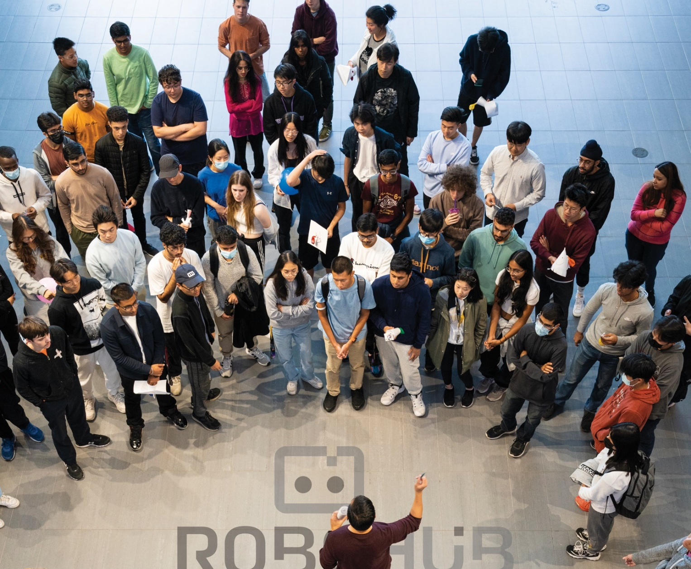
Lessons Learned Collection Process
Describe how was the data collected and how many provided feedback

Slide 15

LESSON LEARNED – What went well
description

Slide 16

LESSON LEARNED – What was challenging
description

Slide 17

LESSON LEARNED – opportunities for improvement
description

Slide 18

What Actions will we take?
Optional topic. Suggested content for this slide:
Summary of the transition plan for the team to continue work without the PM. Often with process improvement project.
Steps to take to leverage the lessons learned.
Tasks need to follow up/require planning in future

Slide 19
What went well
People
description
Process
description
Technology
description
Other
description

Slide 20
What was challenging
People
description
Process
description
Technology
description
Other
description

Slide 21
opportunities for improvement – Next x days (if applicable)
People
description
Process
description
Technology
description
Other
description

Slide 22
opportunities for improvement
People
description
Process
description
Technology
description
Other
description

Slide 23

thank you!
PAGE 23

Slide 24
Canada’s Innovation University

