Slide 1
University of Waterloo
VISUAL IDENTITY REFINEMENT
Communications and Public Affairs
Web Advisory Committee Meeting
December 18, 2012
Presented by:
Ellen Réthoré
Christine Goucher

Slide 2
Refining the Visual Identity
Not again!
But why?
Notes:
2

Slide 3
The current situation - where are we now?

Slide 4
Where are we now?
2008 – Positioning & Identity work
Broad consultation/active working group
Findings informed a new positioning
A sense that other than the ‘attribute’ words, positioning not implemented
Lack of institutional key messages
Notes:
4

Slide 5
Where are we now?
2008 – Positioning & Identity work
Visual Identity
    University identity limited to new wordmark
    Introduced a Faculty colour palette
    Various design ‘languages’
Lacked an Identity Framework
    a clearly defined system for the institution
Notes:
5

Slide 6
Where are we now?
Today
Highly fragmented identity
Nine core ‘brands’ – all different
    Six Faculty ‘brands’
    Marketing and Undergraduate Recruitment
    Warriors
    Alumni
Research Centres and Institutes
Notes:
6

Slide 7

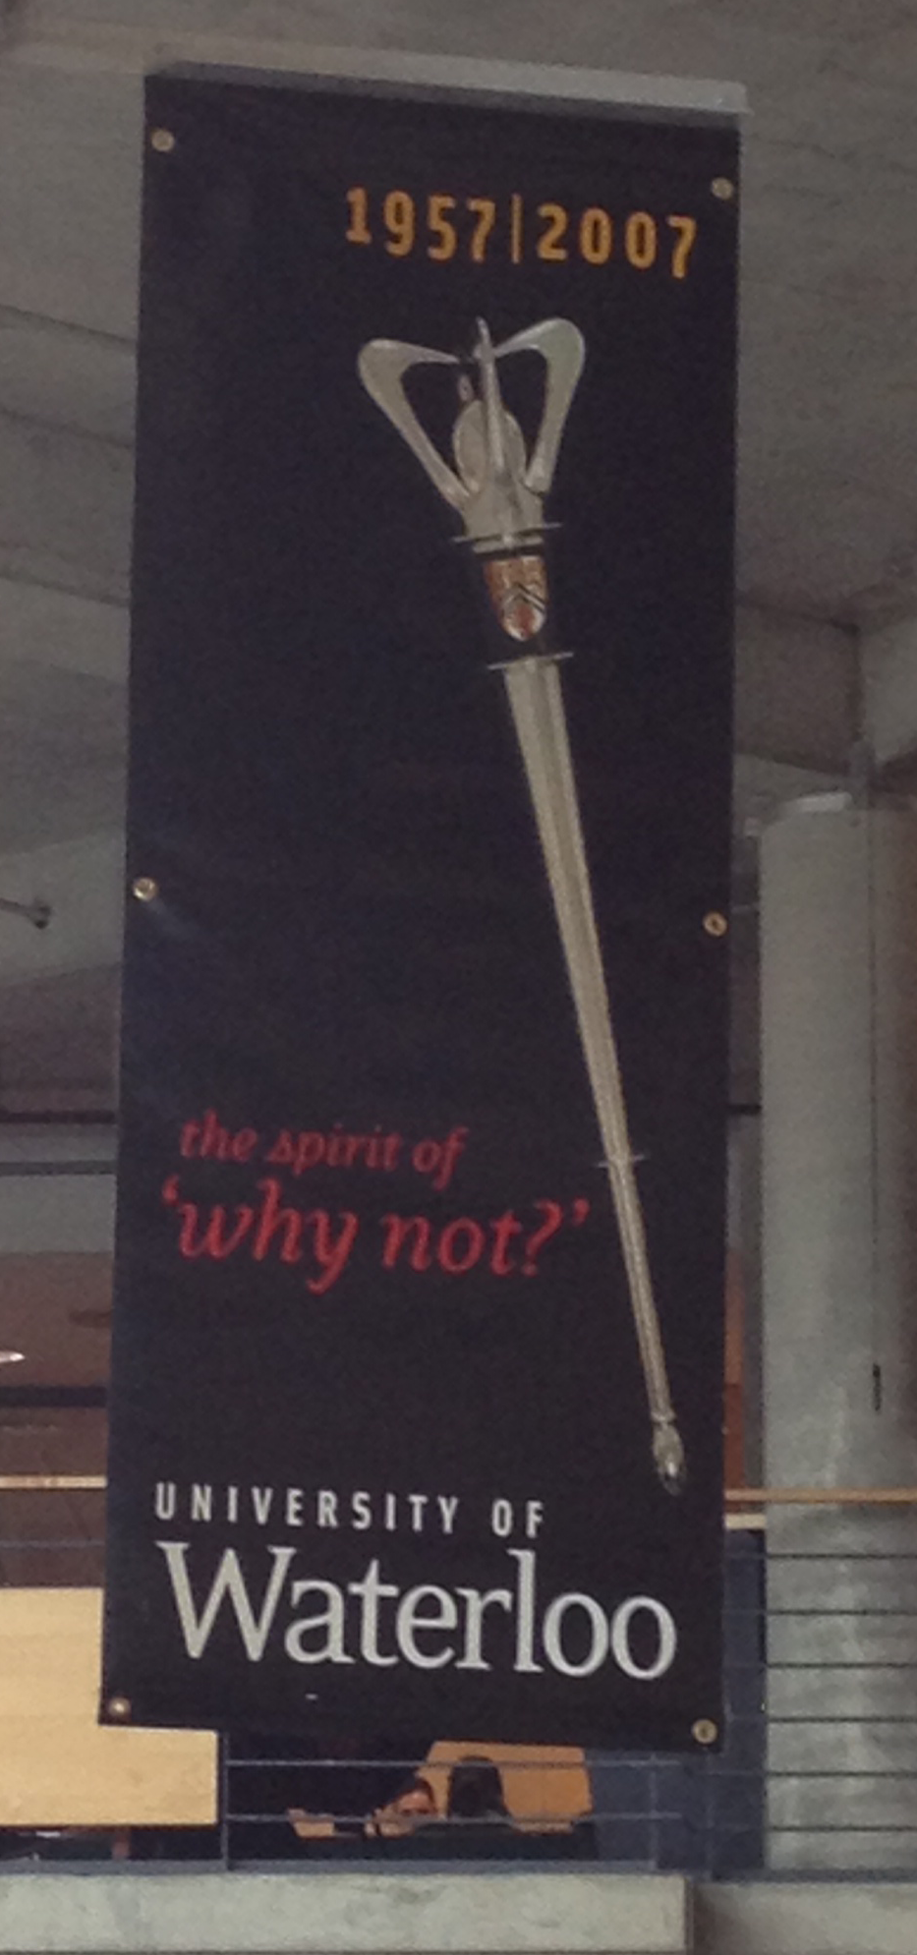
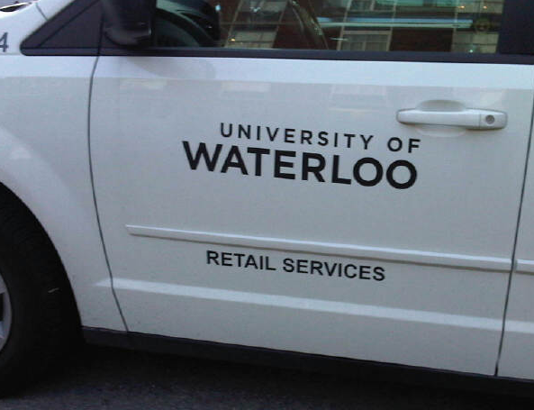
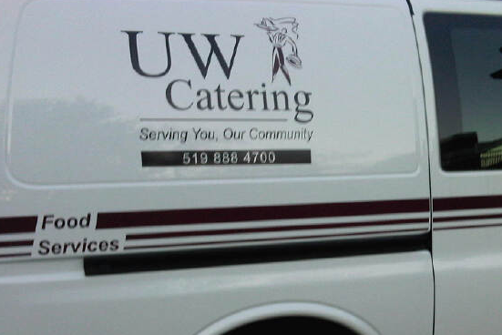
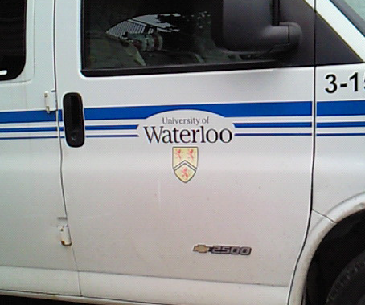
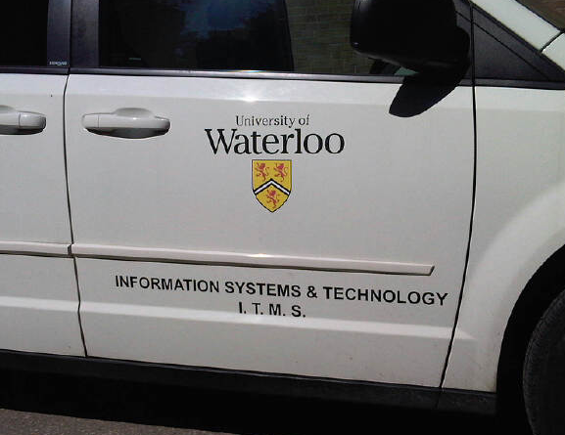



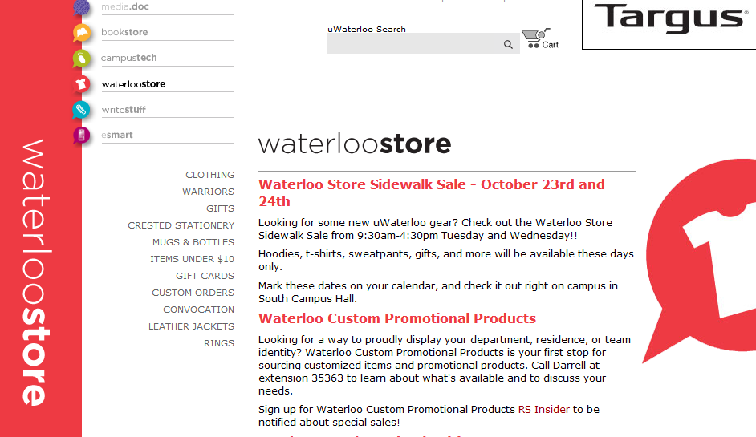
Where are we now?
Notes:
7

Slide 8
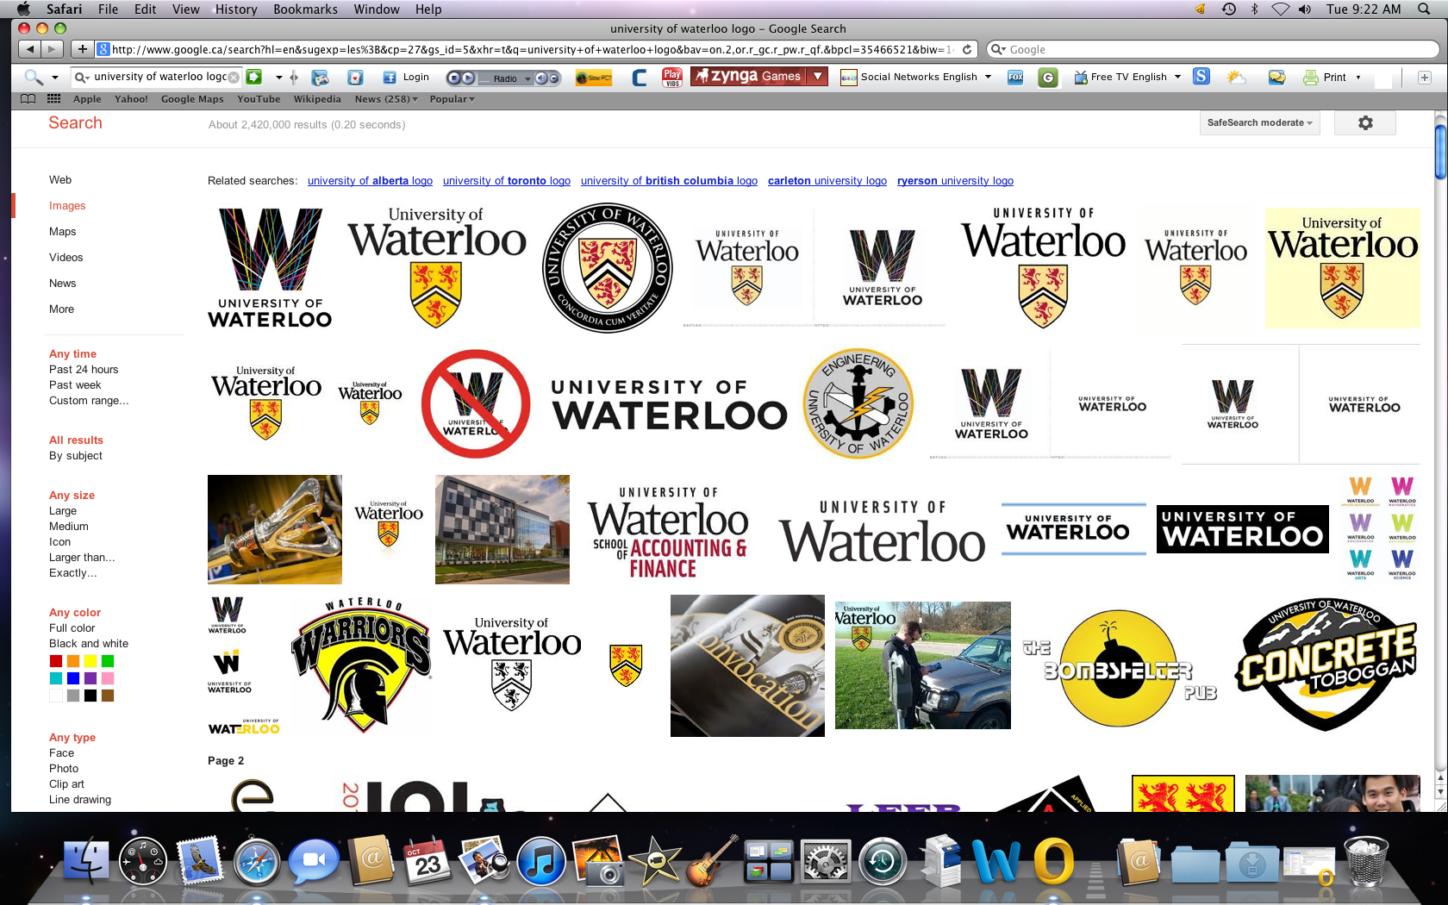
Google Search of University of Waterloo logo
  Google Image Search October 30, 2012

Slide 9
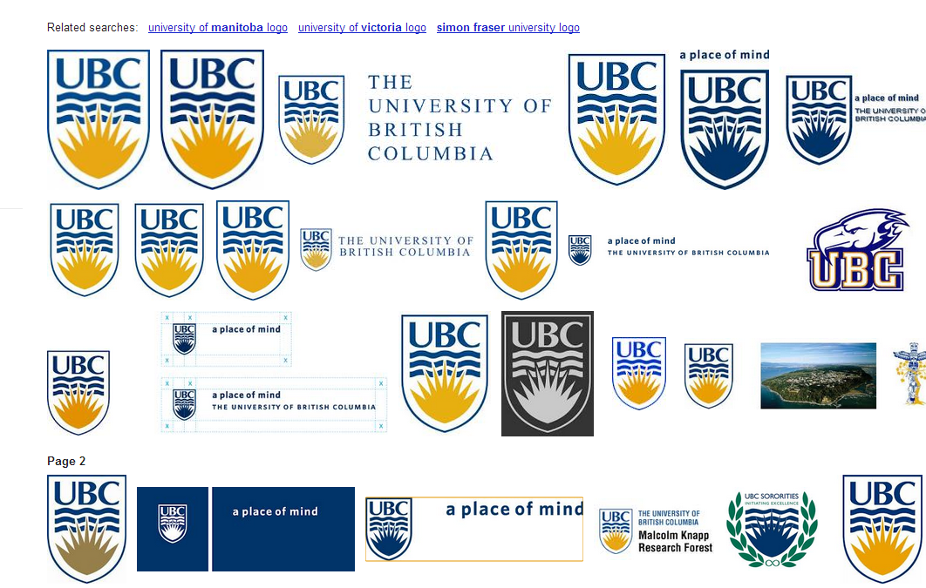
Google Search of UBC logo
  Google Image Search October 30, 2012

Slide 10



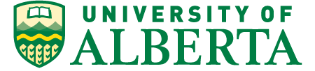



Environmental scan – current wordmark

Slide 11
Research and consultations - what do we know?

Slide 12
What do we know?
Sector analysis
Growing and international competition for the best students, faculty and staff
Increasing attention to rankings
Government and public demand for enhanced quality and accountability
‘Blurring’ between colleges and universities
Notes:
12

Slide 13
What do we know?
Mid-cycle Review consultations – 2011/12
Enabling goal - increase visibility and outreach
    “increase promotion of uW by communicating what we do”
    “partnerships with industry is good, and we should seek out more”
    “Create a ‘brand’ for uW that is recognized nationally and internationally”
    “better marketing of uW outside of Canada”
Notes:
Over 3,400 participants
Of the five enabling goals identified, one was to increase uW’s visibility and outreach
Highest ranked comment in terms of feasibility and importance was ‘increase promotion of uW by communicating what we do’
Second highest – increase partnerships with businesses, universities and organizations
13

Slide 14
What do we know?
Diploma redesign student feedback - 2011
Comprehensive process of consultation
Students selected a traditional diploma
Notes:
14

Slide 15
What do we know?
Ipsos Quantitative Research - 2008
uWaterloo is among the 10 most visible universities in Canada but sits in 6th position
Audiences have some familiarity with uWaterloo but lack any in-depth knowledge
All audiences tend to hear more about other Canadian universities
Profile is much higher in Ontario than the rest of Canada
Notes:
15

Slide 16
What do we know?
Ipsos Quantitative Research – 2008
  uWaterloo is best known for its programs, specifically ENG, Math, CS and Co-op
  Recognized as the most innovative university in Canada
  Image is of “dynamic, making a difference, innovative, connected”
  Shares or leads other universities in “seeking to make a difference in society; well connected to industry”
Notes:
Shares or leads other universities in “seeking to make a difference in society; well connected to industry” (where uW substantially outdistances U of T and McGill).
16

Slide 17
What do we know?
National Reputation Rankings
2012 Maclean’s results
#1 - most innovative (21 years)
Slipped from first to third place…
    Best overall
    Leaders of tomorrow
Notes:
17

Slide 18
What do we know?
International Rankings – vs. year ago
ARWU/Shanghai (no reputational component)
    198 – essentially flat over last five years
QS (reputation weighted 50%)
    Dropped from 160 to 191
THE (reputation weighted 33%)
    Dropped from 212 to 249
Notes:
18

Slide 19
What’s ahead?

Slide 20
What’s ahead?
Digital implications
“By 2014 most web browsing will take place from a mobile device, casting desktop browsing in the same category as landlines, music CD’s and TV without TiVo.”
Source: US Department of Health and Human Services - 2012
Notes:
Slide 20 – Mobile and Homepage Redesign
Critical to stress that we now have a homepage that functions on mobile devices
Critical to understand that we do not have a homepage tailored for mobile delivery
Expect questions on responsive design for mobile (including the homepage)
- WCMS team is conducting responsive design prototyping
- Trend is rapidly shifting to offering responsive design websites (including universities)
20

Slide 21
What’s ahead?
Digital implications
Mobile image-recognition technologies
    Google Goggles
    Identity consistency critical for search
AODA
    Accessibility for Ontarians with Disabilities Act
  Colour consistency
      across print and digital formats
Notes:
Slide 21 – Digital Considerations and Factors
Mobile Image Recognition Technologies
- It is recommended that uWaterloo have a maximum of two standard signatures: a horizontal signature, and a vertical signature.
Mobile image-recognition technologies (e.g., Google Goggles) exist which provide mobile users with organic search results associated with images in the realworld (e.g., ads in magazines, posters in subways).
To help ensure that the uWaterloo signature is associated with uWaterloo by these technologies, it is recommended to constrain the uWaterloo signature to two consistent and standard formats (horizontal and vertical).
Increased variability and lack of standard application of the uWaterloo signature can comprise the ability of these technologies to associate the image with uWaterloo and thus also fail to provide a link to the uWaterloo website.
- As with all marketing-communications, delivering a standard logo (in this case consistent horizontal and/or vertical signature) regardless of delivery vehicle (desktop, mobile) is what’s critical to the visual brand identity.
Colour Requirements and Consistency
AODA requires all publicly facing uWaterloo websites to be compliant for January 1, 2014.
The use of colour on websites is covered under AODA.
The Digital Initiatives team in CPA is reviewing the uWaterloo colour palette, and it is realized that colours in the colour palette will need to be adjusted for use on publicly facing uWaterloo websites in order to comply with AODA.
colours used in print materials will need to be adjusted as well for consistency between uWaterloo websites and print materials.
21

Slide 22
What does it mean?

Slide 23
What does it mean?
Recap of findings
Mid-cycle Review – visibility and outreach
Student feedback – traditional diploma
Ipsos research
Rankings flat or slipping
Impact of digital communications
Notes:
23

Slide 24
What does it mean?
The ‘identity’ as a strategic asset
A disciplined uWaterloo public identity
Strategically focused
Thoughtfully built
Cementing and enriching our status and reputation
Contributes to the achievement of the university’s goals
Notes:
24

Slide 25
What does it mean?
Refining the visual identity
Return of the shield
  Why?
    a universal icon for a university
Notes:
25

Slide 26







What does it mean?
Top ranked universities
QS
THE
Notes:
26

Slide 27


What does it mean?
Notes:
27

Slide 28
What does it mean?
Refining the visual identity
  Return of an official ‘signature’
    Shield + wordmark = signature
  Consistency across all communications
Notes:
28

Slide 29
Official university signature - vertical

Slide 30
Official university signature - horizontal

Slide 31
Environmental scan – refined signature

Slide 32
What does it mean?
Refining the visual identity
  Working with campus…
  Development of an Identity Framework
    a university-wide system
Simplify stationery materials
Comprehensive identity guidelines
Notes:
32

Slide 33
What does it mean?
Timing
  Winter term
    Campus presentations on strategy
    Working with Dean’s Group
    Refined identity framework and guidelines
Notes:
33

Slide 34
Thank you
erethore@uwaterloo.ca
cgoucher@uwaterloo.ca
Notes:
34

