Slide 1
Student Communication Project Updates
Web Advisory Committee
November 2012

Slide 2
Overview
Updates, next steps and asks of YOU for the following projects:
Mobile Web Access & App Development
Student Portal
Open Data & Student Development

Slide 3
Mobile web accessibility
Objective: Find improvements to have an optimal user experience across all devices through:
Responsive designs
Server side enhancements
A separate mobile site

Slide 4
Mobile web accessibility
Review current state of the WCMS themes, Google Search Appliance front end, CAS authentication page etc…
All major design changes should go through A/B testing before deployment

Slide 5
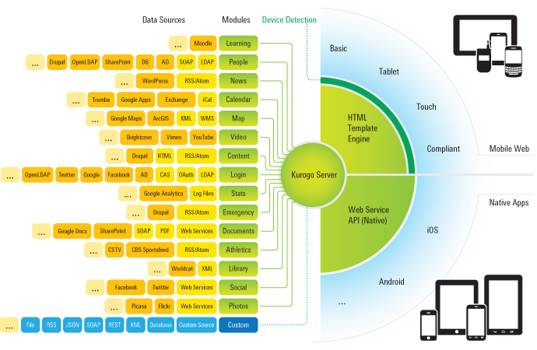
Mobile Development Platform
Objective: provide seamless mobile access to core university services and information systems
Purchase a mobile platform from a tertiary partner to provide consistent and reliable access to core services
Leverage the development platform to further objectives around opening data and fostering student-led application development
Source:
http://kurogo.org/technology/

Slide 6
Mobile Web Access & App Development
Looking for help with:
Design (layout, UI elements, mapping)
Development (HTML5, CSS, JS, Drupal)
UX (feedback on usability across devices)
Decisions on web delivery vs. app delivery
Content creation & governance
Quality assurance and testing
RFI Review (app development)

Slide 7
Student Portal
Currently contacting other institutions to find out more about their portals and how they get feedback from students
Portals vary greatly in functionality between institutions

Slide 8
Student Portal
Have started a basic Drupal prototype
HTML5 Boilerplate base theme
Mobile-first responsive approach
Prototype to include emergency warnings, user profiles, event feeds, basic UI elements

Slide 9
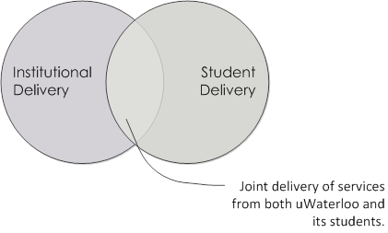
Open Data & Student Development
Objective: Engage students in meaningful development opportunities that enhance the quality of technology on campus
Reduce barriers to starting and sustaining student-led projects
Build a developer repository to foster access to data and awareness of student development

Slide 10
Open Data & Student Development
Looking for help with:
Championing open data in relevant areas
Use cases to inform data and desired formats
Identifying and assessing impact of data sources
Creating resources for development community
Reducing barriers to student development

Slide 11
Working Groups
Portal: meets biweekly (even weeks) for 1hr.
Mobile: meets biweekly (even weeks) for 1hr.
Open Data: meets biweekly (odd weeks), cross campus group with broader community participation

