Slide 1
Using Conditional Rulesets in the WCMS
Jamieson Cox
Communications Specialist, WatPD
Notes:
Hi everyone! I’m Jamieson, I’m from WatPD, and I’m going to talk to you about a new WCMS additive feature we’ve worked on called conditional rulesets

Slide 2
Overview
How we got here
What were our goals?
How conditional rulesets work
Sample use cases
  Find your EDGE quiz tool
  Ready for Co-op? pilot project
How can you use them?
Notes:
Here’s a brief overview of what I’ll cover this afternoon

Slide 3
How did we get here?
Initial idea: create a quiz to help students understand the EDGE certificate
Started working on quiz tool during Spring 2017 term (partnership with IST)
First version of quiz tool pushed to production in September 2017
Presented at WAC in October 2017
Conditional rulesets pushed to production in April
Notes:
We started working on this idea because we wanted to help students understand how they could move through the EDGE certificate. EDGE can be completed in many, many different ways, and it can be confusing at first glace. We wanted to create a quiz where students would be shown paths based on their interests and values
The work began last Spring term when we partnered with IST on hiring a co-op student, Edward. IST helped with his hiring and training, and we were responsible for evaluation and management. We worked together throughout the term and ended up bringing Edward back for a second work term in Winter 2018
We finished the first version of the quiz tool (everything hard coded) in September and asked WAC for feedback and ideas in October. Since then, we’ve been working hard on creating a standardized version of the tool, and this version (a.k.a. conditional rulesets) was pushed to production in April. And now we’re back here!

Slide 4
What were our goals?
Targeting multiple web forms per site
Customizing components and results
Theming confirmation page
Generalized PDFs
Making ruleset creation more like conditionals (i.e. easier)
Notes:
Before I run through the rulesets, I want to review what our goals were last time we spoke to WAC.
We wanted to be able to target multiple web forms per site instead of just having one “quiz” per site.
We wanted users to be able to customize their components (categories of results) and the look/feel of those results without needing special code for everything.
We wanted users to theme their confirmation pages however they pleased instead of working within our custom EDGE theme.
We wanted to generalize the PDFs generated by the “quiz” while still giving users the option to create their own.
And finally, we wanted to make the creation of rules more easy and intuitive. The way conditionals worked seemed like a natural fit, but we weren’t sure it would work yet.
Now that we’re back here, I’m happy to say that we achieved all of these goals in one way or another

Slide 5
How conditional rulesets work:
Ruleset categories
Default values and tokens
Conditional rulesets
Confirmation pages and theming
Notes:
So how do conditional rulesets work? There are a few concepts you need to understand because they work together to make them function. I’ll run through them now, starting with these things called ruleset categories

Slide 6
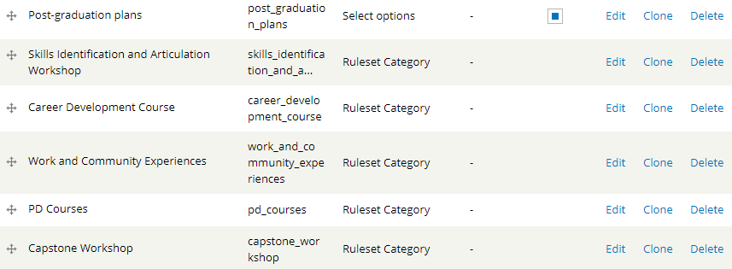
Ruleset categories
New question type
Creates “buckets” of results
Generates tokens
Must populate with
default values
Notes:
Ruleset categories are a new question type you choose when you’re creating web form components. Each ruleset category you create is like a “bucket” for potential results. What does that mean? Let’s say you’re making a quiz and you want to recommend parts of a balanced meal to someone. You could create one ruleset category for veggies, one for meat and alternatives, and one for grains, and then results would end up in those buckets based on people’s responses.
Each ruleset category you create generates tokens you can use to display the corresponding results. We’ll talk about these tokens in more detail in a minute

Slide 7
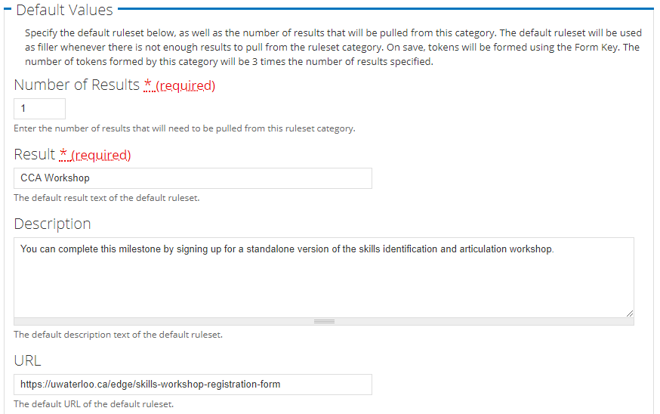
Default values and tokens
Ensures web form
works if no conditions
are met
Description and URL
are optional
Three tokens created
per result specified
  Tokens “pick” a random result from everything in the “bucket”
Notes:
One important thing to note is that you need to think of default values for each ruleset category. Why? Let’s say someone goes through your meal quiz and somehow doesn’t satisfy any of your conditions. You can’t recommend them anything. You need to have default values in place so you have some kind of baseline and the form still works

Slide 8
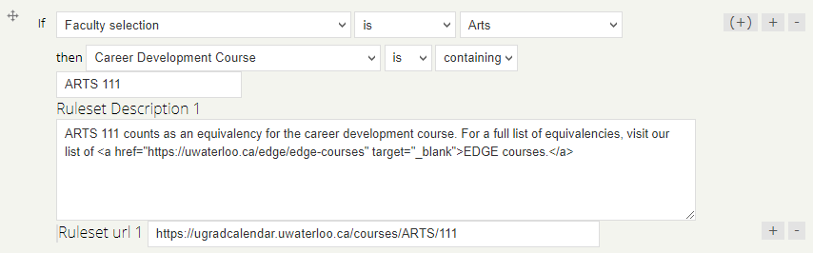
Conditional rulesets
Rules that control results
added to the “buckets”
Uses ruleset categories
and “containing”
Can use Boolean
operators
Can use basic HTML
Input affects tokens
created by ruleset categories

Slide 9
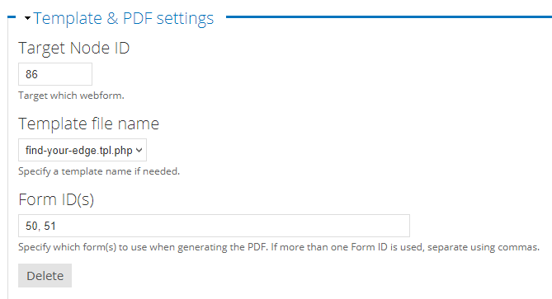
Confirmation pages and theming
Can add multiple
configurations
Can put formatting
around tokens in
WYSIWIG editor or
create custom template
Custom templates are
PHP files with associated
CSS
  Can use for styling, custom rules, specific results…
  More info in the README

Slide 10
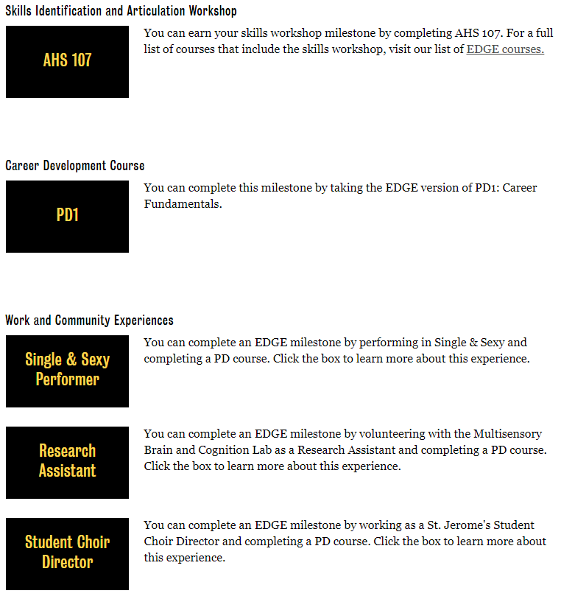
Find your EDGE quiz tool
Students answer questions about faculty/program, interests, etc.
Results suggest milestones they can use to complete EDGE certificate
Results can be refreshed or generated as a PDF
Results link out to undergrad calendar and campus websites
Nearly 300 conditional rulesets

Slide 11
Ready for Co-op?
Pilot project through Co-op and the Centre for Career Action
Goal: help improve student readiness for co-op and co-op accessibility
Two parts:
  Employability Skills Self-Assessment
  Skills Development Planner

Slide 12
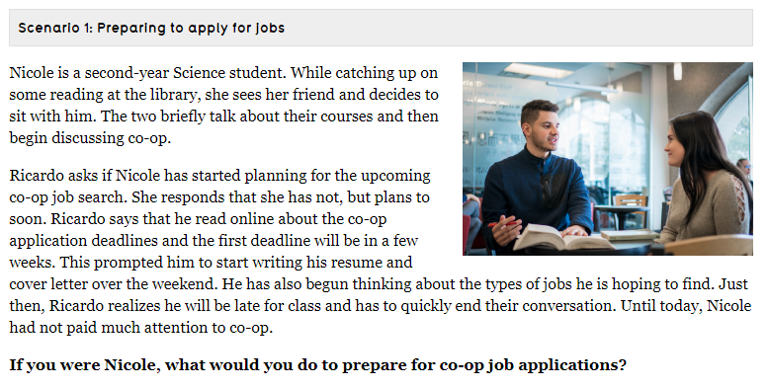
Employability Skills Self-Assessment
Students work through common
co-op scenarios and answer
questions about their skills
Results show up as an employability “scorecard” suggesting areas for improvement
Students are encouraged to look into developing their skills using resources in Skills Development Planner

Slide 13
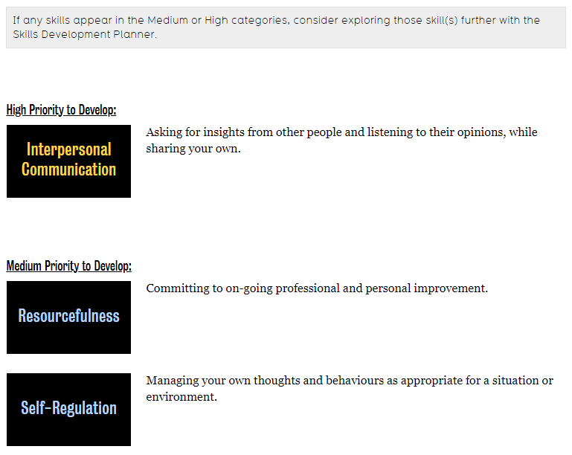
Employability Skills Self-Assessment

Slide 14
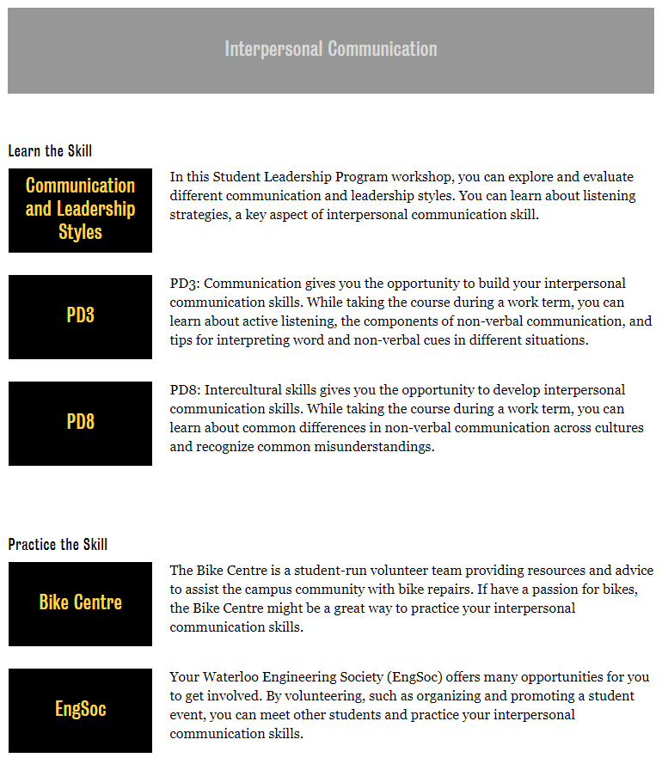
Skills Development Planner
Connects students with campus services, events, and resources aligned with employability skills
Answers customized based on faculty, international status, disability status

Slide 15
How can you use conditional rulesets?
Basic implementation:
  Use tokens generated by ruleset categories
  Format using WYSIWIG editor or basic HTML
Something more complicated:
  Create a custom results template to suit your needs
  Work with co-op students/IST/external developers
  Possible alternative to third-party quizzes
Questions? Feel free to ask us (or ask IST)

Slide 16
Thanks for listening!

