Slide 1
Graded Browser Support
Version 1.2 Q1 2014

Slide 2
Executive summary
Support does not mean that everyone gets exactly the same thing
Instead, every user should be able to consume as much as their browser can technically support
Grades give us a framework to prioritize our support
Initial scope includes all WCMS websites excluding the uwaterloo.ca homepage
A-Grade browsers are:
Chrome (latest stable desktop)
Firefox (latest stable desktop, LTS build, UWaterloo distributed)
Internet Explorer (8.0 – latest stable desktop)
Safari (latest stable desktop)

Slide 3
Purpose
To provide a broader and more reasonable definition of “support”
Introduce the notion of “grades” of support
To document our expectations of browser support for the University

Slide 4
What does “support” mean
Does not mean that everyone gets the same thing
Requiring the same experience for all creates an artificial barrier to participation
Availability and access to content should be our priority
Every user should be able to consume as much as their environment can support
Progressive enhancement

Slide 5
Progressive enhancement v. graceful degradation
Both are approaches to the engineering of “fault tolerance”
GD prioritizes presentation and permits less widely-used browsers to receive less
PE puts content at the center, allows most browsers to receive more
PE is a healthier and more forward-looking approach and a core concept of GBS

Slide 6
What are grades of support?
While an inclusive definition of browser support is necessary, the support continuum does present design, development and testing challenges
If anything goes, how do we know when the experience is broken?
To address this question and restore sense of order to the system we define “grades” of support

Slide 7
Initial Scope
WCMS websites
Excludes uwaterloo.ca homepage
Excludes authoring interface
This will change over time

Slide 8
Definition
 | X-grade | A-grade | B-grade | C-grade
Functional site | Full | Full | Enhanced | Basic
Usage | Rare | Common | Rare | Rare
Age | Modern | Modern | Modern - Outdated | Antiquated
Standards | Capable | Capable | Mostly capable | Incapable
CSS3 | Full | Full | Partial to full | Limited to partial
Support by team | None | Full | None | None
Test by team | No | Full (before release) | Not automatic | Not automatic
Bug fix by team | No | Yes (ASAP) | Yes (soon) | Maybe (when possible, if simple or hyper-critical)

Slide 9
GBS chart
 | X-grade | A-grade | B-grade | C-grade
Android | -- | -- | 4.x | 3.x and earlier
BlackBerry | -- | -- | 10.x, 7.x | 6.x and earlier
Chrome | Chrome Canary | Latest stable (desktop) | Latest stable (mobile/tablet) | --
Firefox | FireFox Nightly | Latest stable (desktop), LTS build, UWaterloo distributed | Latest stable (mobile/tablet) | --
Internet Explorer | -- | 8.0-latest stable (desktop) | 7.0, Windows RT, mobile/tablet | 6.0 and earlier, mobile
Safari | -- | Latest stable (desktop) | 6.x (desktop), iOS 7.x, iOS 6.x | 5.x and earlier (desktop and iOS)
Other | Nightly Webkit builds | -- | -- | Opera, Opera Mini, Maxthon, any others not mentioned

Slide 10
Requirement levels
X-grade | A-grade | B-grade | C-grade
No coding to specifically target X-grade browsers except for new standards-compliance or extreme circumstances | Must work without hacks (browser detection, reliance on parsing bugs) or shims; should work without JavaScript when possible; cannot require Flash | Can use shims, which may require JavaScript and/or Flash | Can use shims, but may be untested; can require JavaScript and/or Flash for certain functions

Slide 11
Special considerations
BROWSER | ISSUE | OUR SOLUTION
IE8 and below | No support for media queries | JS must be enabled for RWD experience
IE8 and below | No support for HTML5 doctype and elements | JS must be enabled (shim) reference: http://www.paulund.co.uk/turn-on-html5-in-ie8-or-lower
IE8 | Incomplete support for :before and :after (http://css-tricks.com/browser-support-pseudo-elements/) | Careful coding; shims may be available
IE7 and below | No support for :before and :after (http://css-tricks.com/browser-support-pseudo-elements/) | Careful coding; shims may be available

Slide 12
Special considerations
BROWSER | ISSUE | OUR SOLUTION
Any | To be determined (http://caniuse.com) | Careful coding; shims may be available
IE8 and below | No support for SVG | Shim or alternative content
IE7-8 | Issues with transparent PNGs and opacity | Add filter to CSS for IE7-8, see: http://www.jacklmoore.com/notes/ie-transparency-problems/

Slide 13
Analytics
For q1 2014

Slide 14
Device overview

Slide 15
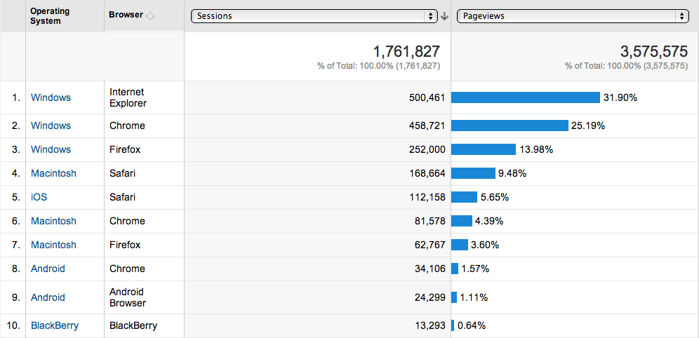
Operating system + browser

Slide 16
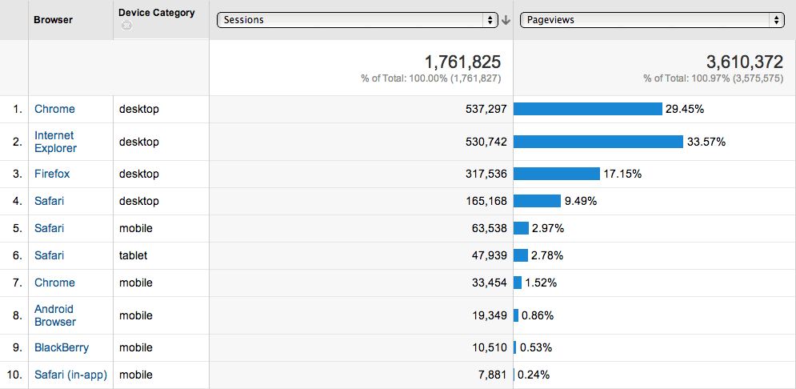
Browser + Device category

Slide 17
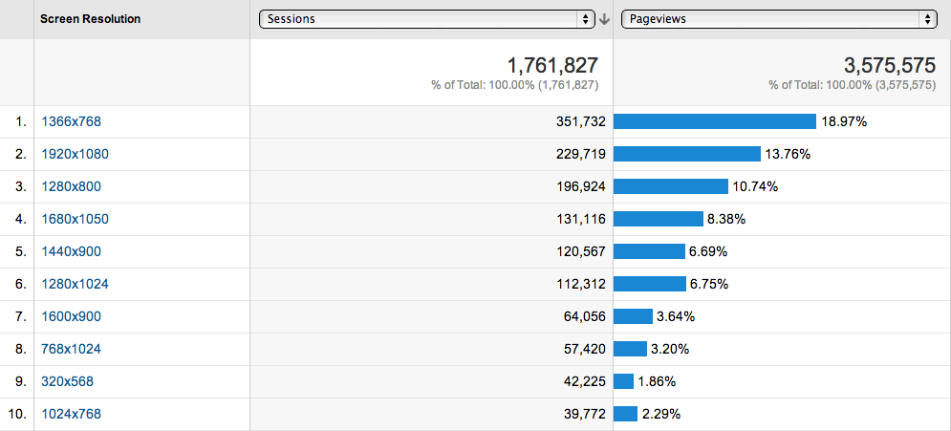
Screen resolution

Slide 18
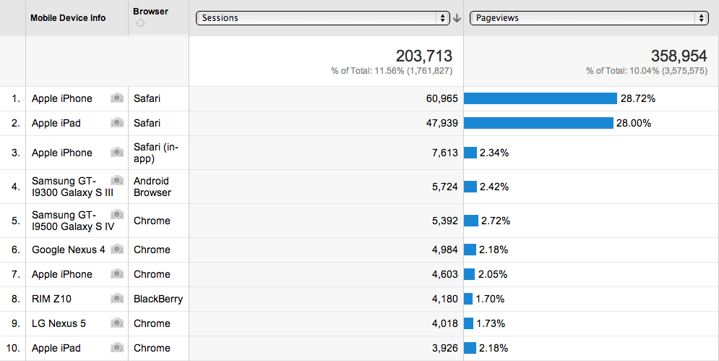
Mobile device + browser

Slide 19
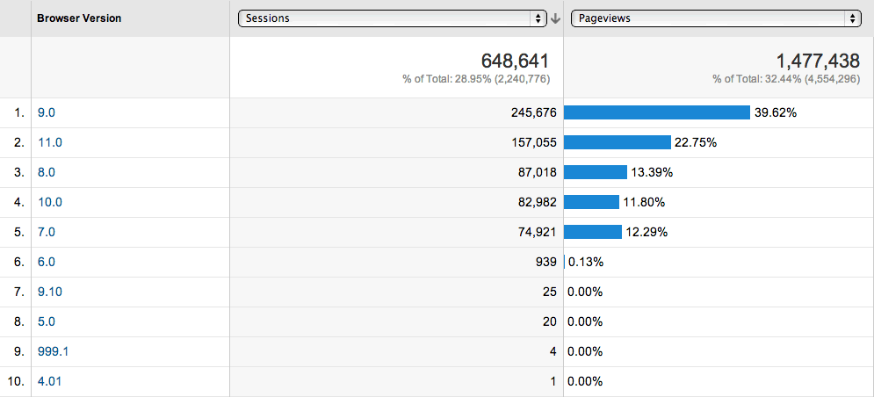
Internet explorer breakdown

Slide 20
Appendix 1 Authoring interface requirements
Much stricter requirements:
Only A-grade browsers are supported, with the exception of Internet Explorer, which is unsupported
Some aspects may require JavaScript
Creation of certain types of content is prohibited
e.g. CSS, JavaScript, iFrames

Slide 21
Appendix 2 Standards and restrictions
All system-generated code and, as much as possible, all user-entered information must meet accessibility standards (https://uwaterloo.ca/web-resources/resources/accessibility) and use semantic markup
Videos and sound must never automatically begin playing
Any pop-ups or “lightboxes” must require a click (or keyboard equivalent) to activate
Primary site navigation must never lead directly off-site
Users must always have a way to navigate within the site
No “breaking the back button”
Intro/clickthrough pages are prohibited

