Slide 1
Roles in WCMS 3

Slide 2
Role comparison
WCMS 2
Content author
  Can create and edit content
Content editor
  Can create, edit, publish, and unpublish/archive content
Site manager
  Can create, edit, publish, unpublish/ archive, and delete content
  Can assign roles
  Can do “site config” tasks
WCMS 3
Content author
  Can create and edit content
Content editor
  Can create, edit, publish, and unpublish/archive content
Site manager
  Can create, edit, publish, unpublish/ archive, and delete content

Slide 3
Role comparison
WCMS 2
WCMS 3
Site owner
  No access to content (would add one of the other roles if needed)
  Can assign roles
  Can do “site config” tasks

Slide 4
How “site owner” will work
Not assignable other than by WCMS team
Would be assigned “automatically” to site’s point of contact (POC)
POCs can request this role be assigned to others on a site-by-site basis, either permanently or with an expiry date
  Maximum of 2 additional per site unless POC provides written justification
Will be able to assign all roles previously assignable by site managers, plus the form editor role
Will be able to change which content types and related taxonomies are available to which roles
  Actions like publishing, deleting content, etc. remains limited by what is available to the role

Slide 5
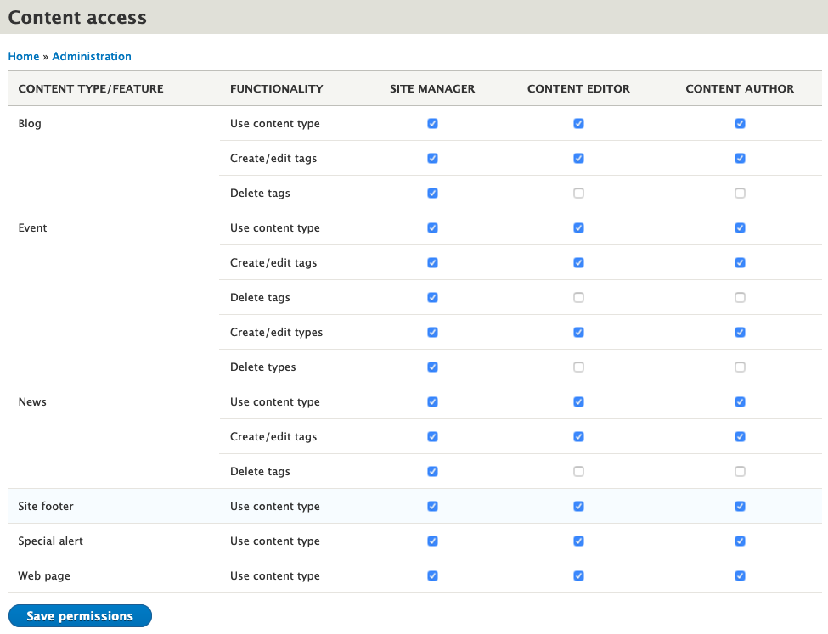
Content access form for site owners (preliminary)

Slide 6
Minor changes to default access by roles
Content editors and content authors will gain access to “home page banners”
  Previously restricted to site managers only
Content authors will gain access to “contacts”
  Previously restricted to site managers and content editors

Slide 7
Questions?

