Slide 1
WCMS Publications
Andrew McAlorum
Manager, Web Development and Support
Information Systems & Technology
University of Waterloo
519-888-4567 x41135
amcalorum@uwaterloo.ca

Slide 2
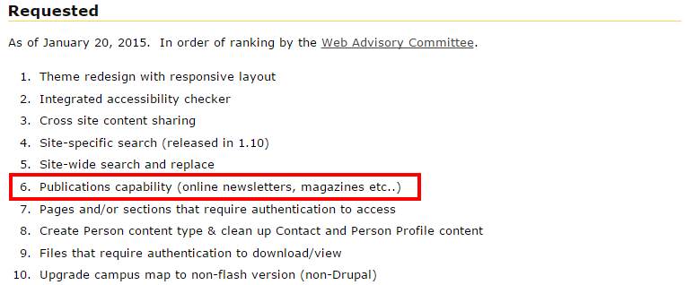
Publications capability

Slide 3
Use Cases
Magazines
Newsletters
Reports

Slide 4
Waterloo Magazine
Development of the WCMS Publications site template is based off of the Waterloo Magazine
Mobile-friendly, responsive
To be launched mid-May

Slide 5
features & Functionality
Publish digital versions of articles
Manage issues and volumes of a digital publication
Archive older issues
Publication Sections/Categories
Basic pages (editorial, about, etc.)
Featured content
Events
Image galleries
Promotional content
Social media integration
University of Waterloo branding and design

Slide 6
Timeline
Standard publication site template (May 11-29)
Pilot with Office of Advancement’s Report on Giving in June
Roll out as a service to UW in July

Slide 7
questions?
Andrew McAlorum
Manager, Web Development and Support
Information Systems & Technology
University of Waterloo
519-888-4567 x41135
amcalorum@uwaterloo.ca

