Slide 1
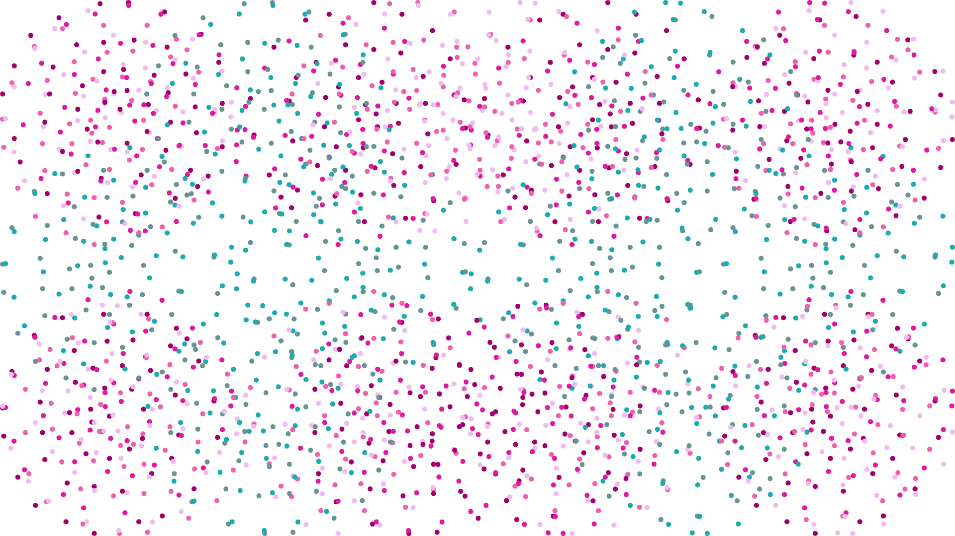
It’s Not You…
WiM - Directed Reading Program
Summer 2026
It’s Your Cluster

Slide 2

Meet The Team!
Meet the Team!

Slide 3
stellar clustering: Evaluating Clustering Methods for Reconstructing Hertzsprung–Russell Diagrams
Project by Elisa Liang
Mentors: Gaia Noseworthy, Téa Fazio
Notes:
Name, project is on [title]

Slide 4
RESEARCH QUESTION
Can unsupervised clustering of random Gaia DR3 data return a plot similar to the Hertzsprung-Russell diagram? If so, which clustering method out of K-means, DBSCAN, GMM gives the best result?
*Research performed in reference to existing GitHub projects by Amelia Robles Delgaro and Rohan Paul
Notes:
Only read question

Slide 5
RESEARCH WORKFLOW
Collect data from GDR3
Process, add features to database
Plot BP-RP colour index vs. absolute magnitude graph
Perform unsupervised clustering using each method (K-Means, DBSCAN, GMM)
Observe finalized plots and draw conclusions

Slide 6
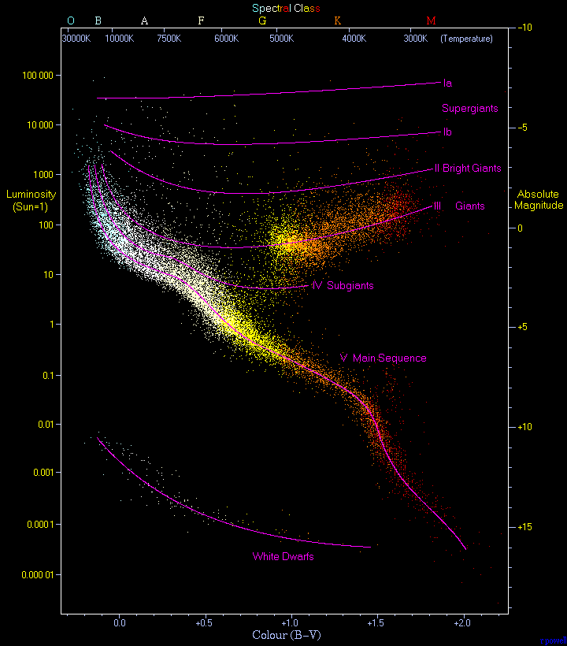
HERTZSPRUNG-RUSSELL DIAGRAM
Scatter plot of stars between absolute magnitude and colour index or spectral sequence
  Can also compare luminosity and temperature
Used to classify and investigate the evolutionary stages of stars
Example of an HR Diagram, image credit: https://en.wikipedia.org/wiki/Hertzsprung%E2%80%93Russell_diagram*
Notes:
Motivation to apply clustering – different regions of graph reveal different intrinsic stellar features, which is how unsupervised clustering groups given data

Slide 7
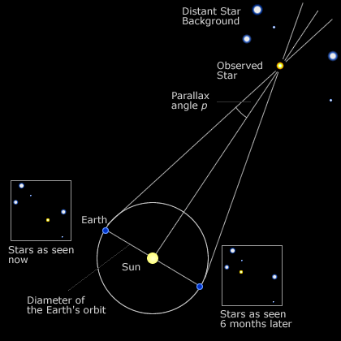
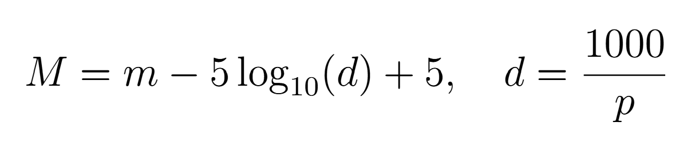
DATA PROCESSING – ABSOLUTE MAGNITUDE
Absolute magnitude – measurement of a star’s true, intrinsic brightness
Calculated using
  p = parallax and m = phot_g_mean_mag:
  d – distance to the stellar object (parsecs)
1 AU
Notes:
One of the axis
Small angle approximation
Gdr3 gives parallax in milliparsecs -> factor of 1000
Very quickly <10

Slide 8
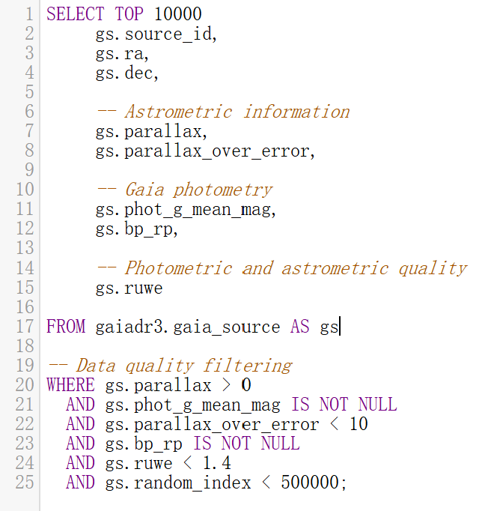
DATA ACQUISITION
Advanced (ADQL) Query from Gaia archive
Function: Pulls a random subset of 10000 stars in GDR3 that satisfies the query
Results compiled as a CSV file
Notes:
Quickly < 30
Astronomical data query language – SQL-based language used to query space databases
Click – parallax and phot_g_mean_mag used to calculate absolute magnitude
Click - bp_rp colour index is the difference in blue and red photometer that determines stellar temperatures
Click – quality filtering conditions

Slide 9
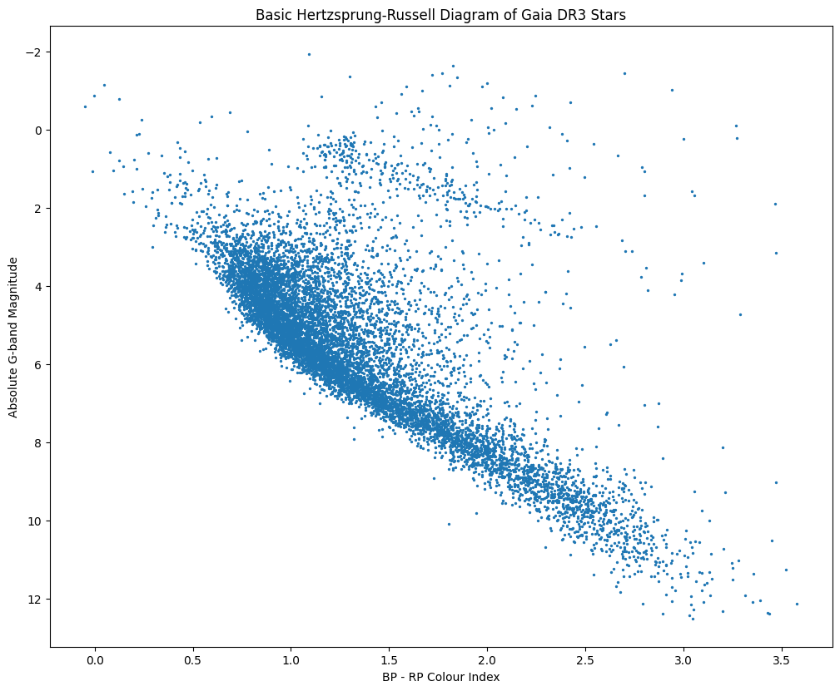
BP_RP VS. ABSOLUTE MAGNITUDE

Slide 10
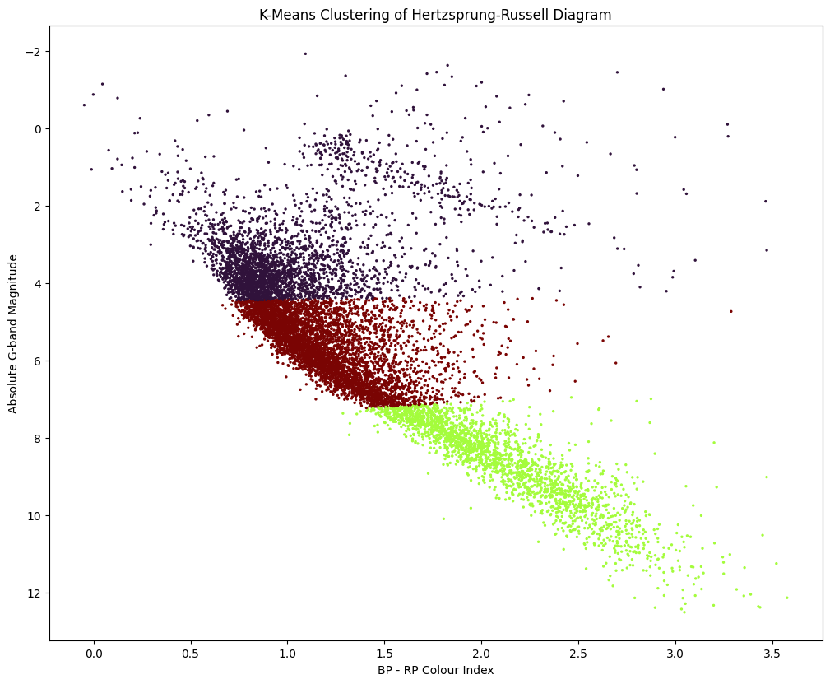
K-MEANS CLUSTERING
K-means – clusters into k distinct groups with a centroid point and Euclidean distance
Limitations – data is not circular: “straight line” divided clusters
Result – performed poorly with data; “clusters” don’t reveal significant physical groups

Slide 11
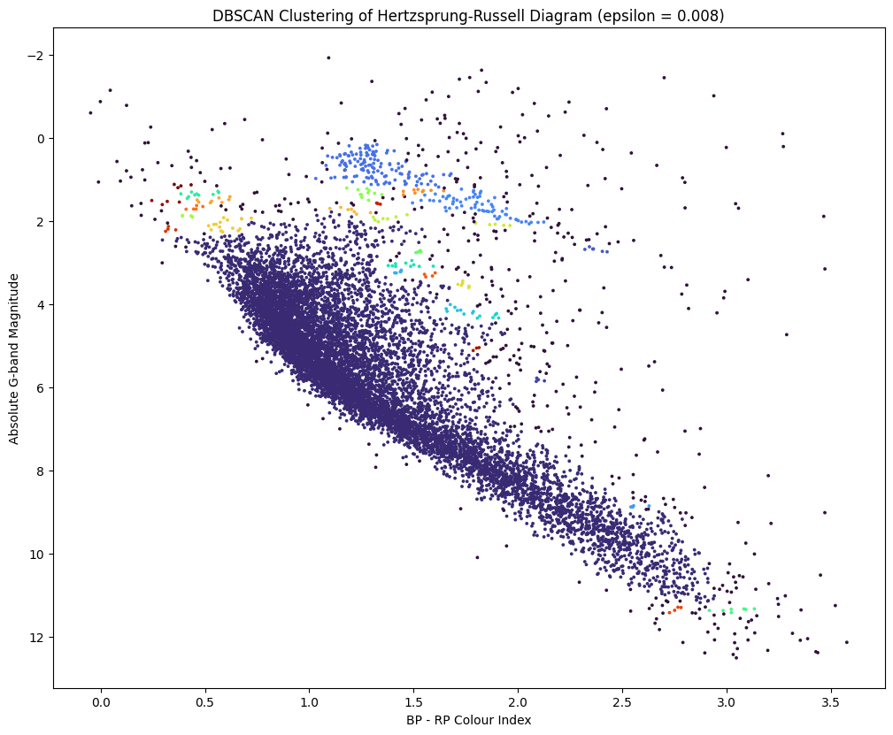
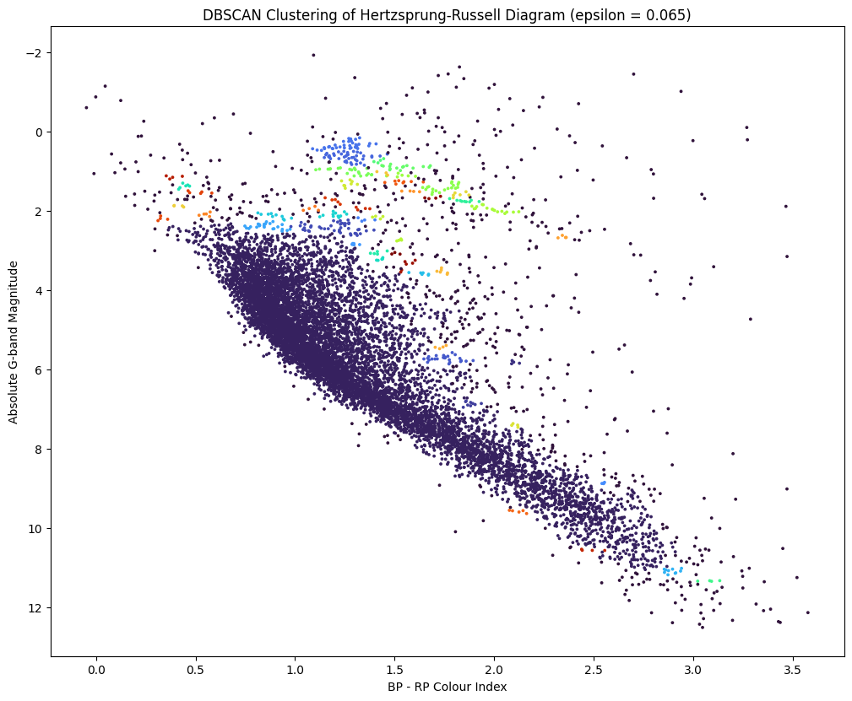
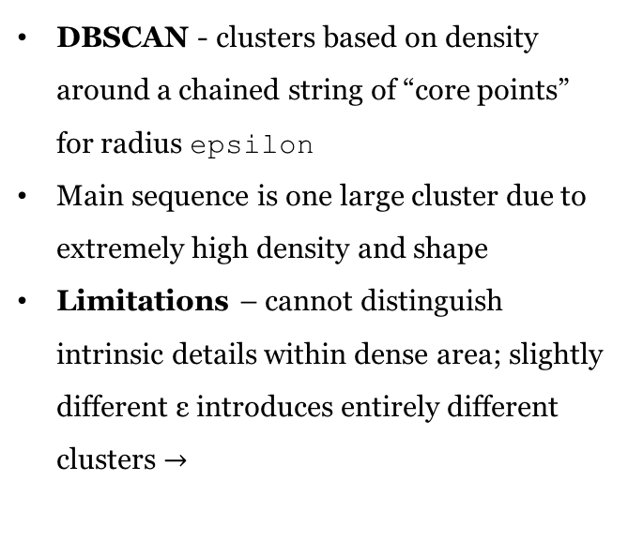
DBSCAN CLUSTERING
DBSCAN - clusters based on density around a chained string of “core points” for radius epsilon
Main sequence is one large cluster due to extremely high density and shape
Limitations – cannot distinguish intrinsic details within dense area; slightly different ε introduces entirely different clusters $→$

Slide 12
DBSCAN CLUSTERING

Slide 13
DBSCAN CLUSTERING
Results – while DBSCAN successfully captured the main sequence cluster of stars as well as different clusters above, it failed to capture further details in the highly dense area

Slide 14
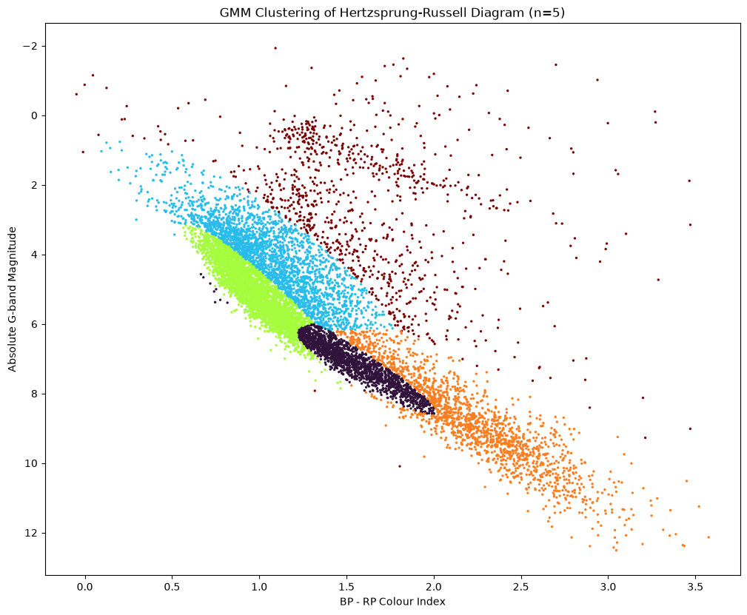
GMM CLUSTERING
GMM – clusters by modeling data as a weighted sum of n Gaussian distributions
Successfully captured intrinsic properties of main sequence stars
Limitations:
  HR diagram groups are not Gaussian; approximates clusters with ellipses
n calculated from BIC score
Notes:
Purple - solar

Slide 15
GMM CLUSTERING
Result – able to distinguish some intrinsic details in main cluster with varying accuracy due to Gaussian data assumptions

Slide 16
CONCLUSION & FUTURE RESEARCH DIRECTIONS
Based on unsupervised clustering with random Gaia DR3 data, Gaussian Mixture Modeling (GMM) gave the best result our of the three for reconstructing the Hertzsprung-Russel diagram
  GMM was able to better capture physical properties of stars instead of purely data density
Future research directions – clustering with more than 10000 stellar data; using more powerful clustering methods
Thank you!

Slide 17
REFERENCES
Amelia Robles Delgaro (ameliarbls), Gaia Hertzsprung-Russel Diagram, 2026, GitHub
Rohan Paul (rohanpauldev), Exploring Stellar Populations Using the Hertzsprung–Russell Diagram and Clustering Analysis of Gaia DR3 Data, 2026, GitHub
Xiaowei Ou, Lina Necib, Anna Frebel, Robust clustering of the local Milky Way stellar kinematic substructures with Gaia eDR3, Monthly Notices of the Royal Astronomical Society, Volume 521, Issue 2, May 2023, Pages 2623–2648
Emily L. Hunt, Sabrine Reffert, Improving the open cluster census - I. Comparison of clustering algorithms applied to Gaia DR2 data, February 2021, A&A, 646 (2021) A104
L. Lindegren, Re-normalising the astrometric chi-square in Gaia DR2, 2018, GAIA-C3-TN-LU-LL-12
Anne Helmenstine, Hertzsprung-Russel Diagram in Astronomy, Science Notes Posts, Astronomy, April 2025

Slide 18
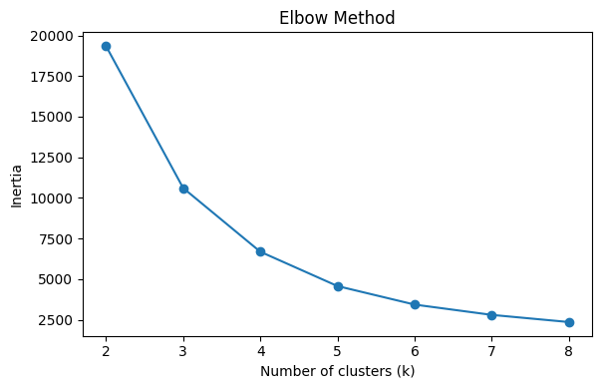
EXTRA: K-MEANS CLUSTERING – CHOICE OF K
Code from Rohan Paul’s GitHub project
Elbow method – runs K-means for range of K values and plots sum of squared distances from point to centroid (inertia)
k = 3

Slide 19
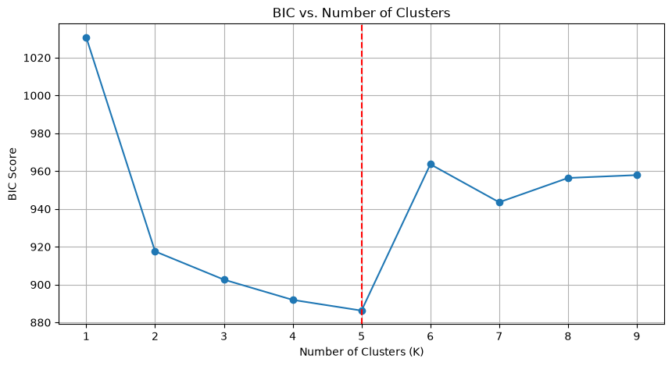
EXTRA: GMM CLUSTERING – CHOOSING N
BIC – statistical tool used to choose best model for data from range of n
Repeated trials with subsets of data revealed n=5

Slide 20
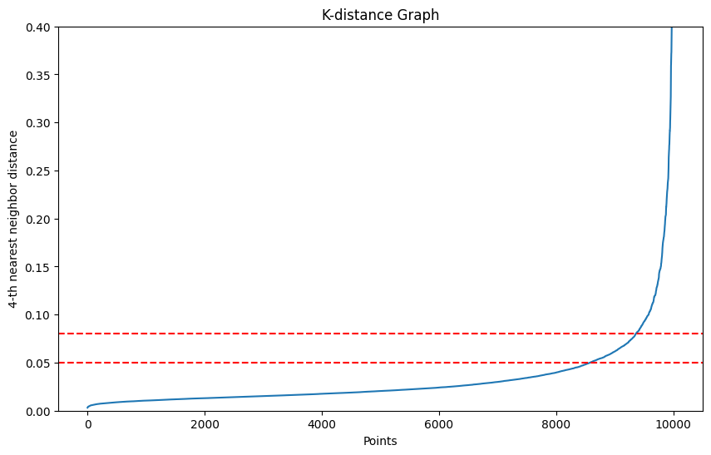
EXTRA: DBSCAN CLUSTERING – CHOOSING EPSILON
K-Nearest Neighbours distance – plots distances of all data points to k-nearest neighbour in ascending order
Optimal epsilon is the “bend” of curve
Epsilon ≈ 0.065

Slide 21
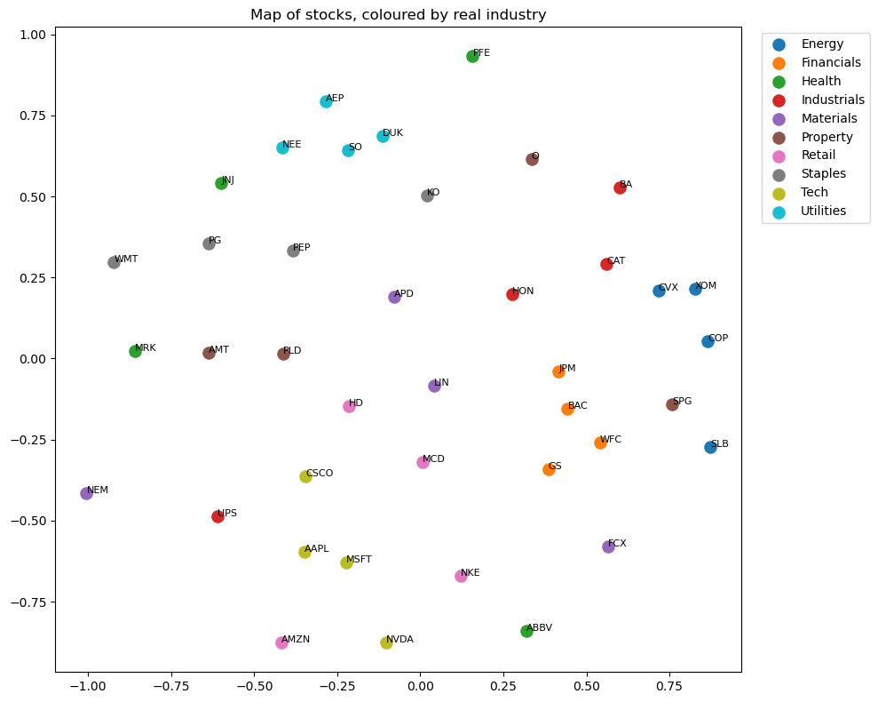
Do stocks in different industries
move together?
Grouping five years of S&P 500 returns with two clustering methods
Cindy Jung
S26 DRP
Mentors: Gaia Noseworthy, Téa Fazio
Notes:
Companies get filed into industries — Energy, Utilities, Tech. My question was simple: do their share prices actually behave that way, or is that just paperwork?
To answer it, I grouped stocks purely by how their prices moved, without telling the computer anything about industries. Then I checked afterwards whether the groups matched the official labels.

Slide 22
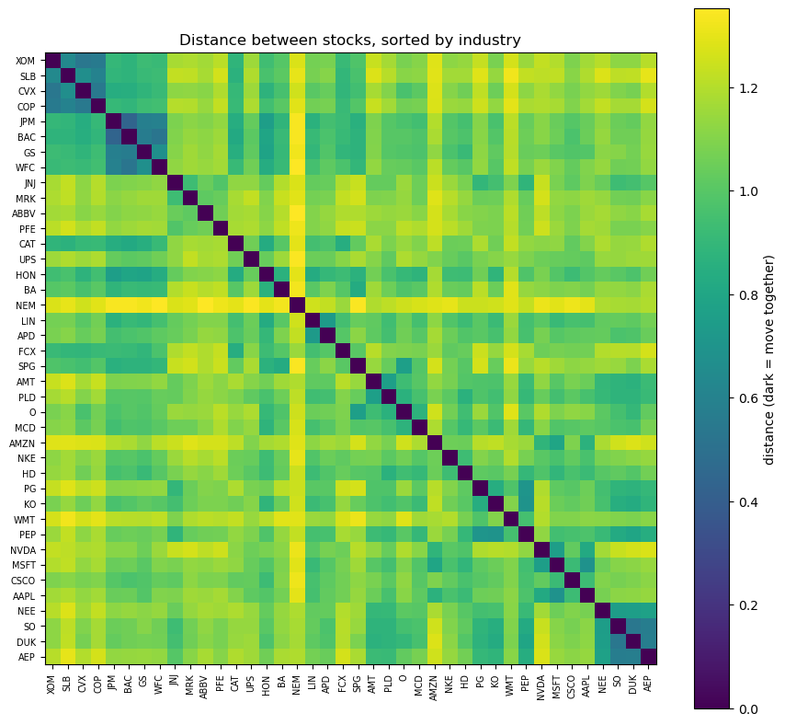

The data, and how I measured distance
The sample: S&P 500 – 40 stocks
Energy
Four per industry keeps it balanced, so no industry dominates.
Window covers calm markets, the COVID crash and the rate rises.
1,250 days for 40 stocks
AMZN, MSFT for Tech, MCD, NKE for Retail
Tech
From "moves together" to a distance
Daily % changes, not prices
For every pair: correlation: do they rise and fall on the same days?
High correlation means close, so I flipped it into a distance:
$$Mantegna Distance= \sqrt{2 × ( 1−correlation)}$$
Utilities
Notes:
I used 40 large US companies, four from each of ten industries, over five years — about 1,250 trading days from Yahoo Finance. Four per industry keeps it balanced so no single industry dominates. Forty in total keeps every chart readable.
I used daily percentage changes, not prices, because a $600 stock and a $30 stock aren't comparable by price level, but 'went up 1% today' is comparable for both.
For every pair I measured correlation — do they rise and fall on the same days? But correlation runs the wrong way for grouping: high correlation means close, while a high distance means far. So I flipped it with the standard finance formula. Perfect lockstep gives zero, unrelated gives about 1.4. This is Mantegna's formula from 1999.
You can already see structure before any clustering. Clear blocks for Energy, Financials and Utilities. Health Care is pale. That bright cross is Newmont, a gold miner, sitting far from everything.

Slide 23
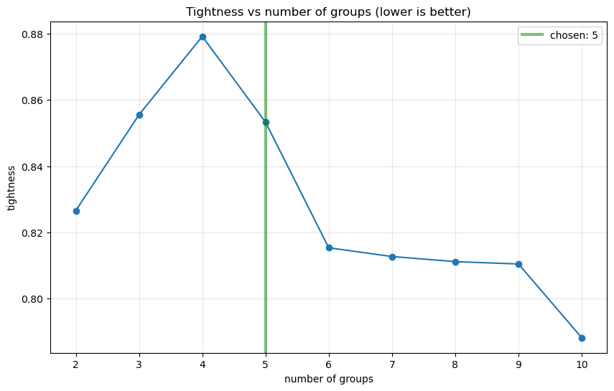
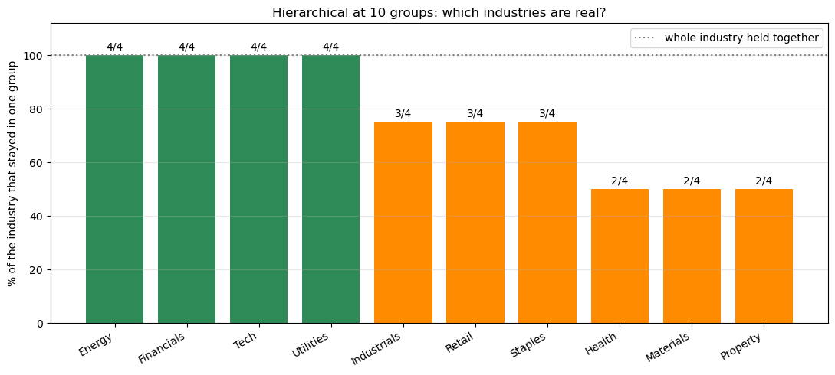
Hierarchical vs. K-Means
Tightness
Average distance inside groups ÷ average distance between groups.
Hierarchical
(Average Linkage)
Repeatedly joins the two closest things until everything is connected. Uses the distance table directly, and produces a tree.
K-Means
Cannot use distances.
Needs the stocks placed as points on a map first, then sorts them into a fixed number of even-sized groups.
Converting distance to coordinates
Multidimensional Scaling (MDS) to turn the distances into a 2-D map.
Hierarchical uses the exact distances;
K-Means uses the MDS approximation.
Notes:
Two methods, chosen because they differ in the way that matters most.
Hierarchical clustering works directly on the distances. It repeatedly joins the two closest things until everything is connected, and it produces a tree.
K-Means cannot use distances. It needs the stocks placed as points on a map first, so I used MDS to build that map. Then K-Means sorts the points into a fixed number of even-sized groups. So the comparison also tests what that extra translation step costs you.
To pick how many groups, I used tightness — the average distance between stocks inside the same group, divided by the average distance between stocks in different groups. Below one means the grouping beat a random split. The curve settles from about five to six groups onward, so I used five.
[If asked why not six: six scores slightly better, 0.815 versus 0.853. The curve is flat from six to nine so anything in that range is defensible; I chose five for interpretability.]

Slide 24
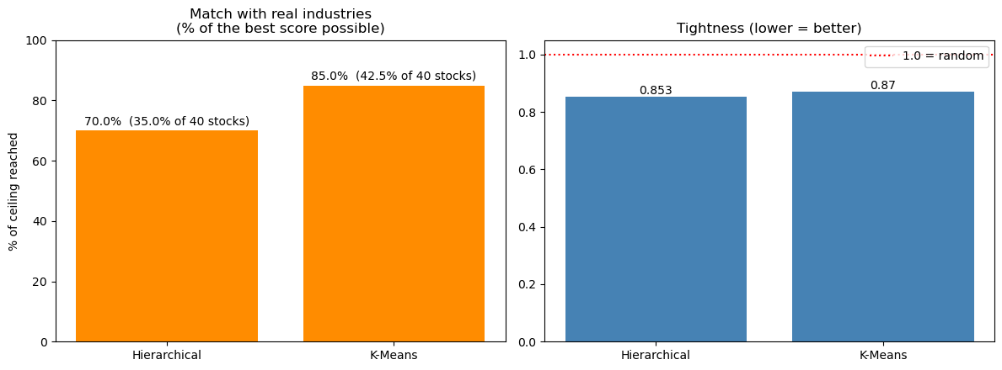
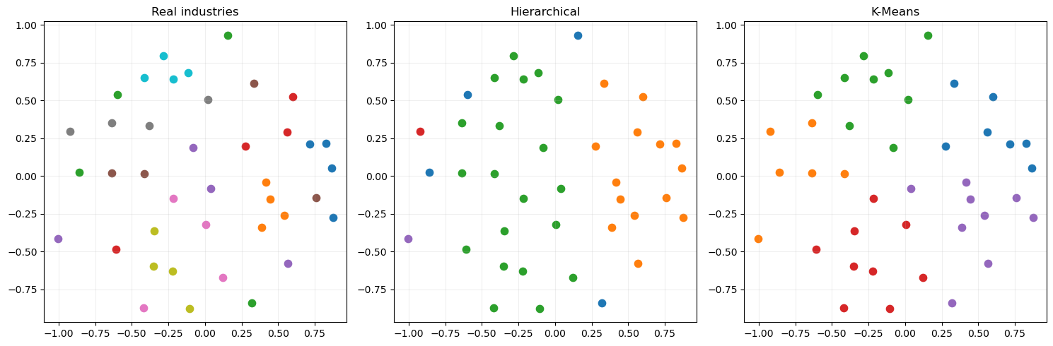
K-Means scored higher
Match rate = % of stocks landing in a group where their own industry is the most common
Why K-Means won
Hierarchical put half of all 40 stocks into one group.
K-Means is built to make similar-sized groups, so it was forced to cut through that blob.
Cutting through it matched reality better.
85%
K-Means
match rate
70%
Hierarchical
match rate
Notes:
K-Means matched the real industries 42.5% of the time. Hierarchical managed 35%.
One important caveat: 42.5% isn't as low as it sounds. I have ten industries but only five groups, and each group only gets credit for one industry. So the maximum possible score is 50%. K-Means reached 42.5 out of a possible 50 — about 85% of what was achievable.
Why did K-Means win? Look at the group sizes. Hierarchical put half of all forty stocks into a single group. K-Means is built to make similar-sized groups, so it was forced to cut through that blob — and cutting through it matched reality better.
That's a finding in itself: when data has no sharp dividing lines, a method that imposes structure can beat one that only follows the data.

Slide 25
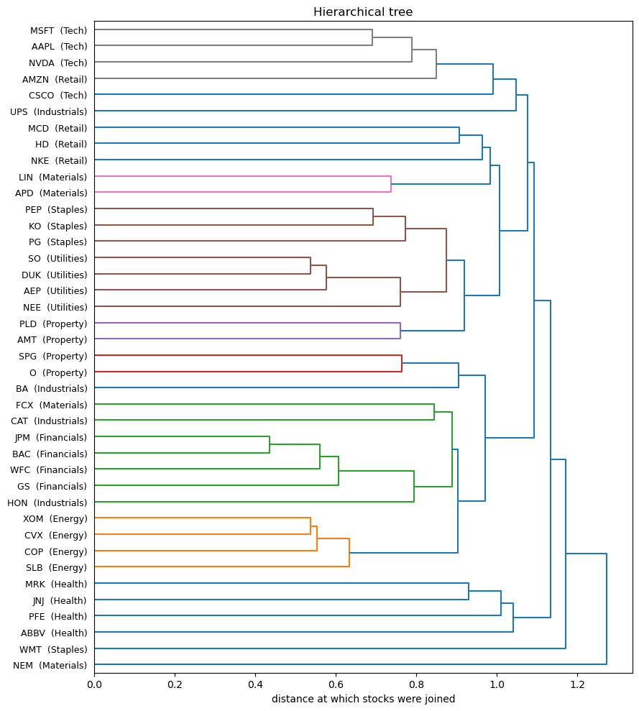
But hierarchical answered the actual question
JPMorgan + Bank of America: the closest pair
Utilities all join by 0.55, Energy by 0.63.
Utilities merged with Staples.
Financials merged with Industrials and Materials.
Utilities & Staples
The clusters found a simpler structure underneath the labels
Utilities group pulled in KO, PEP, JNJ, PFE
Tech group pulled in AMZN, HD, NKE
Industrials group pulled in XOM, CVX
Financials & Industrials, Materials
Takeaway
Energy, Utilities and Financials move as packs while
Health Care, Industrials and Materials don’t.
Structure underneath: growth, cyclical, defensive.
Gold
Notes:
K-Means matched the real industries 42.5% of the time. Hierarchical managed 35%.
One important caveat: 42.5% isn't as low as it sounds. I have ten industries but only five groups, and each group only gets credit for one industry. So the maximum possible score is 50%. K-Means reached 42.5 out of a possible 50 — about 85% of what was achievable.
Why did K-Means win? Look at the group sizes. Hierarchical put half of all forty stocks into a single group. K-Means is built to make similar-sized groups, so it was forced to cut through that blob — and cutting through it matched reality better.
That's a finding in itself: when data has no sharp dividing lines, a method that imposes structure can beat one that only follows the data.

Slide 26
Thank You!
Notes:
Here's where I'll be honest about the two methods. K-Means scored higher — but my goal was to understand how the market moves in the grand scheme, and only the tree can show that. K-Means gives you five labelled buckets and nothing else. The tree shows structure at every level at once.
JPMorgan and Bank of America join at 0.43 — the closest pair in the entire sample. All four utilities join by 0.55, all four energy companies by 0.63.
Then the tree keeps going. Utilities merge with Consumer Staples — a defensive branch. Financials merge with Industrials and Materials — a cyclical branch. Nobody told the algorithm about defensive versus cyclical. It found that on its own.
So: K-Means was the better classifier. Hierarchical was the better explanation. Both earned their place.
The clusters didn't reproduce the ten industries, and looking at how they failed is the best part. The Utilities group pulled in Coca-Cola, Pepsi, Johnson & Johnson and Pfizer. The Tech group pulled in Amazon, Home Depot, McDonald's and Nike. The Industrials group pulled in Exxon and Chevron. Those aren't errors — the algorithm found a simpler structure underneath: growth, cyclical, and defensive. That's how investors actually think, and the clustering found it from price movements alone.
Four honest limitations. Companies that exist today, so failed ones are invisible. Almost everything falls together on bad days, which is why tightness never dropped below 0.85. One five-year window. And K-Means worked on the MDS map, which approximates the real distances, while hierarchical used the exact ones — so that comparison slightly favours hierarchical.
My takeaway: industry labels are only partly real.

Slide 27

ASL Digit Recognition
Progress Report: Comparing image-based and hand-geometry features
Goal: recognize static ASL digit signs from images
Method focus: clustering to evaluate feature quality
Long-term direction: webcam-based sign-to-text prototype
Evelyn DRP summer 2026
Mentor : Gaia Noseworthy, Téa Fazio
1

Slide 28
Method rationale
Why clustering, and where it fits
Clustering is used here as an exploratory test, not as the final product model.
Images — raw hand-sign samples
K-Means groups images by similarity without using digit labels during training.
If the features are meaningful, images of the same digit should naturally appear in the same group.
Labels are used afterward only to interpret and evaluate the clusters.
Feature extraction — ResNet or MediaPipe
K-Means clustering — groups similar features
Final system will use classification; clustering is a feature-quality check.
Cluster analysis — compare groups with labels
2

Slide 29

Data pipeline
Dataset preparation and quality control
Before modelling, images were standardized and manually checked.
Converted images to RGB and resized to 224 × 224 without stretching the hand.
Built an interactive labeling tool for digit labels.
Rejected samples with extra fingers, merged fingers, or incorrect poses.
Rebuilt processed files and labels whenever the dataset changed.
This step reduced label noise before feature extraction.
Example of a problematic / rejected hand image
3

Slide 30
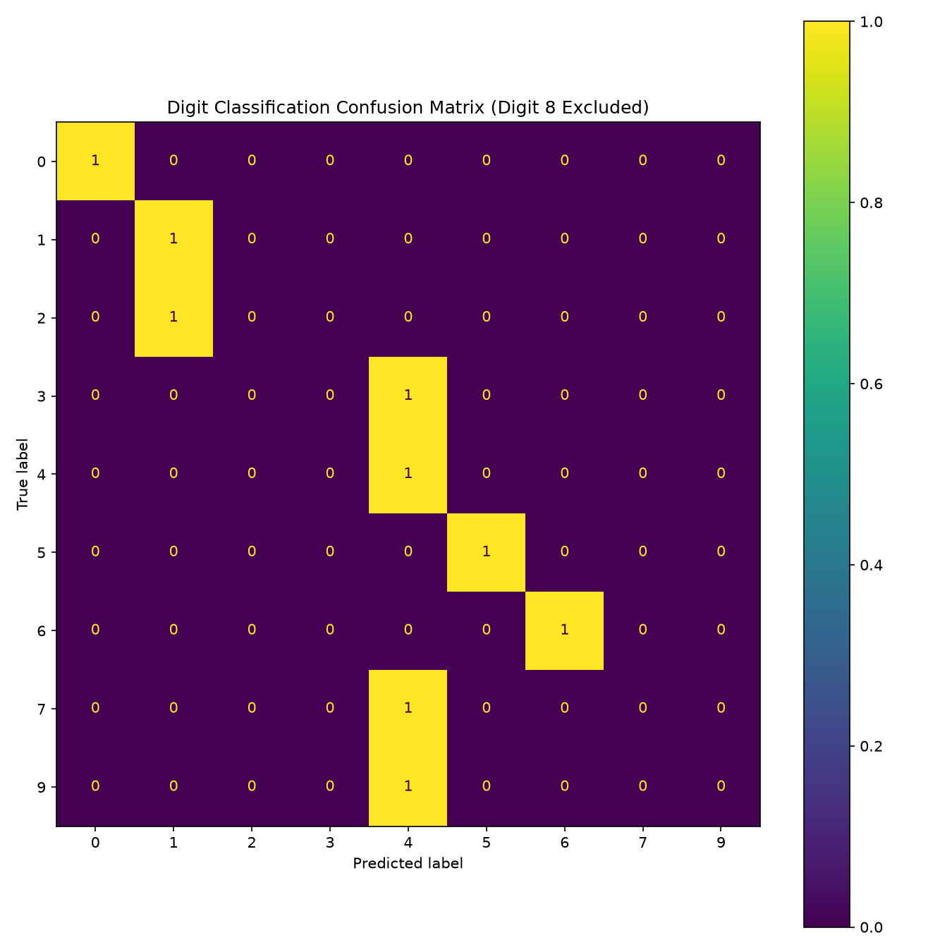
Attempt 1
Baseline: ResNet-18 visual features
Observation
ResNet-18 converted each image into 512 general visual features.
The split used only one test image per included digit, so the accuracy is not stable.
Several signs were mapped to visually similar but incorrect classes.
Result: generic visual features were not focused enough on finger geometry.
Useful as a baseline, but not enough for fine finger differences.
4

Slide 31
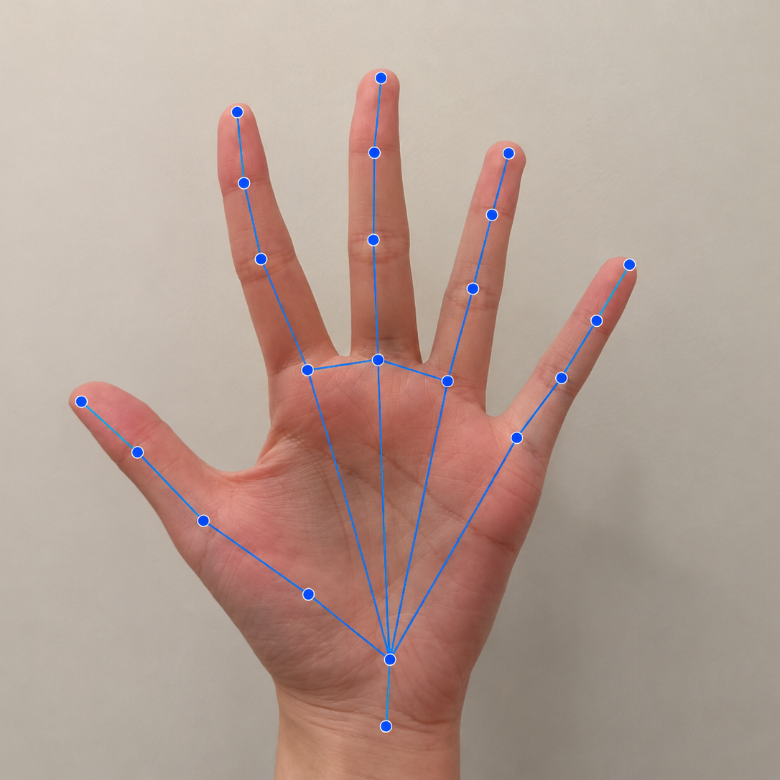
Attempt 2
MediaPipe: hand structure as features
MediaPipe detects 21 key points on the hand.
Coordinates were normalized by wrist position and palm size.
Left-hand coordinates were mirrored into a common orientation.
80 features were created from points, fingertip distances, and finger angles.
These features directly describe hand geometry, not the full image appearance.
80 FEATURE VECTOR
63 landmark coordinates + 4 thumb distances + 5 fingertip-to-wrist distances + 5 finger angles + 3 adjacent fingertip distances
5

Slide 32
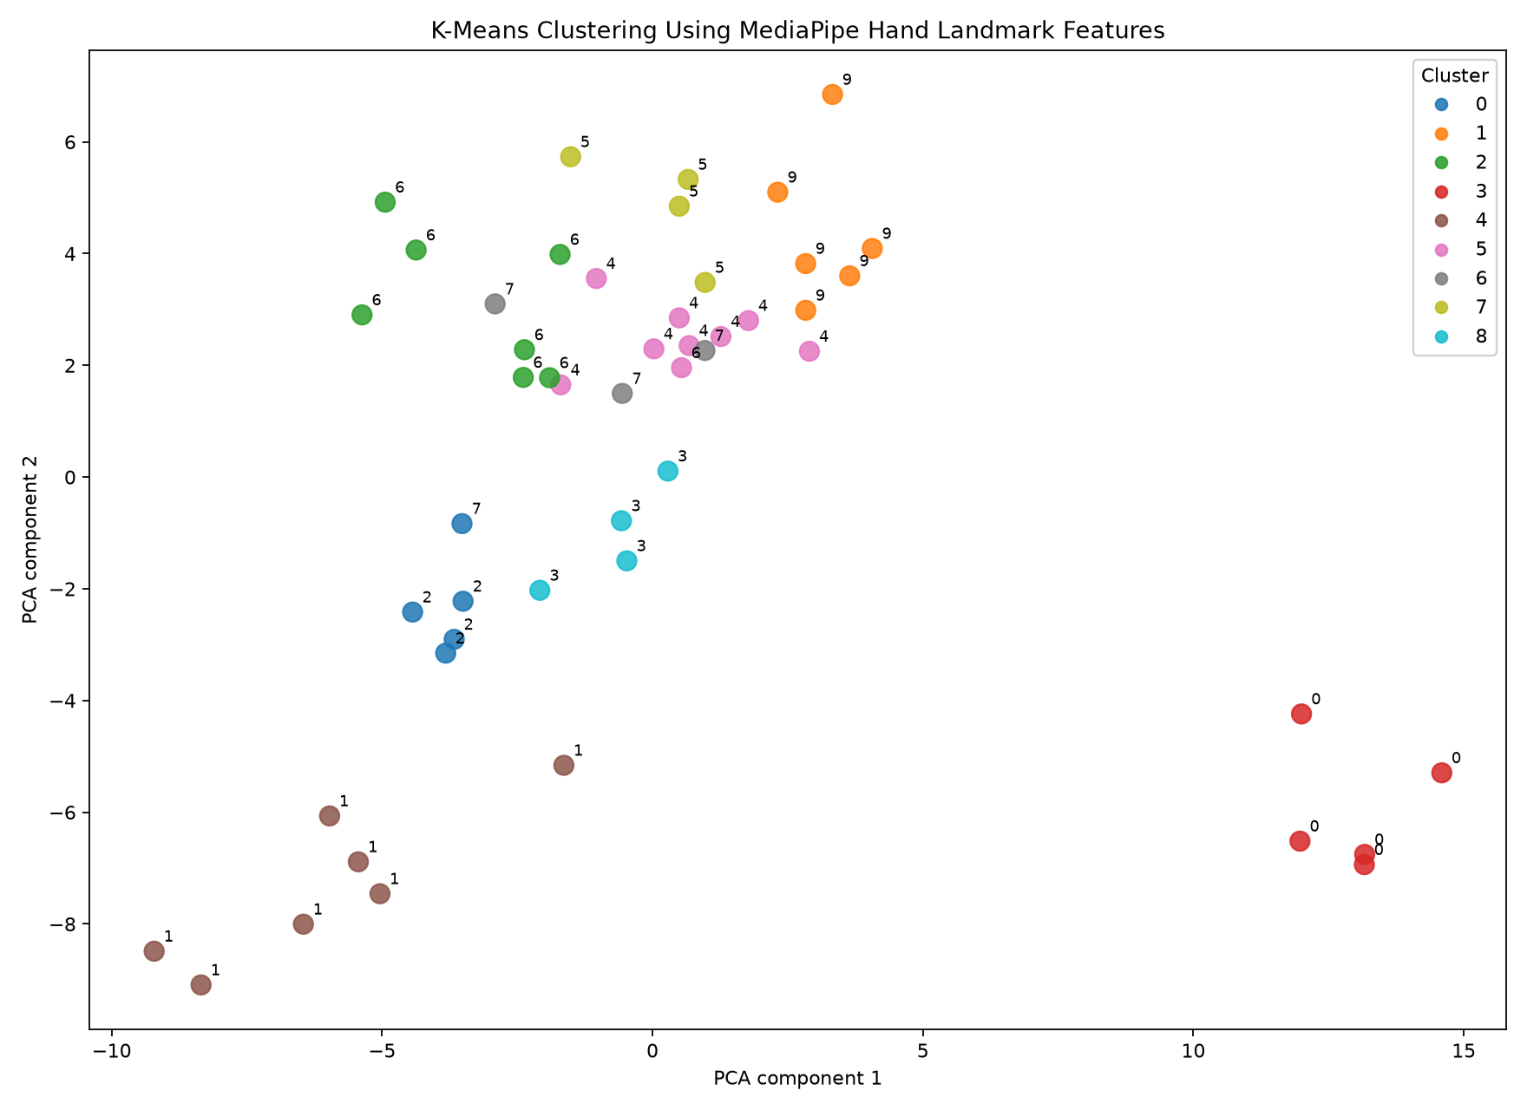
K-Means + PCA visualization
Landmark clustering result
How to read the plot
Each point is one image.
Color = K-Means cluster.
Number beside point = true digit label.
PCA is used to visualize high-dimensional features in 2D.
The groupings became clearer after using hand-landmark features.
Note: cluster_0 does not mean digit 0; cluster IDs are arbitrary.
6

Slide 33

Limitations
Real-image testing and next steps
Findings
The landmark clusters worked well on the cleaned training set.
New phone photos were less stable: one image was not detected and some predictions were uncertain.
Main limitation: synthetic-to-real domain gap.
Next steps
Collect more real images from different users.
Add valid digit-8 samples.
Move from clustering to supervised classification using SVM or MLP.
Add an “unknown” output for uncertain predictions and prepare webcam testing.
Example real phone image
7

Slide 34
GermMM: Clustering Applications for Antimicrobial Resistance Profiling
Grace Evans and Ethan Tran
Mentors: Gaia Noseworthy and Téa Fazio

Slide 35
Research Questions
Resistance Profiling
Can we identify which type of resistance a bacterial strain has?
Anomaly Detection
Can we identify strains with resistance patterns we’ve never seen before?
We will use GMMs to answer these questions!
Notes:
The interests of this project was gain knowledge about antimicrobial resistance in common bacterial strains in Canada. We would like to identify what kinds of resistances do bacteria have against the drugs we commonly use, and try to detect strains of bacteria that may be of concern in order to prevent creating a superbug (which is a strain of bacteria that cannot be killed). We will leverage GMMs to cluster the data into groups based on resistance profiles. GMM gives each strain a probability of belonging to a resistance profile, which acknowledges the model’s confidence for each cluster. It also allows us to perform anomaly detection, as strains with a low probability of belonging to any cluster can be flagged as a novel.

Slide 36
How Antimicrobials Work
Inhibit Cell Wall Synthesis³
Inhibition of Metabolic Pathways⁴
E.g., Penicillins²
Depolarize Cell Membranes⁵
E.g., Sulfonamides²
E.g., Lipopeptides²
Inhibition of Protein Synthesis³
Inhibition of Nucleic Acid Synthesis³
E.g., Tetracyclins²
E.g., Quinolones²

Slide 37
How we Chose the Bacterial Species
High Priority Antimicrobial-Resistant Pathogens in Ontario
Carbapenem-resistant Enterobacterales⁶
Causes⁷:
Intestinal infections.
Urinary tract infections.
Pneumonia.

Slide 38
Data
Minimum Inhibitory Concentration (MIC)
The lowest amount of a drug that stops bacteria from growing (in our case, antibiotics).
MIC is an easy and reliable method for antimicrobial resistance testing. We can use this data to determine patterns in strains!
Notes:
For this project, we will focus on E. coli. We will apply clustering on a metric called MIC, which is the minimum concentration of an antibiotic needed to stop the growth of a certain bacterial strain. Prior literature used MIC for clustering, which motivates using this metric this project. MIC is obtained in a lab, and is generally easier and more reliable than other methods of determining resistance.

Slide 39
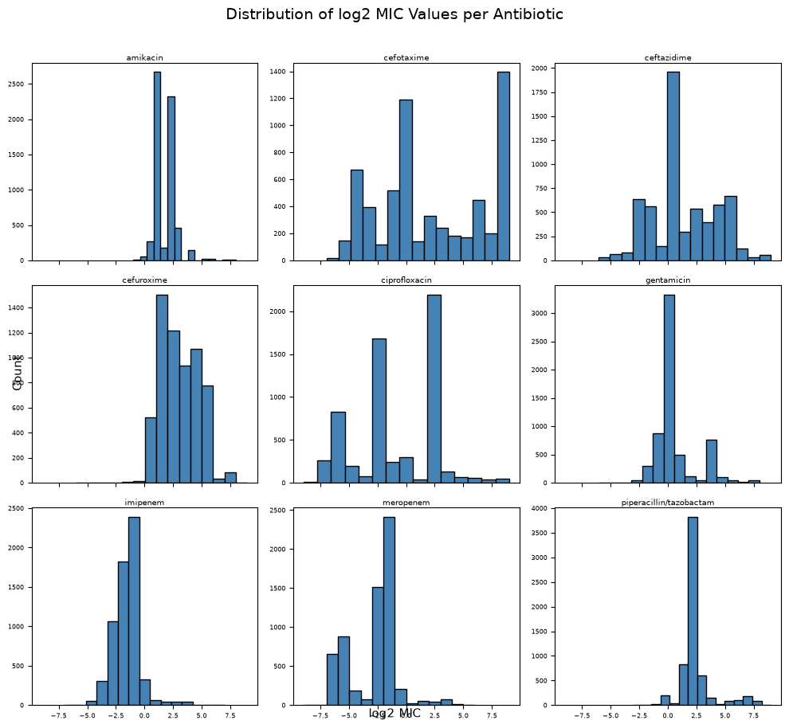
Antibiotics Selected as Features
Dataset size: (6161, 9)
amikacin
cefotaxime
ceftazidime
cefuroxime
ciprofloxacin
gentamicin
imipenem
meropenem
piperacillin-tazobactam
Notes:
We pulled over 7 million observations across different strains of E. coli and antibiotics from a public AMR database. We removed antibiotics from the dataset with more than 50% missing values, leaving us with 9 of the most common types of antibiotics across over 6000 unique strains. We applied kNN (k=5) imputation to fill in gaps in the data since GMMs cannot handle missing values. The distributions of the antibiotics are relatively normal, which further justifies the use of GMM. The drugs used in the model are some of the most important ones to date, being used to treat urinary tract infections, pneumonia, meningitis, sepsis, and hospital-acquired infections. Imipenem and meropenem belong to a family of antibiotics that are used when all other antibiotics fail. It is clear that determining the resistance patterns towards these drugs is extremely important.

Slide 40
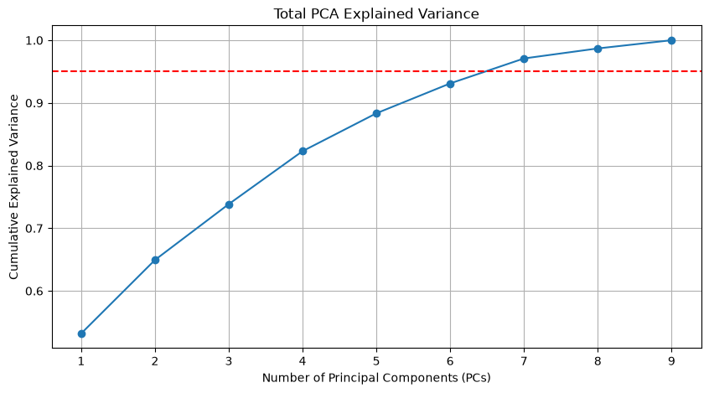
PCA
Notes:
We wish to reduce our dimensions to make computation easier. To do so, we applied PCA to reduce the number of variables we have to make the model simpler. Here, we are left with 7 new variables that explained over 95% of the variance in the data.

Slide 41
PC1
PC2
PC3
PC4
PC5
PC6
PC7
Overall resistance level
Cefuroxime and piperacillin/tazobactam vs aminoglycoside resistance
Fluoroquinolone and aminoglycoside vs carbapenem resistance
Aminoglycoside vs cephalosporin resistance
Piperacillin/tazobactam vs cefuroxime resistance
Amikacin vs gentamicin resistance
Fluoroquinolone vs cephalosporin resistance
Notes:
Each PC corresponded to different interactions between antibiotics. A higher value indicates that a strain is more resistant to antimicrobial A vs B.

Slide 42
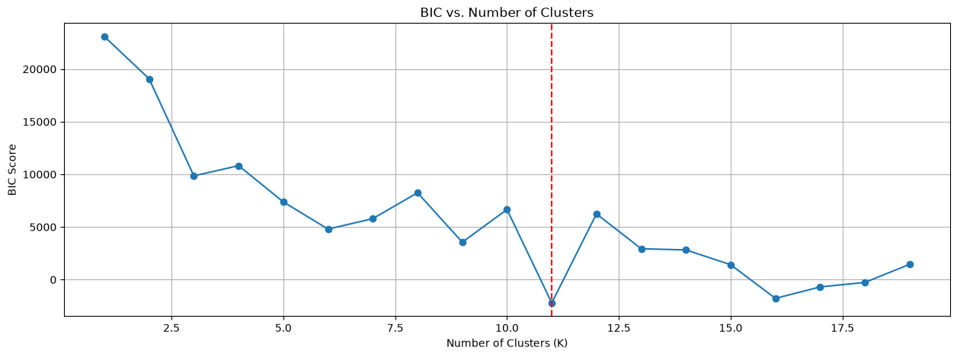
Selecting the Number of Clusters
Notes:
We used BIC to select the number of clusters in our model. We ended up choosing 11 clusters since it is the absolute minimum in the plot.

Slide 43
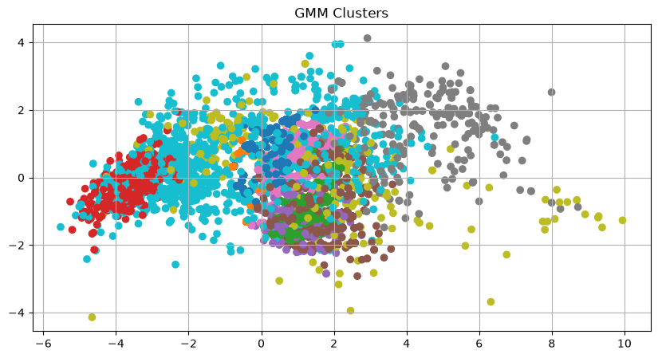
Results
PC2
PC1
Notes:
This is a 2D representation of the clustering result, with each colour being a different cluster plotted on PC1 and PC2. The actual clustering is in 7 dimensions, which makes it hard to plot. We can still see distinct clusters, and if we were to change the axes to different PCs, we would begin to see clearer clusters.

Slide 44
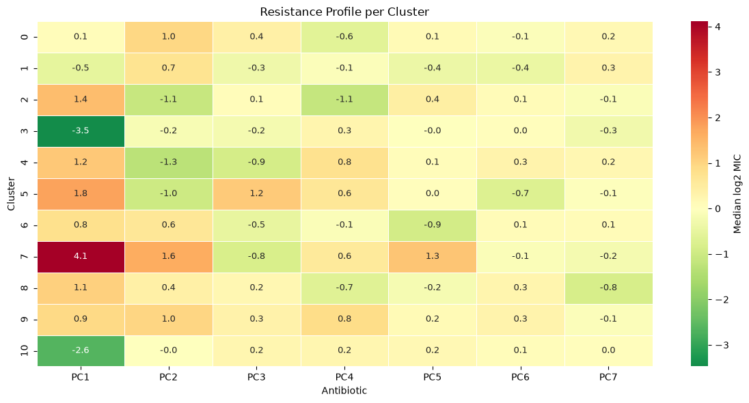
Results
Notes:
We plot the median values of the PCs for each cluster. Each cluster corresponds to a resistance profile. For example, cluster 3 and 10 shows a low general resistance, while cluster 7 shows a higher general resistance, indicating strains belonging to cluster 3 and 10 are easier to treat and strains belonging to cluster 7 should be concerning. Other clusters have varying characteristics between antibiotics, such as cluster 4 and 9 which have opposite resistance relationships in PC2.

Slide 45
Anomaly Detection
The model found these strain IDs to have a low probability of belonging to any cluster.
562.141438
562.142041
562.143115
562.144648
562.2292
562.2347
562.23494
562.52554
562.52593
562.52595
562.52608
562.52611
562.52619
562.52629
562.97811
Notes:
As mentioned before, GMM assigns probabilities to clusters. Our model found these strains to have a low probability of belonging to any cluster, indicating that these strains have a novel resistance profile that we know little about that should be investigated to prevent any harm.

Slide 46
The GermMM project was successful in:
Determining resistance profiles (11 total profiles)
Anomaly detection (15 out of >6000 strains flagged)
Next steps: more data!
Notes:
The GermMM project set out to answer two questions critical to an ongoing medical crisis. Our developed model was successful in assigning strains of E. coli to profiles using MIC data, and managed to find 15 novel strains that may require investigation. A limitation for this model is the amount and type of data available to us. Future development could focus on data: more E. coli strains, more antimicrobials, and more species.

Slide 47
Thank you!

Slide 48
References
1. Kerek, Á., Szabó, Á., and Jerzsele, Á. (2025). Antimicrobial Susceptibility Profiles of Escherichia coli Isolates from Clinical Cases of Geese in Hungary Between 2022 and 2023. Antibiotics (basel), 14(5):450. doi: 10.3390/antibiotics14050450
2. Reygaert, W. C. (2018). An Overview of the antimicrobial resistance mechanisms of bacteria. AIMS Microbiology, 4(3):482-501. doi: 10.3934/microbiol.2018.3.482
3. Kohanski, M. A., Dwyer, D. J., and Collins, J. J. (2010). How antibiotics kill bacteria: from targets to networks. Nature Reviews Microbiology, 8(6): 423-435. doi: 10.1038/nrmicro2333
4. Murima, P., McKinney, J. D., Pethe, K. (2014). Targeting Bacterial Central Metabolism for Drug Development. Chemistry and Biology, 21(11): 1423-1432. doi: 10.1016/j.chembiol.2014.08.020
5. Juhaniewicz-Dębińska, J., Lasek, R., Tymecka, D., Burdach, K., Bartosik, D., Sęk, S. (2020). Physicochemical and Biological Characterization of Novel Membrane-Active Cationic Lipopeptides with Antimicrobial Properties. Langmuir, 36(43): 12900-12910. doi: 10.1021/acs.langmuir.0c02135
6. Government of Canada. (2025). Canada’s priority antimicrobial-resistant pathogens. Canada.ca Retrieved from: https://www.canada.ca/en/public-health/services/antimicrobial-resistance/health-professionals/priority-pathogens.html
7. Mueller, M., Rausch-Phung, E. A., and Tainter, C. R. (2025). Escherichia coli Infection. StatPearls [Internet]. Retrieved from: https://www.ncbi.nlm.nih.gov/books/NBK564298/
Notes:
Kerek, Á., Szabó, Á., and Jerzsele, Á. ()

